Slide 1
Chapter 6,
Arrays and Vectors
C++ How to Program,
Late Objects Version, 7/e

Slide 2
1 // Fig. 6.11: fig06_11.cpp
2 // Poll analysis program.
3 #include <iostream>
4 #include <iomanip>
5 using namespace std;
6
7 int main()
8 {
9 // define array sizes
10 const int responseSize = 40; // size of array responses
11 const int frequencySize = 11; // size of array frequency
12
13 // place survey responses in array responses
14 const int responses[ responseSize ] = { 1, 2, 6, 4, 8, 5,
15 9, 7, 8, 10, 1, 6, 3, 8, 6, 10, 3, 8, 2, 7, 6, 5, 7, 6,
16 8, 6, 7, 5, 6, 6, 5, 6, 7, 5, 6, 4, 8, 6, 8, 10 };
17

Slide 3
18 // initialize frequency counters to 0
19 int frequency[ frequencySize ] = { 0 };
20
21 // for each answer, select responses element and use that value
22 // as frequency subscript to determine element to increment
23 for ( int answer = 0; answer < responseSize; answer++ )
24 frequency[ responses[ answer ] ]++;
25
26 cout << "Rating" << setw( 17 ) << "Frequency" << endl;
27
28 // output each array element’s value
29 for ( int rating = 1; rating < frequencySize; rating++ )
30 cout << setw( 6 ) << rating
31 << setw( 17 ) << frequency[ rating ] << endl;
32 } // end main

Slide 4
Fig. 6.11
0 | 1 | 2 | 3 | 4 | 5 | 6 | 7 | 8 | 9 | 10 | 11 | 12 | 13 | 14
1 | 2 | 6 | 4 | 8 | 5 | 9 | 7 | 8 | 10 | 1 | 6 | 3 | 8 | 6
responses
15 | 16 | 17 | 18 | 19 | 20 | 21 | 22 | 23 | 24 | 25 | 26 | 27 | 28 | 29
10 | 3 | 8 | 2 | 7 | 6 | 5 | 7 | 6 | 8 | 6 | 7 | 5 | 6 | 6
0 | 1 | 2 | 3 | 4 | 5 | 6 | 7 | 8 | 9 | 10
0 | 0 | 0 | 0 | 0 | 0 | 0 | 0 | 0 | 0 | 0
frequency
for( int answer = 0; answer < 30; answer++ )
++frequency[ responses[ answer ] ];

Slide 5
Fig. 6.11
0 | 1 | 2 | 3 | 4 | 5 | 6 | 7 | 8 | 9 | 10 | 11 | 12 | 13 | 14
1 | 2 | 6 | 4 | 8 | 5 | 9 | 7 | 8 | 10 | 1 | 6 | 3 | 8 | 6
responses
15 | 16 | 17 | 18 | 19 | 20 | 21 | 22 | 23 | 24 | 25 | 26 | 27 | 28 | 29
10 | 3 | 8 | 2 | 7 | 6 | 5 | 7 | 6 | 8 | 6 | 7 | 5 | 6 | 6
0 | 1 | 2 | 3 | 4 | 5 | 6 | 7 | 8 | 9 | 10
0 | 1 | 0 | 0 | 0 | 0 | 0 | 0 | 0 | 0 | 0
frequency
for( int answer = 0; answer < 30; answer++ )
++frequency[ responses[ answer ] ];

Slide 6
Fig. 6.11
0 | 1 | 2 | 3 | 4 | 5 | 6 | 7 | 8 | 9 | 10 | 11 | 12 | 13 | 14
1 | 2 | 6 | 4 | 8 | 5 | 9 | 7 | 8 | 10 | 1 | 6 | 3 | 8 | 6
responses
15 | 16 | 17 | 18 | 19 | 20 | 21 | 22 | 23 | 24 | 25 | 26 | 27 | 28 | 29
10 | 3 | 8 | 2 | 7 | 6 | 5 | 7 | 6 | 8 | 6 | 7 | 5 | 6 | 6
0 | 1 | 2 | 3 | 4 | 5 | 6 | 7 | 8 | 9 | 10
0 | 1 | 1 | 0 | 0 | 0 | 0 | 0 | 0 | 0 | 0
frequency
for( int answer = 0; answer < 30; answer++ )
++frequency[ responses[ answer ] ];

Slide 7
Fig. 6.11
0 | 1 | 2 | 3 | 4 | 5 | 6 | 7 | 8 | 9 | 10 | 11 | 12 | 13 | 14
1 | 2 | 6 | 4 | 8 | 5 | 9 | 7 | 8 | 10 | 1 | 6 | 3 | 8 | 6
responses
15 | 16 | 17 | 18 | 19 | 20 | 21 | 22 | 23 | 24 | 25 | 26 | 27 | 28 | 29
10 | 3 | 8 | 2 | 7 | 6 | 5 | 7 | 6 | 8 | 6 | 7 | 5 | 6 | 6
0 | 1 | 2 | 3 | 4 | 5 | 6 | 7 | 8 | 9 | 10
0 | 1 | 1 | 0 | 0 | 0 | 1 | 0 | 0 | 0 | 0
frequency
for( int answer = 0; answer < 30; answer++ )
++frequency[ responses[ answer ] ];

Slide 8
Fig. 6.11
0 | 1 | 2 | 3 | 4 | 5 | 6 | 7 | 8 | 9 | 10 | 11 | 12 | 13 | 14
1 | 2 | 6 | 4 | 8 | 5 | 9 | 7 | 8 | 10 | 1 | 6 | 3 | 8 | 6
responses
15 | 16 | 17 | 18 | 19 | 20 | 21 | 22 | 23 | 24 | 25 | 26 | 27 | 28 | 29
10 | 3 | 8 | 2 | 7 | 6 | 5 | 7 | 6 | 8 | 6 | 7 | 5 | 6 | 6
0 | 1 | 2 | 3 | 4 | 5 | 6 | 7 | 8 | 9 | 10
0 | 1 | 1 | 0 | 1 | 0 | 1 | 0 | 0 | 0 | 0
frequency
for( int answer = 0; answer < 30; answer++ )
++frequency[ responses[ answer ] ];

Slide 9
Fig. 6.11
0 | 1 | 2 | 3 | 4 | 5 | 6 | 7 | 8 | 9 | 10 | 11 | 12 | 13 | 14
1 | 2 | 6 | 4 | 8 | 5 | 9 | 7 | 8 | 10 | 1 | 6 | 3 | 8 | 6
responses
15 | 16 | 17 | 18 | 19 | 20 | 21 | 22 | 23 | 24 | 25 | 26 | 27 | 28 | 29
10 | 3 | 8 | 2 | 7 | 6 | 5 | 7 | 6 | 8 | 6 | 7 | 5 | 6 | 6
0 | 1 | 2 | 3 | 4 | 5 | 6 | 7 | 8 | 9 | 10
0 | 1 | 1 | 0 | 1 | 0 | 1 | 0 | 1 | 0 | 0
frequency
for( int answer = 0; answer < 30; answer++ )
++frequency[ responses[ answer ] ];

Slide 10
Fig. 6.11
0 | 1 | 2 | 3 | 4 | 5 | 6 | 7 | 8 | 9 | 10 | 11 | 12 | 13 | 14
1 | 2 | 6 | 4 | 8 | 5 | 9 | 7 | 8 | 10 | 1 | 6 | 3 | 8 | 6
responses
15 | 16 | 17 | 18 | 19 | 20 | 21 | 22 | 23 | 24 | 25 | 26 | 27 | 28 | 29
10 | 3 | 8 | 2 | 7 | 6 | 5 | 7 | 6 | 8 | 6 | 7 | 5 | 6 | 6
0 | 1 | 2 | 3 | 4 | 5 | 6 | 7 | 8 | 9 | 10
0 | 1 | 1 | 0 | 1 | 1 | 1 | 0 | 1 | 0 | 0
frequency
for( int answer = 0; answer < 30; answer++ )
++frequency[ responses[ answer ] ];

Slide 11
Fig. 6.11
0 | 1 | 2 | 3 | 4 | 5 | 6 | 7 | 8 | 9 | 10 | 11 | 12 | 13 | 14
1 | 2 | 6 | 4 | 8 | 5 | 9 | 7 | 8 | 10 | 1 | 6 | 3 | 8 | 6
responses
15 | 16 | 17 | 18 | 19 | 20 | 21 | 22 | 23 | 24 | 25 | 26 | 27 | 28 | 29
10 | 3 | 8 | 2 | 7 | 6 | 5 | 7 | 6 | 8 | 6 | 7 | 5 | 6 | 6
0 | 1 | 2 | 3 | 4 | 5 | 6 | 7 | 8 | 9 | 10
0 | 1 | 1 | 0 | 1 | 1 | 1 | 0 | 1 | 1 | 0
frequency
for( int answer = 0; answer < 30; answer++ )
++frequency[ responses[ answer ] ];

Slide 12
Fig. 6.11
0 | 1 | 2 | 3 | 4 | 5 | 6 | 7 | 8 | 9 | 10 | 11 | 12 | 13 | 14
1 | 2 | 6 | 4 | 8 | 5 | 9 | 7 | 8 | 10 | 1 | 6 | 3 | 8 | 6
responses
15 | 16 | 17 | 18 | 19 | 20 | 21 | 22 | 23 | 24 | 25 | 26 | 27 | 28 | 29
10 | 3 | 8 | 2 | 7 | 6 | 5 | 7 | 6 | 8 | 6 | 7 | 5 | 6 | 6
0 | 1 | 2 | 3 | 4 | 5 | 6 | 7 | 8 | 9 | 10
0 | 1 | 1 | 0 | 1 | 1 | 1 | 1 | 1 | 1 | 0
frequency
for( int answer = 0; answer < 30; answer++ )
++frequency[ responses[ answer ] ];

Slide 13
Fig. 6.11
0 | 1 | 2 | 3 | 4 | 5 | 6 | 7 | 8 | 9 | 10 | 11 | 12 | 13 | 14
1 | 2 | 6 | 4 | 8 | 5 | 9 | 7 | 8 | 10 | 1 | 6 | 3 | 8 | 6
responses
15 | 16 | 17 | 18 | 19 | 20 | 21 | 22 | 23 | 24 | 25 | 26 | 27 | 28 | 29
10 | 3 | 8 | 2 | 7 | 6 | 5 | 7 | 6 | 8 | 6 | 7 | 5 | 6 | 6
0 | 1 | 2 | 3 | 4 | 5 | 6 | 7 | 8 | 9 | 10
0 | 1 | 1 | 0 | 1 | 1 | 1 | 1 | 2 | 1 | 0
frequency
for( int answer = 0; answer < 30; answer++ )
++frequency[ responses[ answer ] ];

Slide 14
Fig. 6.11
0 | 1 | 2 | 3 | 4 | 5 | 6 | 7 | 8 | 9 | 10 | 11 | 12 | 13 | 14
1 | 2 | 6 | 4 | 8 | 5 | 9 | 7 | 8 | 10 | 1 | 6 | 3 | 8 | 6
responses
15 | 16 | 17 | 18 | 19 | 20 | 21 | 22 | 23 | 24 | 25 | 26 | 27 | 28 | 29
10 | 3 | 8 | 2 | 7 | 6 | 5 | 7 | 6 | 8 | 6 | 7 | 5 | 6 | 6
0 | 1 | 2 | 3 | 4 | 5 | 6 | 7 | 8 | 9 | 10
0 | 1 | 1 | 0 | 1 | 1 | 1 | 1 | 2 | 1 | 1
frequency
for( int answer = 0; answer < 30; answer++ )
++frequency[ responses[ answer ] ];

Slide 15
Fig. 6.11
0 | 1 | 2 | 3 | 4 | 5 | 6 | 7 | 8 | 9 | 10 | 11 | 12 | 13 | 14
1 | 2 | 6 | 4 | 8 | 5 | 9 | 7 | 8 | 10 | 1 | 6 | 3 | 8 | 6
responses
15 | 16 | 17 | 18 | 19 | 20 | 21 | 22 | 23 | 24 | 25 | 26 | 27 | 28 | 29
10 | 3 | 8 | 2 | 7 | 6 | 5 | 7 | 6 | 8 | 6 | 7 | 5 | 6 | 6
0 | 1 | 2 | 3 | 4 | 5 | 6 | 7 | 8 | 9 | 10
0 | 2 | 1 | 0 | 1 | 1 | 1 | 1 | 2 | 1 | 1
frequency
for( int answer = 0; answer < 30; answer++ )
++frequency[ responses[ answer ] ];

Slide 16
Rating Frequency
1 2
2 2
3 2
4 2
5 5
6 11
7 5
8 7
9 1
10 3

Slide 17
// Fig. 6.11: fig06_11.cpp
// Poll analysis program.
#include <iostream>
using std::cout;
using std::endl;
#include <iomanip>
using std::setw;
int main()
{
const int responseSize = 40;
const int frequencySize = 11;
const int responses[ responseSize ] = { 1, 2, 6, 4, 8, 5, 9,
7, 8, 10, 1, 6, 3, 8, 6, 10, 3, 8, 2, 7, 6, 5, 7, 6,
8, 6, 7, 5, 6, 6, 5, 6, 7, 5, 6, 4, 8, 6, 8, 10 };
int frequency[ frequencySize ] = { 0 };

Slide 18
for ( int answer = 0; answer < responseSize; answer++ )
switch ( responses[ answer ] )
{
case 1:
++frequency[ 1 ]; break;
case 2:
++frequency[ 2 ]; break;
case 3:
++frequency[ 3 ]; break;
case 4:
++frequency[ 4 ]; break;
case 5:
++frequency[ 5 ]; break;
case 6:
++frequency[ 6 ]; break;
case 7:
++frequency[ 7 ]; break;
case 8:
++frequency[ 8 ]; break;
case 9:
++frequency[ 9 ]; break;
case 10:
++frequency[ 10 ]; break;
default:
cout << "program should never get here!";
}

Slide 19
for ( int answer = 0; answer < responseSize; answer++ )
switch ( responses[answer] )
{
case 1:
++frequency[ responses[ answer ] ]; break;
case 2:
++frequency[ responses[ answer ] ]; break;
case 3:
++frequency[ responses[ answer ] ]; break;
case 4:
++frequency[ responses[ answer ] ]; break;
case 5:
++frequency[ responses[ answer ] ]; break;
case 6:
++frequency[ responses[ answer ] ]; break;
case 7:
++frequency[ responses[ answer ] ]; break;
case 8:
++frequency[ responses[ answer ] ]; break;
case 9:
++frequency[ responses[ answer ] ]; break;
case 10:
++frequency[ responses[ answer ] ]; break;
default:
cout << "program should never get here!";
}

Slide 20
for ( int answer = 0; answer < responseSize; answer++ )
++frequency[ responses[ answer ] ];

Slide 21
cout << "Rating" << setw( 17 ) << "Frequency" << endl;
for ( int rating = 1; rating < frequencySize; rating++ )
cout << setw( 6 ) << rating
<< setw( 17 ) << frequency[ rating ] << endl;
} // end main

Slide 22
1 // Fig. 5.11: fig05_11.cpp
2 // A scoping example.
3 #include <iostream>
4 using namespace std;
5
6 void useLocal( void ); // function prototype
7 void useStaticLocal( void ); // function prototype
8 void useGlobal( void ); // function prototype
9
10 int x = 1; // global variable
11

Slide 23
12 int main()
13 {
14 cout << “global x in main is " << x << endl;
15
16 int x = 5; // local variable to main
17
18 cout << "local x in main's outer scope is " << x << endl;
19
20 { // start new scope
21 int x = 7;
22
23 cout << "local x in main's inner scope is " << x << endl;
24 } // end new scope
25
26 cout << "local x in main's outer scope is " << x << endl;
27
28 useLocal(); // useLocal has local x
29 useStaticLocal(); // useStaticLocal has static local x
30 useGlobal(); // useGlobal uses global x
31 useLocal(); // useLocal reinitializes its local x
32 useStaticLocal(); // static local x retains its prior value
33 useGlobal(); // global x also retains its value
34
35 cout << "\nlocal x in main is " << x << endl;
36 } // end main

Slide 24
37
38 // useLocal reinitializes local variable x during each call
39 void useLocal( void )
40 {
41 int x = 25; // initialized each time useLocal is called
42
43 cout << endl << "local x is " << x
43 << " on entering useLocal" << endl;
44 ++x;
45 cout << "local x is " << x
45 << " on exiting useLocal" << endl;
46 } // end function useLocal
47

Slide 25
48 // useStaticLocal initializes static local variable x only
49 // the first time the function is called; value of x is
50 // saved between calls to this function
51 void useStaticLocal( void )
52 {
53 static int x = 50;
54
55 cout << endl << "local static x is " << x
56 << " on entering useStaticLocal" << endl;
57 ++x;
58 cout << "local static x is " << x
59 << " on exiting useStaticLocal" << endl;
60 } // end function useStaticLocal
61

Slide 26
62 // useGlobal modifies global variable x during each call
63 void useGlobal( void )
64 {
65 cout << endl << "global x is " << x
65 << " on entering useGlobal" << endl;
66 x *= 10;
67 cout << "global x is " << x
67 << " on exiting useGlobal" << endl;
68 } // end function useGlobal
local x in main's outer scope is 5
local x in main's inner scope is 7
local x in main's outer scope is 5
local x is 25 on entering useLocal
local x is 26 on exiting useLocal
local static x is 50 on entering useStaticLocal
local static x is 51 on exiting useStaticLocal
global x is 1 on entering useGlobal
global x is 10 on exiting useGlobal

Slide 27
local x is 25 on entering useLocal
local x is 26 on exiting useLocal
local static x is 51 on entering useStaticLocal
local static x is 52 on exiting useStaticLocal
global x is 10 on entering useGlobal
global x is 100 on exiting useGlobal
local x in main is 5

Slide 28
10 int x = 1;
12 int main()
13 {
16 int x = 5;
18 cout << "local x in main's outer scope is " << x << endl;
20 {
21 int x = 7;
23 cout << "local x in main's inner scope is " << x << endl;
24 }
26 cout << "local x in main's outer scope is " << x << endl;
28 useLocal();
31 useLocal();
35 cout << "\nlocal x in main is " << x << endl;
36 }
39 void useLocal( void )
40 {
41 int x = 25;
43 cout << endl << "local x is " << x
43 << " on entering useLocal" << endl;
44 ++x;
45 cout << "local x is " << x
45 << " on exiting useLocal" << endl;
46 }

Slide 29
global x
x | 1
int x = 1;
int main()
{
int x = 5;
cout << x << endl;
{
int x = 7;
cout << x << endl;
}
cout << x << endl;
useLocal();
useLocal();
cout << x << endl;
}
void useLocal( void )
{
int x = 25;
cout << x << endl;
++x;
cout << x << endl;
}
5

Slide 30
local x in main's outer scope
global x
x | 1
x | 5
int x = 1;
int main()
{
int x = 5;
cout << x << endl;
{
int x = 7;
cout << x << endl;
}
cout << x << endl;
useLocal();
useLocal();
cout << x << endl;
}
void useLocal( void )
{
int x = 25;
cout << x << endl;
++x;
cout << x << endl;
}
5

Slide 31
local x in main's outer scope
global x
x | 1
x | 5
x | 7
local x in main's inner scope
int x = 1;
int main()
{
int x = 5;
cout << x << endl;
{
int x = 7;
cout << x << endl;
}
cout << x << endl;
useLocal();
useLocal();
cout << x << endl;
}
void useLocal( void )
{
int x = 25;
cout << x << endl;
++x;
cout << x << endl;
}
5

Slide 32
local x in main's outer scope
global x
x | 1
x | 5
x | 7
local x in main's inner scope
int x = 1;
int main()
{
int x = 5;
cout << x << endl;
{
int x = 7;
cout << x << endl;
}
cout << x << endl;
useLocal();
useLocal();
cout << x << endl;
}
void useLocal( void )
{
int x = 25;
cout << x << endl;
++x;
cout << x << endl;
}
5 7

Slide 33
local x in main's outer scope
global x
x | 1
x | 5
int x = 1;
int main()
{
int x = 5;
cout << x << endl;
{
int x = 7;
cout << x << endl;
}
cout << x << endl;
useLocal();
useLocal();
cout << x << endl;
}
void useLocal( void )
{
int x = 25;
cout << x << endl;
++x;
cout << x << endl;
}
5 7

Slide 34
local x in main's outer scope
global x
x | 1
x | 5
int x = 1;
int main()
{
int x = 5;
cout << x << endl;
{
int x = 7;
cout << x << endl;
}
cout << x << endl;
useLocal();
useLocal();
cout << x << endl;
}
void useLocal( void )
{
int x = 25;
cout << x << endl;
++x;
cout << x << endl;
}
5 7 5

Slide 35
local x in main's outer scope
local x in useLocal
global x
x | 1
x | 5
x | 25
int x = 1;
int main()
{
int x = 5;
cout << x << endl;
{
int x = 7;
cout << x << endl;
}
cout << x << endl;
useLocal();
useLocal();
cout << x << endl;
}
void useLocal( void )
{
int x = 25;
cout << x << endl;
++x;
cout << x << endl;
}
5 7 5

Slide 36
local x in main's outer scope
local x in useLocal
global x
x | 1
x | 5
x | 25
int x = 1;
int main()
{
int x = 5;
cout << x << endl;
{
int x = 7;
cout << x << endl;
}
cout << x << endl;
useLocal();
useLocal();
cout << x << endl;
}
void useLocal( void )
{
int x = 25;
cout << x << endl;
++x;
cout << x << endl;
}
5 7 5 25

Slide 37
local x in main's outer scope
local x in useLocal
global x
x | 1
x | 5
x | 26
int x = 1;
int main()
{
int x = 5;
cout << x << endl;
{
int x = 7;
cout << x << endl;
}
cout << x << endl;
useLocal();
useLocal();
cout << x << endl;
}
void useLocal( void )
{
int x = 25;
cout << x << endl;
++x;
cout << x << endl;
}
5 7 5 25

Slide 38
local x in main's outer scope
local x in useLocal
global x
x | 1
x | 5
x | 26
int x = 1;
int main()
{
int x = 5;
cout << x << endl;
{
int x = 7;
cout << x << endl;
}
cout << x << endl;
useLocal();
useLocal();
cout << x << endl;
}
void useLocal( void )
{
int x = 25;
cout << x << endl;
++x;
cout << x << endl;
}
5 7 5 25 26

Slide 39
local x in main's outer scope
global x
x | 1
x | 5
int x = 1;
int main()
{
int x = 5;
cout << x << endl;
{
int x = 7;
cout << x << endl;
}
cout << x << endl;
useLocal();
useLocal();
cout << x << endl;
}
void useLocal( void )
{
int x = 25;
cout << x << endl;
++x;
cout << x << endl;
}
5 7 5 25 26

Slide 40
local x in main's outer scope
local x in useLocal
global x
x | 1
x | 5
x | 25
int x = 1;
int main()
{
int x = 5;
cout << x << endl;
{
int x = 7;
cout << x << endl;
}
cout << x << endl;
useLocal();
useLocal();
cout << x << endl;
}
void useLocal( void )
{
int x = 25;
cout << x << endl;
++x;
cout << x << endl;
}
5 7 5 25 26

Slide 41
local x in main's outer scope
local x in useLocal
global x
x | 1
x | 5
x | 25
int x = 1;
int main()
{
int x = 5;
cout << x << endl;
{
int x = 7;
cout << x << endl;
}
cout << x << endl;
useLocal();
useLocal();
cout << x << endl;
}
void useLocal( void )
{
int x = 25;
cout << x << endl;
++x;
cout << x << endl;
}
5 7 5 25 26 25

Slide 42
local x in main's outer scope
local x in useLocal
global x
x | 1
x | 5
x | 26
int x = 1;
int main()
{
int x = 5;
cout << x << endl;
{
int x = 7;
cout << x << endl;
}
cout << x << endl;
useLocal();
useLocal();
cout << x << endl;
}
void useLocal( void )
{
int x = 25;
cout << x << endl;
++x;
cout << x << endl;
}
5 7 5 25 26 25

Slide 43
local x in main's outer scope
local x in useLocal
global x
x | 1
x | 5
x | 26
int x = 1;
int main()
{
int x = 5;
cout << x << endl;
{
int x = 7;
cout << x << endl;
}
cout << x << endl;
useLocal();
useLocal();
cout << x << endl;
}
void useLocal( void )
{
int x = 25;
cout << x << endl;
++x;
cout << x << endl;
}
5 7 5 25 26 25 26

Slide 44
local x in main's outer scope
global x
x | 1
x | 5
int x = 1;
int main()
{
int x = 5;
cout << x << endl;
{
int x = 7;
cout << x << endl;
}
cout << x << endl;
useLocal();
useLocal();
cout << x << endl;
}
void useLocal( void )
{
int x = 25;
cout << x << endl;
++x;
cout << x << endl;
}
5 7 5 25 26 25 26

Slide 45
local x in main's outer scope
global x
x | 1
x | 5
int x = 1;
int main()
{
int x = 5;
cout << x << endl;
{
int x = 7;
cout << x << endl;
}
cout << x << endl;
useLocal();
useLocal();
cout << x << endl;
}
void useLocal( void )
{
int x = 25;
cout << x << endl;
++x;
cout << x << endl;
}
5 7 5 25 26 25 26 5

Slide 46
10 int x = 1;
12 int main()
13 {
16 int x = 5;
18 cout << "local x in main's outer scope is " << x << endl;
20 {
21 int x = 7;
23 cout << "local x in main's inner scope is " << x << endl;
24 }
26 cout << "local x in main's outer scope is " << x << endl;
29 useStaticLocal();
32 useStaticLocal();
35 cout << "\nlocal x in main is " << x << endl;
36 }
51 void useStaticLocal( void )
52 {
53 static int x = 50;
55 cout << endl << "local static x is " << x
56 << " on entering useStaticLocal" << endl;
57 ++x;
58 cout << "local static x is " << x
59 << " on exiting useStaticLocal" << endl;
60 }

Slide 47
static local x in useStaticLocal
global x
x | 1
x
int x = 1;
int main()
{
int x = 5;
cout << x << endl;
{
int x = 7;
cout << x << endl;
}
cout << x << endl;
useStaticLocal();
useStaticLocal();
cout << x << endl;
}
void useStaticLocal()
{
static int x = 50;
cout << x << endl;
++x;
cout << x << endl;
}
5

Slide 48
local x in main's outer scope
static local x in useStaticLocal
global x
x | 1
x | 5
x
int x = 1;
int main()
{
int x = 5;
cout << x << endl;
{
int x = 7;
cout << x << endl;
}
cout << x << endl;
useStaticLocal();
useStaticLocal();
cout << x << endl;
}
void useStaticLocal()
{
static int x = 50;
cout << x << endl;
++x;
cout << x << endl;
}
5

Slide 49
local x in main's outer scope
static local x in useStaticLocal
global x
x | 1
x | 5
x
x | 7
local x in main's inner scope
int x = 1;
int main()
{
int x = 5;
cout << x << endl;
{
int x = 7;
cout << x << endl;
}
cout << x << endl;
useStaticLocal();
useStaticLocal();
cout << x << endl;
}
void useStaticLocal()
{
static int x = 50;
cout << x << endl;
++x;
cout << x << endl;
}
5

Slide 50
local x in main's outer scope
static local x in useStaticLocal
global x
x | 1
x | 5
x
x | 7
local x in main's inner scope
int x = 1;
int main()
{
int x = 5;
cout << x << endl;
{
int x = 7;
cout << x << endl;
}
cout << x << endl;
useStaticLocal();
useStaticLocal();
cout << x << endl;
}
void useStaticLocal()
{
static int x = 50;
cout << x << endl;
++x;
cout << x << endl;
}
5 7

Slide 51
local x in main's outer scope
static local x in useStaticLocal
global x
x | 1
x | 5
x
int x = 1;
int main()
{
int x = 5;
cout << x << endl;
{
int x = 7;
cout << x << endl;
}
cout << x << endl;
useStaticLocal();
useStaticLocal();
cout << x << endl;
}
void useStaticLocal()
{
static int x = 50;
cout << x << endl;
++x;
cout << x << endl;
}
5 7

Slide 52
local x in main's outer scope
static local x in useStaticLocal
global x
x | 1
x | 5
x
int x = 1;
int main()
{
int x = 5;
cout << x << endl;
{
int x = 7;
cout << x << endl;
}
cout << x << endl;
useStaticLocal();
useStaticLocal();
cout << x << endl;
}
void useStaticLocal()
{
static int x = 50;
cout << x << endl;
++x;
cout << x << endl;
}
5 7 5

Slide 53
local x in main's outer scope
static local x in useStaticLocal
global x
x | 1
x | 5
x | 50
int x = 1;
int main()
{
int x = 5;
cout << x << endl;
{
int x = 7;
cout << x << endl;
}
cout << x << endl;
useStaticLocal();
useStaticLocal();
cout << x << endl;
}
void useStaticLocal()
{
static int x = 50;
cout << x << endl;
++x;
cout << x << endl;
}
5 7 5

Slide 54
local x in main's outer scope
static local x in useStaticLocal
global x
x | 1
x | 5
x | 50
int x = 1;
int main()
{
int x = 5;
cout << x << endl;
{
int x = 7;
cout << x << endl;
}
cout << x << endl;
useStaticLocal();
useStaticLocal();
cout << x << endl;
}
void useStaticLocal()
{
static int x = 50;
cout << x << endl;
++x;
cout << x << endl;
}
5 7 5 50

Slide 55
local x in main's outer scope
static local x in useStaticLocal
global x
x | 1
x | 5
x | 51
int x = 1;
int main()
{
int x = 5;
cout << x << endl;
{
int x = 7;
cout << x << endl;
}
cout << x << endl;
useStaticLocal();
useStaticLocal();
cout << x << endl;
}
void useStaticLocal()
{
static int x = 50;
cout << x << endl;
++x;
cout << x << endl;
}
5 7 5 50

Slide 56
local x in main's outer scope
static local x in useStaticLocal
global x
x | 1
x | 5
x | 51
int x = 1;
int main()
{
int x = 5;
cout << x << endl;
{
int x = 7;
cout << x << endl;
}
cout << x << endl;
useStaticLocal();
useStaticLocal();
cout << x << endl;
}
void useStaticLocal()
{
static int x = 50;
cout << x << endl;
++x;
cout << x << endl;
}
5 7 5 50 51

Slide 57
local x in main's outer scope
static local x in useStaticLocal
global x
x | 1
x | 5
x | 51
int x = 1;
int main()
{
int x = 5;
cout << x << endl;
{
int x = 7;
cout << x << endl;
}
cout << x << endl;
useStaticLocal();
useStaticLocal();
cout << x << endl;
}
void useStaticLocal()
{
static int x = 50;
cout << x << endl;
++x;
cout << x << endl;
}
5 7 5 50 51 51

Slide 58
local x in main's outer scope
static local x in useStaticLocal
global x
x | 1
x | 5
x | 52
int x = 1;
int main()
{
int x = 5;
cout << x << endl;
{
int x = 7;
cout << x << endl;
}
cout << x << endl;
useStaticLocal();
useStaticLocal();
cout << x << endl;
}
void useStaticLocal()
{
static int x = 50;
cout << x << endl;
++x;
cout << x << endl;
}
5 7 5 50 51 51

Slide 59
local x in main's outer scope
static local x in useStaticLocal
global x
x | 1
x | 5
x | 52
int x = 1;
int main()
{
int x = 5;
cout << x << endl;
{
int x = 7;
cout << x << endl;
}
cout << x << endl;
useStaticLocal();
useStaticLocal();
cout << x << endl;
}
void useStaticLocal()
{
static int x = 50;
cout << x << endl;
++x;
cout << x << endl;
}
5 7 5 50 51 51 52

Slide 60
local x in main's outer scope
static local x in useStaticLocal
global x
x | 1
x | 5
x | 52
int x = 1;
int main()
{
int x = 5;
cout << x << endl;
{
int x = 7;
cout << x << endl;
}
cout << x << endl;
useStaticLocal();
useStaticLocal();
cout << x << endl;
}
void useStaticLocal()
{
static int x = 50;
cout << x << endl;
++x;
cout << x << endl;
}
5 7 5 50 51 51 52 5

Slide 61
10 int x = 1;
12 int main()
13 {
16 int x = 5;
18 cout << "local x in main's outer scope is " << x << endl;
20 {
21 int x = 7;
23 cout << "local x in main's inner scope is " << x << endl;
24 }
26 cout << "local x in main's outer scope is " << x << endl;
30 useGlobal();
33 useGlobal();
35 cout << "\nlocal x in main is " << x << endl;
36 }
63 void useGlobal( void )
64 {
65 cout << endl << "global x is " << x
65 << " on entering useGlobal" << endl;
66 x *= 10;
67 cout << "global x is " << x
67 << " on exiting useGlobal" << endl;
68 }

Slide 62
global x
x | 1
int x = 1;
int main()
{
int x = 5;
cout << x << endl;
{
int x = 7;
cout << x << endl;
}
cout << x << endl;
useGlobal();
useGlobal();
cout << x << endl;
}
void useGlobal( void )
{
cout << x << endl;
x *= 10;
cout << x << endl;
}
5

Slide 63
local x in main's outer scope
global x
x | 1
x | 5
int x = 1;
int main()
{
int x = 5;
cout << x << endl;
{
int x = 7;
cout << x << endl;
}
cout << x << endl;
useGlobal();
useGlobal();
cout << x << endl;
}
void useGlobal( void )
{
cout << x << endl;
x *= 10;
cout << x << endl;
}
5

Slide 64
local x in main's outer scope
global x
x | 1
x | 5
x | 7
local x in main's inner scope
int x = 1;
int main()
{
int x = 5;
cout << x << endl;
{
int x = 7;
cout << x << endl;
}
cout << x << endl;
useGlobal();
useGlobal();
cout << x << endl;
}
void useGlobal( void )
{
cout << x << endl;
x *= 10;
cout << x << endl;
}
5

Slide 65
local x in main's outer scope
global x
x | 1
x | 5
x | 7
local x in main's inner scope
int x = 1;
int main()
{
int x = 5;
cout << x << endl;
{
int x = 7;
cout << x << endl;
}
cout << x << endl;
useGlobal();
useGlobal();
cout << x << endl;
}
void useGlobal( void )
{
cout << x << endl;
x *= 10;
cout << x << endl;
}
5 7

Slide 66
local x in main's outer scope
global x
x | 1
x | 5
int x = 1;
int main()
{
int x = 5;
cout << x << endl;
{
int x = 7;
cout << x << endl;
}
cout << x << endl;
useGlobal();
useGlobal();
cout << x << endl;
}
void useGlobal( void )
{
cout << x << endl;
x *= 10;
cout << x << endl;
}
5 7

Slide 67
local x in main's outer scope
global x
x | 1
x | 5
int x = 1;
int main()
{
int x = 5;
cout << x << endl;
{
int x = 7;
cout << x << endl;
}
cout << x << endl;
useGlobal();
useGlobal();
cout << x << endl;
}
void useGlobal( void )
{
cout << x << endl;
x *= 10;
cout << x << endl;
}
5 7 5

Slide 68
local x in main's outer scope
global x
x | 1
x | 5
int x = 1;
int main()
{
int x = 5;
cout << x << endl;
{
int x = 7;
cout << x << endl;
}
cout << x << endl;
useGlobal();
useGlobal();
cout << x << endl;
}
void useGlobal( void )
{
cout << x << endl;
x *= 10;
cout << x << endl;
}
5 7 5 1

Slide 69
local x in main's outer scope
global x
x | 10
x | 5
int x = 1;
int main()
{
int x = 5;
cout << x << endl;
{
int x = 7;
cout << x << endl;
}
cout << x << endl;
useGlobal();
useGlobal();
cout << x << endl;
}
void useGlobal( void )
{
cout << x << endl;
x *= 10;
cout << x << endl;
}
5 7 5 1

Slide 70
local x in main's outer scope
global x
x | 10
x | 5
int x = 1;
int main()
{
int x = 5;
cout << x << endl;
{
int x = 7;
cout << x << endl;
}
cout << x << endl;
useGlobal();
useGlobal();
cout << x << endl;
}
void useGlobal( void )
{
cout << x << endl;
x *= 10;
cout << x << endl;
}
5 7 5 1 10

Slide 71
local x in main's outer scope
global x
x | 10
x | 5
int x = 1;
int main()
{
int x = 5;
cout << x << endl;
{
int x = 7;
cout << x << endl;
}
cout << x << endl;
useGlobal();
useGlobal();
cout << x << endl;
}
void useGlobal( void )
{
cout << x << endl;
x *= 10;
cout << x << endl;
}
5 7 5 1 10 10

Slide 72
local x in main's outer scope
global x
x | 100
x | 5
int x = 1;
int main()
{
int x = 5;
cout << x << endl;
{
int x = 7;
cout << x << endl;
}
cout << x << endl;
useGlobal();
useGlobal();
cout << x << endl;
}
void useGlobal( void )
{
cout << x << endl;
x *= 10;
cout << x << endl;
}
5 7 5 1 10 10

Slide 73
local x in main's outer scope
global x
x | 100
x | 5
int x = 1;
int main()
{
int x = 5;
cout << x << endl;
{
int x = 7;
cout << x << endl;
}
cout << x << endl;
useGlobal();
useGlobal();
cout << x << endl;
}
void useGlobal( void )
{
cout << x << endl;
x *= 10;
cout << x << endl;
}
5 7 5 1 10 10 100

Slide 74
local x in main's outer scope
global x
x | 100
x | 5
int x = 1;
int main()
{
int x = 5;
cout << x << endl;
{
int x = 7;
cout << x << endl;
}
cout << x << endl;
useGlobal();
useGlobal();
cout << x << endl;
}
void useGlobal( void )
{
cout << x << endl;
x *= 10;
cout << x << endl;
}
5 7 5 1 10 10 100 5

Slide 75
6.4 Examples Using Arrays
Recall static storage (Chapter 5)
  If static, local variables save values between function calls
  Visible only in function body
  Can declare local arrays to be static
    Initialized to zero
    static int array[3];
If not static
  Created (and destroyed) in every function call

Slide 76
1 // Fig. 6.12: fig06_12.cpp
2 // Static arrays are initialized to zero.
3 #include <iostream>
4 using namespace std;
5
6 void staticArrayInit( void ); // function prototype
7 void automaticArrayInit( void ); // function prototype
8 Const int arraySize = 3;
9
10 int main()
11 {
12 cout << "First call to each function:\n";
13 staticArrayInit();
14 automaticArrayInit();
15
16 cout << "\n\nSecond call to each function:\n";
17 staticArrayInit();
18 automaticArrayInit();
19 cout << endl;
20 } // end main
21

Slide 77
22 // function to demonstrate a static local array
23 void staticArrayInit( void )
24 {
25 // initializes elements to 0 first time function is called
26 static int array1[ arraySize ];
27
28 cout << "\nValues on entering staticArrayInit:\n";
29
30 // output contents of array1
31 for ( int i = 0; i < 3; i++ )
32 cout << "array1[" << i << "] = " << array1[ i ] << " ";
33
34 cout << "\nValues on exiting staticArrayInit:\n";
35
36 // modify and output contents of array1
37 for ( int j = 0; j < 3; j++ )
38 cout << "array1[" << j << "] = "
<< ( array1[ j ] += 5 ) << " ";
39 } // end function staticArrayInit
40

Slide 78
41 // function to demonstrate an automatic local array
42 void automaticArrayInit( void )
43 {
44 // initializes elements each time function is called
45 int array2[ 3 ] = { 1, 2, 3 }; // automatic local array
46
47 cout << "\n\nValues on entering automaticArrayInit:\n";
48
49 // output contents of array2
50 for ( int i = 0; i < 3; i++ )
51 cout << "array2[" << i << "] = " << array2[ i ] << " ";
52
53 cout << "\nValues on exiting automaticArrayInit:\n";
54
55 // modify and output contents of array2
56 for ( int j = 0; j < 3; j++ )
57 cout << "array2[" << j << "] = "
<< ( array2[ j ] += 5 ) << " ";
58 } // end function automaticArrayInit

Slide 79
First call to each function:
Values on entering staticArrayInit:
array1[0] = 0 array1[1] = 0 array1[2] = 0
Values on exiting staticArrayInit:
array1[0] = 5 array1[1] = 5 array1[2] = 5
Values on entering automaticArrayInit:
array2[0] = 1 array2[1] = 2 array2[2] = 3
Values on exiting automaticArrayInit:
array2[0] = 6 array2[1] = 7 array2[2] = 8
Second call to each function:
Values on entering staticArrayInit:
array1[0] = 5 array1[1] = 5 array1[2] = 5
Values on exiting staticArrayInit:
array1[0] = 10 array1[1] = 10 array1[2] = 10
Values on entering automaticArrayInit:
array2[0] = 1 array2[1] = 2 array2[2] = 3
Values on exiting automaticArrayInit:
array2[0] = 6 array2[1] = 7 array2[2] = 8

Slide 80
10 int main()
11 {
14 automaticArrayInit();
15
18 automaticArrayInit();
22 }
43
44 void automaticArrayInit( void )
45 {
47 int array2[ 3 ] = { 1, 2, 3 };
48
52 for ( int i = 0; i < 3; i++ )
53 cout << "array2[" << i << "] = " << array2[ i ] << " ";
54
58 for ( int j = 0; j < 3; j++ )
59 cout << "array2[" << j << "] = "
60 << ( array2[ j ] += 5 ) << " ";
61 }

Slide 81
 | 0 | 1 | 2
array2 | 1 | 2 | 3
int main()
{
automaticArrayInit();
automaticArrayInit();
return 0;
}
void automaticArrayInit( void )
{
int array2[ 3 ] = { 1, 2, 3 };
for( int j = 0; j < 3; j++ )
array2[ j ] += 5;
}

Slide 82
 | 0 | 1 | 2
array2 | 6 | 7 | 8
int main()
{
automaticArrayInit();
automaticArrayInit();
return 0;
}
void automaticArrayInit( void )
{
int array2[ 3 ] = { 1, 2, 3 };
for( int j = 0; j < 3; j++ )
array2[ j ] += 5;
}

Slide 83
 | 0 | 1 | 2
array2 | 1 | 2 | 3
int main()
{
automaticArrayInit();
automaticArrayInit();
return 0;
}
void automaticArrayInit( void )
{
int array2[ 3 ] = { 1, 2, 3 };
for( int j = 0; j < 3; j++ )
array2[ j ] += 5;
}

Slide 84
 | 0 | 1 | 2
array2 | 6 | 7 | 8
int main()
{
automaticArrayInit();
automaticArrayInit();
return 0;
}
void automaticArrayInit( void )
{
int array2[ 3 ] = { 1, 2, 3 };
for( int j = 0; j < 3; j++ )
array2[ j ] += 5;
}

Slide 85
10 int main()
11 {
13 staticArrayInit();
15
17 staticArrayInit();
22 }
24
25 void staticArrayInit( void )
26 {
28 static int array1[ 3 ];
29
33 for ( int i = 0; i < 3; i++ )
34 cout << "array1[" << i << "] = " << array1[ i ] << " ";
35
39 for ( int j = 0; j < 3; j++ )
40 cout << "array1[" << j << "] = "
41 << ( array1[ j ] += 5 ) << " ";
42 }

Slide 86
 | 0 | 1 | 2
array1 | 1 | 2 | 3
int main()
{
staticArrayInit();
staticArrayInit();
return 0;
}
void staticArrayInit( void )
{
static int array1[ 3 ] = { 1, 2, 3 };
for( int j = 0; j < 3; j++ )
array1[ j ] += 5;
}

Slide 87
 | 0 | 1 | 2
array1 | 6 | 7 | 8
int main()
{
staticArrayInit();
staticArrayInit();
return 0;
}
void staticArrayInit( void )
{
static int array1[ 3 ] = { 1, 2, 3 };
for( int j = 0; j < 3; j++ )
array1[ j ] += 5;
}

Slide 88
 | 0 | 1 | 2
array1 | 11 | 12 | 13
int main()
{
staticArrayInit();
staticArrayInit();
return 0;
}
void staticArrayInit( void )
{
static int array1[ 3 ] = { 1, 2, 3 };
for( int j = 0; j < 3; j++ )
array1[ j ] += 5;
}

Slide 89
 | 0 | 1 | 2
array1 | 0 | 0 | 0
int main()
{
staticArrayInit();
staticArrayInit();
return 0;
}
void staticArrayInit( void )
{
static int array1[ 3 ];
for( int j = 0; j < 3; j++ )
array1[ j ] += 5;
}

Slide 90
 | 0 | 1 | 2
array1 | 5 | 5 | 5
int main()
{
staticArrayInit();
staticArrayInit();
return 0;
}
void staticArrayInit( void )
{
static int array1[ 3 ];
for( int j = 0; j < 3; j++ )
array1[ j ] += 5;
}

Slide 91
 | 0 | 1 | 2
array1 | 10 | 10 | 10
int main()
{
staticArrayInit();
staticArrayInit();
return 0;
}
void staticArrayInit( void )
{
static int array1[ 3 ];
for( int j = 0; j < 3; j++ )
array1[ j ] += 5;
}

Slide 92
1 // Fig. 6.14: fig06_14.cpp
2 // Demonstrating the const type qualifier.
3 #include <iostream>
4 using namespace std;
5
6 void tryToModifyArray( const int [] ); // function prototype
7
8 int main()
9 {
10 int a[] = { 10, 20, 30 };
11
12 tryToModifyArray( a );
13 cout << a[ 0 ] << ' ' << a[ 1 ] << ' ' << a[ 2 ] << '\n';
14 } // end main
15

Slide 93
16 // In function tryToModifyArray, "b" cannot be used
17 // to modify the original array "a" in main.
18 void tryToModifyArray( const int b[] )
19 {
20 b[ 0 ] /= 2; // error
21 b[ 1 ] /= 2; // error
22 b[ 2 ] /= 2; // error
23 } // end function tryToModifyArray
d:\cpphtp4_examples\ch04\Fig04_15.cpp(26) : error C2166:
l-value specifies const object
d:\cpphtp4_examples\ch04\Fig04_15.cpp(27) : error C2166:
l-value specifies const object
d:\cpphtp4_examples\ch04\Fig04_15.cpp(28) : error C2166:
l-value specifies const object

Slide 94
1 // Fig. 6.15: fig06_15.cpp
2 // Linear search of an array.
3 #include <iostream>
4 using namespace std;
5
6 int linearSearch( const int [], int, int ); // prototype
7
8 int main()
9 {
10 const int arraySize = 100; // size of array a
11 int a[ arraySize ]; // create array a
12 int searchKey; // value to locate in array a
13
14 for ( int i = 0; i < arraySize; i++ )
15 a[ i ] = 2 * i; // create some data
16
17 cout << "Enter integer search key: ";
18 cin >> searchKey;
19

Slide 95
20 // attempt to locate searchKey in array a
21 int element = linearSearch( a, searchKey, arraySize );
22
23 // display results
24 if ( element != -1 )
25 cout << "Found value in element " << element << endl;
26 else
27 cout << "Value not found" << endl;
28 } // end main
29
30 // compare key to every element of array until location is
31 // found or until end of array is reached; return subscript of
32 // element if key or -1 if key not found
33 int linearSearch( const int array[], int key, int sizeOfArray )
34 {
35 for ( int j = 0; j < sizeOfArray; j++ )
36 if ( array[ j ] == key ) // if found,
37 return j; // return location of key
38
39 return -1; // key not found
40 } // end function linearSearch

Slide 96
Enter integer search key: 36
Found value in element 18
Enter integer search key: 37
Value not found

Slide 97
20 // attempt to locate searchKey in array a
21 int element = linearSearch( a, searchKey, arraySize - 1 );
22
23 // display results
24 if ( element != -1 )
25 cout << "Found value in element " << element << endl;
26 else
27 cout << "Value not found" << endl;
28 } // end main
29
30 // compare key to every element of array until location is
31 // found or until end of array is reached; return subscript of
32 // element if key or -1 if key not found
33 int linearSearch( const int array[], int key, int last )
34 {
35 for ( int j = 0; j <= last; j++ )
36 if ( array[ j ] == key ) // if found,
37 return j; // return location of key
38
39 return -1; // key not found
40 } // end function linearSearch

Slide 98
Recursive Linear Search

Slide 99
int linearSearch( const int array[], int key, int last )
{
for( int j = 0; j <= last; j++ )
if( array[ j ] == key )
return j;
return -1;
}
int linearSearch( const int array[], int key, int last )
{
if( array[ last ] == key )
return last;
else if( last == 0 )
return -1;
else
return linearSearch( array, key, last - 1 );
}

Slide 100
int linearSearch( const int array[], int key, int last )
{
for( int j = 0; j <= last; j++ )
if( array[ j ] == key )
return j;
return -1;
}
int linearSearch( const int array[], int key, int last )
{
if( array[ last ] == key )
return last;
else if( last == 0 )
return -1;
else
return linearSearch( array, key, last - 1 );
}

Slide 101
int linearSearch( const int array[], int key, int last )
{
for( int j = 0; j <= last; j++ )
if( array[ j ] == key )
return j;
return -1;
}
int linearSearch( const int array[], int key, int last )
{
if( last == 0 )
if( array[ 0 ] == key )
return 0;
else
return -1;
if( array[ last ] == key )
return last;
else
return linearSearch( array, key, last - 1 );
}

Slide 102
int linearSearch( const int array[], int key, int last )
{
for( int j = 0; j <= last; j++ )
if( array[ j ] == key )
return j;
return -1;
}
int linearSearch( const int array[], int key, int last )
{
if( last == 0 )
if( array[ last ] == key )
return last;
else
return -1;
if( array[ last ] == key )
return last;
else
return linearSearch( array, key, last - 1 );
}

Slide 103
int linearSearch( const int array[], int key, int last )
{
for( int j = 0; j <= last; j++ )
if( array[ j ] == key )
return j;
return -1;
}
int linearSearch( const int array[], int key, int last )
{
if( last == -1 )
return -1;
if( array[ last ] == key )
return last;
else
return linearSearch( array, key, last - 1 );
}

Slide 104
3
int linearSearch( const int array[], int key, int last )
{
if( array[ last ] == key ) return last;
else if( last == 0 ) return -1;
else return linearSearch( array, key, last - 1 );
}
2
int linearSearch( const int array[], int key, int last )
{
if( array[ last ] == key ) return last;
else if( last == 0 ) return -1;
else return linearSearch( array, key, last - 1 );
}
0 | 1 | 2
3 | 6 | 4
int linearSearch( const int array[], int key, int last )
{
if( array[ last ] == key ) return last;
else if( last == 0 ) return -1;
else return linearSearch( array, key, last - 1 );
}

Slide 105
3
int linearSearch( const int array[], int key, int last )
{
if( array[ last ] == key ) return last;
else if( last == 0 ) return -1;
else return linearSearch( array, key, last - 1 );
}
2
3
int linearSearch( const int array[], int key, int last )
{
if( array[ last ] == key ) return last;
else if( last == 0 ) return -1;
else return linearSearch( array, key, last - 1 );
}
1
0 | 1 | 2
3 | 6 | 4
int linearSearch( const int array[], int key, int last )
{
if( array[ last ] == key ) return last;
else if( last == 0 ) return -1;
else return linearSearch( array, key, last - 1 );
}

Slide 106
3
int linearSearch( const int array[], int key, int last )
{
if( array[ last ] == key ) return last;
else if( last == 0 ) return -1;
else return linearSearch( array, key, last - 1 );
}
2
3
int linearSearch( const int array[], int key, int last )
{
if( array[ last ] == key ) return last;
else if( last == 0 ) return -1;
else return linearSearch( array, key, last - 1 );
}
1
0 | 1 | 2
3 | 6 | 4
3
0
int linearSearch( const int array[], int key, int last )
{
if( array[ last ] == key ) return last;
else if( last == 0 ) return -1;
else return linearSearch( array, key, last - 1 );
}

Slide 107
int linearSearch( const int array[], int key, int last ) {
if( last == -1 ) return -1;
if( array[ last ] == key ) return last;
else return linearSearch( array, key, last - 1 ); }
int linearSearch( const int array[], int key, int last ) {
if( last == -1 ) return -1;
if( array[ last ] == key ) return last;
else return linearSearch( array, key, last - 1 ); }
int linearSearch( const int array[], int key, int last ) {
if( last == -1 ) return -1;
if( array[ last ] == key ) return last;
else return linearSearch( array, key, last - 1 ); }
int linearSearch( const int array[], int key, int last ) {
if( last == -1 ) return -1;
if( array[ last ] == key ) return last;
else return linearSearch( array, key, last - 1 ); }

Slide 108
6.7 Sorting Arrays with Insertion Sort
0 | 1 | 2 | 3 | 4 | 5 | 6 | 7 | 8 | 9
34 | 56 | 4 | 10 | 77 | 51 | 93 | 30 | 5 | 52
34 | 56 | 4 | 10 | 77 | 51 | 93 | 30 | 5 | 52
34 | 4 | 56 | 10 | 77 | 51 | 93 | 30 | 5 | 52
4 | 34 | 56 | 10 | 77 | 51 | 93 | 30 | 5 | 52
4 | 34 | 10 | 56 | 77 | 51 | 93 | 30 | 5 | 52
4 | 10 | 34 | 56 | 77 | 51 | 93 | 30 | 5 | 52

Slide 109
arraySize = 5
next | 1
0 | 1 | 2 | 3 | 4 | 5 | 6 | 7 | 8 | 9
34 | 56 | 4 | 10 | 77 | 51 | 93 | 30 | 5 | 52
insert | 56
moveItem | 1
for( int next = 1; next < arraySize; next++ )
{
insert = data[ next ];
int moveItem = next;
while( ( moveItem > 0 ) && ( data[ moveItem - 1 ] > insert ) )
{
data[ moveItem ] = data[ moveItem - 1 ];
moveItem--;
}
data[ moveItem ] = insert;
}

Slide 110
arraySize = 5
next | 2
0 | 1 | 2 | 3 | 4 | 5 | 6 | 7 | 8 | 9
34 | 56 | 4 | 10 | 77 | 51 | 93 | 30 | 5 | 52
insert | 4
moveItem | 2
for( int next = 1; next < arraySize; next++ )
{
insert = data[ next ];
int moveItem = next;
while( ( moveItem > 0 ) && ( data[ moveItem - 1 ] > insert ) )
{
data[ moveItem ] = data[ moveItem - 1 ];
moveItem--;
}
data[ moveItem ] = insert;
}

Slide 111
arraySize = 5
next | 2
0 | 1 | 2 | 3 | 4 | 5 | 6 | 7 | 8 | 9
34 | 56 | 56 | 10 | 77 | 51 | 93 | 30 | 5 | 52
insert | 4
moveItem | 2
for( int next = 1; next < arraySize; next++ )
{
insert = data[ next ];
int moveItem = next;
while( ( moveItem > 0 ) && ( data[ moveItem - 1 ] > insert ) )
{
data[ moveItem ] = data[ moveItem - 1 ];
moveItem--;
}
data[ moveItem ] = insert;
}

Slide 112
arraySize = 5
next | 2
0 | 1 | 2 | 3 | 4 | 5 | 6 | 7 | 8 | 9
34 | 56 | 56 | 10 | 77 | 51 | 93 | 30 | 5 | 52
insert | 4
moveItem | 1
for( int next = 1; next < arraySize; next++ )
{
insert = data[ next ];
int moveItem = next;
while( ( moveItem > 0 ) && ( data[ moveItem - 1 ] > insert ) )
{
data[ moveItem ] = data[ moveItem - 1 ];
moveItem--;
}
data[ moveItem ] = insert;
}

Slide 113
arraySize = 5
next | 2
0 | 1 | 2 | 3 | 4 | 5 | 6 | 7 | 8 | 9
34 | 34 | 56 | 10 | 77 | 51 | 93 | 30 | 5 | 52
insert | 4
moveItem | 1
for( int next = 1; next < arraySize; next++ )
{
insert = data[ next ];
int moveItem = next;
while( ( moveItem > 0 ) && ( data[ moveItem - 1 ] > insert ) )
{
data[ moveItem ] = data[ moveItem - 1 ];
moveItem--;
}
data[ moveItem ] = insert;
}

Slide 114
arraySize = 5
next | 2
0 | 1 | 2 | 3 | 4 | 5 | 6 | 7 | 8 | 9
34 | 34 | 56 | 10 | 77 | 51 | 93 | 30 | 5 | 52
insert | 4
moveItem | 0
for( int next = 1; next < arraySize; next++ )
{
insert = data[ next ];
int moveItem = next;
while( ( moveItem > 0 ) && ( data[ moveItem - 1 ] > insert ) )
{
data[ moveItem ] = data[ moveItem - 1 ];
moveItem--;
}
data[ moveItem ] = insert;
}

Slide 115
arraySize = 5
next | 2
0 | 1 | 2 | 3 | 4 | 5 | 6 | 7 | 8 | 9
4 | 34 | 56 | 10 | 77 | 51 | 93 | 30 | 5 | 52
insert | 4
moveItem | 0
for( int next = 1; next < arraySize; next++ )
{
insert = data[ next ];
int moveItem = next;
while( ( moveItem > 0 ) && ( data[ moveItem - 1 ] > insert ) )
{
data[ moveItem ] = data[ moveItem - 1 ];
moveItem--;
}
data[ moveItem ] = insert;
}

Slide 116
arraySize = 5
next | 3
0 | 1 | 2 | 3 | 4 | 5 | 6 | 7 | 8 | 9
4 | 34 | 56 | 10 | 77 | 51 | 93 | 30 | 5 | 52
insert | 10
moveItem | 3
for( int next = 1; next < arraySize; next++ )
{
insert = data[ next ];
int moveItem = next;
while( ( moveItem > 0 ) && ( data[ moveItem - 1 ] > insert ) )
{
data[ moveItem ] = data[ moveItem - 1 ];
moveItem--;
}
data[ moveItem ] = insert;
}

Slide 117
arraySize = 5
next | 3
0 | 1 | 2 | 3 | 4 | 5 | 6 | 7 | 8 | 9
4 | 34 | 56 | 56 | 77 | 51 | 93 | 30 | 5 | 52
insert | 10
moveItem | 3
for( int next = 1; next < arraySize; next++ )
{
insert = data[ next ];
int moveItem = next;
while( ( moveItem > 0 ) && ( data[ moveItem - 1 ] > insert ) )
{
data[ moveItem ] = data[ moveItem - 1 ];
moveItem--;
}
data[ moveItem ] = insert;
}

Slide 118
arraySize = 5
next | 3
0 | 1 | 2 | 3 | 4 | 5 | 6 | 7 | 8 | 9
4 | 34 | 56 | 56 | 77 | 51 | 93 | 30 | 5 | 52
insert | 10
moveItem | 2
for( int next = 1; next < arraySize; next++ )
{
insert = data[ next ];
int moveItem = next;
while( ( moveItem > 0 ) && ( data[ moveItem - 1 ] > insert ) )
{
data[ moveItem ] = data[ moveItem - 1 ];
moveItem--;
}
data[ moveItem ] = insert;
}

Slide 119
arraySize = 5
next | 3
0 | 1 | 2 | 3 | 4 | 5 | 6 | 7 | 8 | 9
4 | 34 | 34 | 56 | 77 | 51 | 93 | 30 | 5 | 52
insert | 10
moveItem | 2
for( int next = 1; next < arraySize; next++ )
{
insert = data[ next ];
int moveItem = next;
while( ( moveItem > 0 ) && ( data[ moveItem - 1 ] > insert ) )
{
data[ moveItem ] = data[ moveItem - 1 ];
moveItem--;
}
data[ moveItem ] = insert;
}

Slide 120
arraySize = 5
next | 3
0 | 1 | 2 | 3 | 4 | 5 | 6 | 7 | 8 | 9
4 | 34 | 34 | 56 | 77 | 51 | 93 | 30 | 5 | 52
insert | 10
moveItem | 1
for( int next = 1; next < arraySize; next++ )
{
insert = data[ next ];
int moveItem = next;
while( ( moveItem > 0 ) && ( data[ moveItem - 1 ] > insert ) )
{
data[ moveItem ] = data[ moveItem - 1 ];
moveItem--;
}
data[ moveItem ] = insert;
}

Slide 121
arraySize = 5
next | 3
0 | 1 | 2 | 3 | 4 | 5 | 6 | 7 | 8 | 9
4 | 10 | 34 | 56 | 77 | 51 | 93 | 30 | 5 | 52
insert | 10
moveItem | 1
for( int next = 1; next < arraySize; next++ )
{
insert = data[ next ];
int moveItem = next;
while( ( moveItem > 0 ) && ( data[ moveItem - 1 ] > insert ) )
{
data[ moveItem ] = data[ moveItem - 1 ];
moveItem--;
}
data[ moveItem ] = insert;
}

Slide 122
for( int next = 1; next < arraySize; next++ )
{
insert = data[ next ];
int moveItem = next;
while ( ( moveItem > 0 ) && ( data[ moveItem - 1 ] > insert ) )
{
data[ moveItem ] = data[ moveItem - 1 ];
moveItem--;
}
data[ moveItem ] = insert;
}
for( int *next = data + 1; next < data + arraySize; next++ )
{
insert = *next;
int *moveItem = next;
while ( ( moveItem > data ) && ( *( moveItem - 1 ) > insert ) )
{
*moveItem = *( moveItem - 1 );
moveItem--;
}
*moveItem = insert;
}

Slide 123
for( int next = 1; next < arraySize; next++ )
{
insert = data[ next ];
int moveItem = next;
while ( ( moveItem > 0 ) && ( data[ moveItem - 1 ] > insert ) )
{
data[ moveItem ] = data[ moveItem - 1 ];
moveItem--;
}
data[ moveItem ] = insert;
}
for( int *next = data + 1; next < data + arraySize; next++ )
{
insert = *next;
int *moveItem = next;
while ( ( moveItem > data ) && ( *( moveItem - 1 ) > insert ) )
{
*moveItem = *( moveItem - 1 );
moveItem--;
}
*moveItem = insert;
}

Slide 124
for( int next = 1; next < arraySize; next++ )
{
insert = data[ next ];
int moveItem = next;
while ( ( moveItem > 0 ) && ( data[ moveItem - 1 ] > insert ) )
{
data[ moveItem ] = data[ moveItem - 1 ];
moveItem--;
}
data[ moveItem ] = insert;
}
for( int *next = data + 1; next < data + arraySize; next++ )
{
insert = *next;
int *moveItem = next;
while ( ( moveItem > data ) && ( *( moveItem - 1 ) > insert ) )
{
*moveItem = *( moveItem - 1 );
moveItem--;
}
*moveItem = insert;
}

Slide 125
for( int next = 1; next < arraySize; next++ )
{
insert = data[ next ];
int moveItem = next;
while ( ( moveItem > 0 ) && ( data[ moveItem - 1 ] > insert ) )
{
data[ moveItem ] = data[ moveItem - 1 ];
moveItem--;
}
data[ moveItem ] = insert;
}
for( int *next = data + 1; next < data + arraySize; next++ )
{
insert = *next;
int *moveItem = next;
while ( ( moveItem > data ) && ( *( moveItem - 1 ) > insert ) )
{
*moveItem = *( moveItem - 1 );
moveItem--;
}
*moveItem = insert;
}

Slide 126
for( int next = 1; next < arraySize; next++ )
{
insert = data[ next ];
int moveItem = next;
while ( ( moveItem > 0 ) && ( data[ moveItem - 1 ] > insert ) )
{
data[ moveItem ] = data[ moveItem - 1 ];
moveItem--;
}
data[ moveItem ] = insert;
}
for( int *next = data + 1; next < data + arraySize; next++ )
{
insert = *next;
int *moveItem = next;
while ( ( moveItem > data ) && ( *( moveItem - 1 ) > insert ) )
{
*moveItem = *( moveItem - 1 );
moveItem--;
}
*moveItem = insert;
}

Slide 127
for( int next = 1; next < arraySize; next++ )
{
insert = data[ next ];
int moveItem = next;
while ( ( moveItem > 0 ) && ( data[ moveItem - 1 ] > insert ) )
{
data[ moveItem ] = data[ moveItem - 1 ];
moveItem--;
}
data[ moveItem ] = insert;
}
for( int *next = data + 1; next < data + arraySize; next++ )
{
insert = *next;
int *moveItem = next;
while ( ( moveItem > data ) && ( *( moveItem - 1 ) > insert ) )
{
*moveItem = *( moveItem - 1 );
moveItem--;
}
*moveItem = insert;
}

Slide 128
for( int next = 1; next < arraySize; next++ )
{
insert = data[ next ];
int moveItem = next;
while ( ( moveItem > 0 ) && ( data[ moveItem - 1 ] > insert ) )
{
data[ moveItem ] = data[ moveItem - 1 ];
moveItem--;
}
data[ moveItem ] = insert;
}
for( int *next = data + 1; next < data + arraySize; next++ )
{
insert = *next;
int *moveItem = next;
while ( ( moveItem > data ) && ( *( moveItem - 1 ) > insert ) )
{
*moveItem = *( moveItem - 1 );
moveItem--;
}
*moveItem = insert;
}

Slide 129
for( int next = 1; next < arraySize; next++ )
{
insert = data[ next ];
int moveItem = next;
while ( ( moveItem > 0 ) && ( data[ moveItem - 1 ] > insert ) )
{
data[ moveItem ] = data[ moveItem - 1 ];
moveItem--;
}
data[ moveItem ] = insert;
}
for( int *next = data + 1; next < data + arraySize; next++ )
{
insert = *next;
int *moveItem = next;
while ( ( moveItem > data ) && ( *( moveItem - 1 ) > insert ) )
{
*moveItem = *( moveItem - 1 );
moveItem--;
}
*moveItem = insert;
}

Slide 130
for( int next = 1; next < arraySize; next++ )
{
insert = data[ next ];
int moveItem = next;
while ( ( moveItem > 0 ) && ( data[ moveItem - 1 ] > insert ) )
{
data[ moveItem ] = data[ moveItem - 1 ];
moveItem--;
}
data[ moveItem ] = insert;
}
for( int *next = data + 1; next < data + arraySize; next++ )
{
insert = *next;
int *moveItem = next;
while ( ( moveItem > data ) && ( *( moveItem - 1 ) > insert ) )
{
*moveItem = *( moveItem - 1 );
moveItem--;
}
*moveItem = insert;
}

Slide 131
for( int next = 1; next < arraySize; next++ )
{
insert = data[ next ];
int moveItem = next;
while ( ( moveItem > 0 ) && ( data[ moveItem - 1 ] > insert ) )
{
data[ moveItem ] = data[ moveItem - 1 ];
moveItem--;
}
data[ moveItem ] = insert;
}
for( int *next = data + 1; next < data + arraySize; next++ )
{
insert = *next;
int *moveItem = next;
while ( ( moveItem > data ) && ( *( moveItem - 1 ) > insert ) )
{
*moveItem = *( moveItem - 1 );
moveItem--;
}
*moveItem = insert;
}

Slide 132
arraySize = 5
next
0 | 1 | 2 | 3 | 4 | 5 | 6 | 7 | 8 | 9
34 | 56 | 4 | 10 | 77 | 51 | 93 | 30 | 5 | 52
insert
moveItem
for( int *next = data + 1; next < data + arraySize; next++ )
{
insert = *next;
int *moveItem = next;
while( ( moveItem > data ) && ( *( moveItem - 1 ) > insert ) )
{
*moveItem = *( moveItem - 1 );
moveItem--;
}
*moveItem = insert;
}

Slide 133
arraySize = 5
next
0 | 1 | 2 | 3 | 4 | 5 | 6 | 7 | 8 | 9
34 | 56 | 4 | 10 | 77 | 51 | 93 | 30 | 5 | 52
insert
moveItem
for( int *next = data + 1; next < data + arraySize; next++ )
{
insert = *next;
int *moveItem = next;
while( ( moveItem > data ) && ( *( moveItem - 1 ) > insert ) )
{
*moveItem = *( moveItem - 1 );
moveItem--;
}
*moveItem = insert;
}

Slide 134
arraySize = 5
next
0 | 1 | 2 | 3 | 4 | 5 | 6 | 7 | 8 | 9
34 | 56 | 4 | 10 | 77 | 51 | 93 | 30 | 5 | 52
insert | 56
moveItem
for( int *next = data + 1; next < data + arraySize; next++ )
{
insert = *next;
int *moveItem = next;
while( ( moveItem > data ) && ( *( moveItem - 1 ) > insert ) )
{
*moveItem = *( moveItem - 1 );
moveItem--;
}
*moveItem = insert;
}

Slide 135
arraySize = 5
next
0 | 1 | 2 | 3 | 4 | 5 | 6 | 7 | 8 | 9
34 | 56 | 4 | 10 | 77 | 51 | 93 | 30 | 5 | 52
insert | 56
moveItem
for( int *next = data + 1; next < data + arraySize; next++ )
{
insert = *next;
int *moveItem = next;
while( ( moveItem > data ) && ( *( moveItem - 1 ) > insert ) )
{
*moveItem = *( moveItem - 1 );
moveItem--;
}
*moveItem = insert;
}

Slide 136
arraySize = 5
next
0 | 1 | 2 | 3 | 4 | 5 | 6 | 7 | 8 | 9
34 | 56 | 4 | 10 | 77 | 51 | 93 | 30 | 5 | 52
insert | 56
moveItem
for( int *next = data + 1; next < data + arraySize; next++ )
{
insert = *next;
int *moveItem = next;
while( ( moveItem > data ) && ( *( moveItem - 1 ) > insert ) )
{
*moveItem = *( moveItem - 1 );
moveItem--;
}
*moveItem = insert;
}

Slide 137
arraySize = 5
next
0 | 1 | 2 | 3 | 4 | 5 | 6 | 7 | 8 | 9
34 | 56 | 4 | 10 | 77 | 51 | 93 | 30 | 5 | 52
insert | 56
moveItem
for( int *next = data + 1; next < data + arraySize; next++ )
{
insert = *next;
int *moveItem = next;
while( ( moveItem > data ) && ( *( moveItem - 1 ) > insert ) )
{
*moveItem = *( moveItem - 1 );
moveItem--;
}
*moveItem = insert;
}

Slide 138
arraySize = 5
next
0 | 1 | 2 | 3 | 4 | 5 | 6 | 7 | 8 | 9
34 | 56 | 4 | 10 | 77 | 51 | 93 | 30 | 5 | 52
insert | 4
moveItem
for( int *next = data + 1; next < data + arraySize; next++ )
{
insert = *next;
int *moveItem = next;
while( ( moveItem > data ) && ( *( moveItem - 1 ) > insert ) )
{
*moveItem = *( moveItem - 1 );
moveItem--;
}
*moveItem = insert;
}

Slide 139
arraySize = 5
next
0 | 1 | 2 | 3 | 4 | 5 | 6 | 7 | 8 | 9
34 | 56 | 4 | 10 | 77 | 51 | 93 | 30 | 5 | 52
insert | 4
moveItem
for( int *next = data + 1; next < data + arraySize; next++ )
{
insert = *next;
int *moveItem = next;
while( ( moveItem > data ) && ( *( moveItem - 1 ) > insert ) )
{
*moveItem = *( moveItem - 1 );
moveItem--;
}
*moveItem = insert;
}

Slide 140
arraySize = 5
next
0 | 1 | 2 | 3 | 4 | 5 | 6 | 7 | 8 | 9
34 | 56 | 56 | 10 | 77 | 51 | 93 | 30 | 5 | 52
insert | 4
moveItem
for( int *next = data + 1; next < data + arraySize; next++ )
{
insert = *next;
int *moveItem = next;
while( ( moveItem > data ) && ( *( moveItem - 1 ) > insert ) )
{
*moveItem = *( moveItem - 1 );
moveItem--;
}
*moveItem = insert;
}

Slide 141
arraySize = 5
next
0 | 1 | 2 | 3 | 4 | 5 | 6 | 7 | 8 | 9
34 | 56 | 56 | 10 | 77 | 51 | 93 | 30 | 5 | 52
insert | 4
moveItem
for( int *next = data + 1; next < data + arraySize; next++ )
{
insert = *next;
int *moveItem = next;
while( ( moveItem > data ) && ( *( moveItem - 1 ) > insert ) )
{
*moveItem = *( moveItem - 1 );
moveItem--;
}
*moveItem = insert;
}

Slide 142
arraySize = 5
next
0 | 1 | 2 | 3 | 4 | 5 | 6 | 7 | 8 | 9
34 | 34 | 56 | 10 | 77 | 51 | 93 | 30 | 5 | 52
insert | 4
moveItem
for( int *next = data + 1; next < data + arraySize; next++ )
{
insert = *next;
int *moveItem = next;
while( ( moveItem > data ) && ( *( moveItem - 1 ) > insert ) )
{
*moveItem = *( moveItem - 1 );
moveItem--;
}
*moveItem = insert;
}

Slide 143
arraySize = 5
next
0 | 1 | 2 | 3 | 4 | 5 | 6 | 7 | 8 | 9
34 | 34 | 56 | 10 | 77 | 51 | 93 | 30 | 5 | 52
insert | 4
moveItem
for( int *next = data + 1; next < data + arraySize; next++ )
{
insert = *next;
int *moveItem = next;
while( ( moveItem > data ) && ( *( moveItem - 1 ) > insert ) )
{
*moveItem = *( moveItem - 1 );
moveItem--;
}
*moveItem = insert;
}

Slide 144
arraySize = 5
next
0 | 1 | 2 | 3 | 4 | 5 | 6 | 7 | 8 | 9
4 | 34 | 56 | 10 | 77 | 51 | 93 | 30 | 5 | 52
insert | 4
moveItem
for( int *next = data + 1; next < data + arraySize; next++ )
{
insert = *next;
int *moveItem = next;
while( ( moveItem > data ) && ( *( moveItem - 1 ) > insert ) )
{
*moveItem = *( moveItem - 1 );
moveItem--;
}
*moveItem = insert;
}

Slide 145
arraySize = 5
next
0 | 1 | 2 | 3 | 4 | 5 | 6 | 7 | 8 | 9
4 | 34 | 56 | 10 | 77 | 51 | 93 | 30 | 5 | 52
insert | 4
moveItem
for( int *next = data + 1; next < data + arraySize; next++ )
{
insert = *next;
int *moveItem = next;
while( ( moveItem > data ) && ( *( moveItem - 1 ) > insert ) )
{
*moveItem = *( moveItem - 1 );
moveItem--;
}
*moveItem = insert;
}

Slide 146
arraySize = 5
next
0 | 1 | 2 | 3 | 4 | 5 | 6 | 7 | 8 | 9
4 | 34 | 56 | 10 | 77 | 51 | 93 | 30 | 5 | 52
insert | 10
moveItem
for( int *next = data + 1; next < data + arraySize; next++ )
{
insert = *next;
int *moveItem = next;
while( ( moveItem > data ) && ( *( moveItem - 1 ) > insert ) )
{
*moveItem = *( moveItem - 1 );
moveItem--;
}
*moveItem = insert;
}

Slide 147
arraySize = 5
next
0 | 1 | 2 | 3 | 4 | 5 | 6 | 7 | 8 | 9
4 | 34 | 56 | 10 | 77 | 51 | 93 | 30 | 5 | 52
insert | 10
moveItem
for( int *next = data + 1; next < data + arraySize; next++ )
{
insert = *next;
int *moveItem = next;
while( ( moveItem > data ) && ( *( moveItem - 1 ) > insert ) )
{
*moveItem = *( moveItem - 1 );
moveItem--;
}
*moveItem = insert;
}

Slide 148
arraySize = 5
next
0 | 1 | 2 | 3 | 4 | 5 | 6 | 7 | 8 | 9
4 | 34 | 56 | 56 | 77 | 51 | 93 | 30 | 5 | 52
insert | 10
moveItem
for( int *next = data + 1; next < data + arraySize; next++ )
{
insert = *next;
int *moveItem = next;
while( ( moveItem > data ) && ( *( moveItem - 1 ) > insert ) )
{
*moveItem = *( moveItem - 1 );
moveItem--;
}
*moveItem = insert;
}

Slide 149
arraySize = 5
next
0 | 1 | 2 | 3 | 4 | 5 | 6 | 7 | 8 | 9
4 | 34 | 56 | 56 | 77 | 51 | 93 | 30 | 5 | 52
insert | 10
moveItem
for( int *next = data + 1; next < data + arraySize; next++ )
{
insert = *next;
int *moveItem = next;
while( ( moveItem > data ) && ( *( moveItem - 1 ) > insert ) )
{
*moveItem = *( moveItem - 1 );
moveItem--;
}
*moveItem = insert;
}

Slide 150
arraySize = 5
next
0 | 1 | 2 | 3 | 4 | 5 | 6 | 7 | 8 | 9
4 | 34 | 34 | 56 | 77 | 51 | 93 | 30 | 5 | 52
insert | 10
moveItem
for( int *next = data + 1; next < data + arraySize; next++ )
{
insert = *next;
int *moveItem = next;
while( ( moveItem > data ) && ( *( moveItem - 1 ) > insert ) )
{
*moveItem = *( moveItem - 1 );
moveItem--;
}
*moveItem = insert;
}

Slide 151
arraySize = 5
next
0 | 1 | 2 | 3 | 4 | 5 | 6 | 7 | 8 | 9
4 | 34 | 34 | 56 | 77 | 51 | 93 | 30 | 5 | 52
insert | 10
moveItem
for( int *next = data + 1; next < data + arraySize; next++ )
{
insert = *next;
int *moveItem = next;
while( ( moveItem > data ) && ( *( moveItem - 1 ) > insert ) )
{
*moveItem = *( moveItem - 1 );
moveItem--;
}
*moveItem = insert;
}

Slide 152
arraySize = 5
next
0 | 1 | 2 | 3 | 4 | 5 | 6 | 7 | 8 | 9
4 | 10 | 34 | 56 | 77 | 51 | 93 | 30 | 5 | 52
insert | 10
moveItem
for( int *next = data + 1; next < data + arraySize; next++ )
{
insert = *next;
int *moveItem = next;
while( ( moveItem > data ) && ( *( moveItem - 1 ) > insert ) )
{
*moveItem = *( moveItem - 1 );
moveItem--;
}
*moveItem = insert;
}

Slide 154
for( int *next = data + 1; next < data + arraySize; next++ )
{
insert = *next;
int *moveItem = next;
while( ( moveItem > data ) && ( *( moveItem - 1 ) > insert ) )
{
*moveItem = *( moveItem - 1 );
moveItem--;
}
*moveItem = insert;
}
insert |  | 0012FF6C
data[0] | 34 | 0012FF70
data[1] | 56 | 0012FF74
data[2] | 4 | 0012FF78
data[3] | 10 | 0012FF7C
data[4] | 77 | 0012FF80
data[5] | 51 | 0012FF84
data[6] | 93 | 0012FF88
data[7] | 30 | 0012FF8C
moveItem |  | 0012FF64
next | 0012FF74 | 0012FF68

Slide 155
for( int *next = data + 1; next < data + arraySize; next++ )
{
insert = *next;
int *moveItem = next;
while( ( moveItem > data ) && ( *( moveItem - 1 ) > insert ) )
{
*moveItem = *( moveItem - 1 );
moveItem--;
}
*moveItem = insert;
}
insert | 56 | 0012FF6C
data[0] | 34 | 0012FF70
data[1] | 56 | 0012FF74
data[2] | 4 | 0012FF78
data[3] | 10 | 0012FF7C
data[4] | 77 | 0012FF80
data[5] | 51 | 0012FF84
data[6] | 93 | 0012FF88
data[7] | 30 | 0012FF8C
moveItem |  | 0012FF64
next | 0012FF74 | 0012FF68

Slide 156
for( int *next = data + 1; next < data + arraySize; next++ )
{
insert = *next;
int *moveItem = next;
while( ( moveItem > data ) && ( *( moveItem - 1 ) > insert ) )
{
*moveItem = *( moveItem - 1 );
moveItem--;
}
*moveItem = insert;
}
insert | 56 | 0012FF6C
data[0] | 34 | 0012FF70
data[1] | 56 | 0012FF74
data[2] | 4 | 0012FF78
data[3] | 10 | 0012FF7C
data[4] | 77 | 0012FF80
data[5] | 51 | 0012FF84
data[6] | 93 | 0012FF88
data[7] | 30 | 0012FF8C
moveItem | 0012FF74 | 0012FF64
next | 0012FF74 | 0012FF68

Slide 157
for( int *next = data + 1; next < data + arraySize; next++ )
{
insert = *next;
int *moveItem = next;
while( ( moveItem > data ) && ( *( moveItem - 1 ) > insert ) )
{
*moveItem = *( moveItem - 1 );
moveItem--;
}
*moveItem = insert;
}
insert | 56 | 0012FF6C
data[0] | 34 | 0012FF70
data[1] | 56 | 0012FF74
data[2] | 4 | 0012FF78
data[3] | 10 | 0012FF7C
data[4] | 77 | 0012FF80
data[5] | 51 | 0012FF84
data[6] | 93 | 0012FF88
data[7] | 30 | 0012FF8C
moveItem | 0012FF74 | 0012FF64
next | 0012FF78 | 0012FF68

Slide 158
for( int *next = data + 1; next < data + arraySize; next++ )
{
insert = *next;
int *moveItem = next;
while( ( moveItem > data ) && ( *( moveItem - 1 ) > insert ) )
{
*moveItem = *( moveItem - 1 );
moveItem--;
}
*moveItem = insert;
}
insert | 34 | 0012FF6C
data[0] | 34 | 0012FF70
data[1] | 56 | 0012FF74
data[2] | 4 | 0012FF78
data[3] | 10 | 0012FF7C
data[4] | 77 | 0012FF80
data[5] | 51 | 0012FF84
data[6] | 93 | 0012FF88
data[7] | 30 | 0012FF8C
moveItem | 0012FF74 | 0012FF64
next | 0012FF78 | 0012FF68

Slide 159
for( int *next = data + 1; next < data + arraySize; next++ )
{
insert = *next;
int *moveItem = next;
while( ( moveItem > data ) && ( *( moveItem - 1 ) > insert ) )
{
*moveItem = *( moveItem - 1 );
moveItem--;
}
*moveItem = insert;
}
insert | 34 | 0012FF6C
data[0] | 34 | 0012FF70
data[1] | 56 | 0012FF74
data[2] | 4 | 0012FF78
data[3] | 10 | 0012FF7C
data[4] | 77 | 0012FF80
data[5] | 51 | 0012FF84
data[6] | 93 | 0012FF88
data[7] | 30 | 0012FF8C
moveItem | 0012FF74 | 0012FF64
next | 0012FF78 | 0012FF68

Slide 160
for( int *next = data + 1; next < data + arraySize; next++ )
{
insert = *next;
int *moveItem = next;
while( ( moveItem > data ) && ( *( moveItem - 1 ) > insert ) )
{
*moveItem = *( moveItem - 1 );
moveItem--;
}
*moveItem = insert;
}
insert | 4 | 0012FF6C
data[0] | 34 | 0012FF70
data[1] | 56 | 0012FF74
data[2] | 4 | 0012FF78
data[3] | 10 | 0012FF7C
data[4] | 77 | 0012FF80
data[5] | 51 | 0012FF84
data[6] | 93 | 0012FF88
data[7] | 30 | 0012FF8C
moveItem | 0012FF74 | 0012FF64
next | 0012FF78 | 0012FF68

Slide 161
for( int *next = data + 1; next < data + arraySize; next++ )
{
insert = *next;
int *moveItem = next;
while( ( moveItem > data ) && ( *( moveItem - 1 ) > insert ) )
{
*moveItem = *( moveItem - 1 );
moveItem--;
}
*moveItem = insert;
}
insert | 4 | 0012FF6C
data[0] | 34 | 0012FF70
data[1] | 56 | 0012FF74
data[2] | 56 | 0012FF78
data[3] | 10 | 0012FF7C
data[4] | 77 | 0012FF80
data[5] | 51 | 0012FF84
data[6] | 93 | 0012FF88
data[7] | 30 | 0012FF8C
moveItem | 0012FF74 | 0012FF64
next | 0012FF78 | 0012FF68

Slide 162
for( int *next = data + 1; next < data + arraySize; next++ )
{
insert = *next;
int *moveItem = next;
while( ( moveItem > data ) && ( *( moveItem - 1 ) > insert ) )
{
*moveItem = *( moveItem - 1 );
moveItem--;
}
*moveItem = insert;
}
insert | 4 | 0012FF6C
data[0] | 34 | 0012FF70
data[1] | 56 | 0012FF74
data[2] | 56 | 0012FF78
data[3] | 10 | 0012FF7C
data[4] | 77 | 0012FF80
data[5] | 51 | 0012FF84
data[6] | 93 | 0012FF88
data[7] | 30 | 0012FF8C
moveItem | 0012FF74 | 0012FF64
next | 0012FF78 | 0012FF68

Slide 163
for( int *next = data + 1; next < data + arraySize; next++ )
{
insert = *next;
int *moveItem = next;
while( ( moveItem > data ) && ( *( moveItem - 1 ) > insert ) )
{
*moveItem = *( moveItem - 1 );
moveItem--;
}
*moveItem = insert;
}
insert | 4 | 0012FF6C
data[0] | 34 | 0012FF70
data[1] | 34 | 0012FF74
data[2] | 56 | 0012FF78
data[3] | 10 | 0012FF7C
data[4] | 77 | 0012FF80
data[5] | 51 | 0012FF84
data[6] | 93 | 0012FF88
data[7] | 30 | 0012FF8C
moveItem | 0012FF74 | 0012FF64
next | 0012FF78 | 0012FF68

Slide 164
for( int *next = data + 1; next < data + arraySize; next++ )
{
insert = *next;
int *moveItem = next;
while( ( moveItem > data ) && ( *( moveItem - 1 ) > insert ) )
{
*moveItem = *( moveItem - 1 );
moveItem--;
}
*moveItem = insert;
}
insert | 4 | 0012FF6C
data[0] | 34 | 0012FF70
data[1] | 34 | 0012FF74
data[2] | 56 | 0012FF78
data[3] | 10 | 0012FF7C
data[4] | 77 | 0012FF80
data[5] | 51 | 0012FF84
data[6] | 93 | 0012FF88
data[7] | 30 | 0012FF8C
moveItem | 0012FF74 | 0012FF64
next | 0012FF78 | 0012FF68

Slide 165
for( int *next = data + 1; next < data + arraySize; next++ )
{
insert = *next;
int *moveItem = next;
while( ( moveItem > data ) && ( *( moveItem - 1 ) > insert ) )
{
*moveItem = *( moveItem - 1 );
moveItem--;
}
*moveItem = insert;
}
insert | 4 | 0012FF6C
data[0] | 4 | 0012FF70
data[1] | 34 | 0012FF74
data[2] | 56 | 0012FF78
data[3] | 10 | 0012FF7C
data[4] | 77 | 0012FF80
data[5] | 51 | 0012FF84
data[6] | 93 | 0012FF88
data[7] | 30 | 0012FF8C
moveItem | 0012FF74 | 0012FF64
next | 0012FF78 | 0012FF68

Slide 166
for( int *next = data + 1; next < data + arraySize; next++ )
{
insert = *next;
int *moveItem = next;
while( ( moveItem > data ) && ( *( moveItem - 1 ) > insert ) )
{
*moveItem = *( moveItem - 1 );
moveItem--;
}
*moveItem = insert;
}
insert | 4 | 0012FF6C
data[0] | 4 | 0012FF70
data[1] | 34 | 0012FF74
data[2] | 56 | 0012FF78
data[3] | 10 | 0012FF7C
data[4] | 77 | 0012FF80
data[5] | 51 | 0012FF84
data[6] | 93 | 0012FF88
data[7] | 30 | 0012FF8C
moveItem | 0012FF74 | 0012FF64
next | 0012FF78 | 0012FF68

Slide 167
for( int *next = data + 1; next < data + arraySize; next++ )
{
insert = *next;
int *moveItem = next;
while( ( moveItem > data ) && ( *( moveItem - 1 ) > insert ) )
{
*moveItem = *( moveItem - 1 );
moveItem--;
}
*moveItem = insert;
}
insert | 10 | 0012FF6C
data[0] | 4 | 0012FF70
data[1] | 34 | 0012FF74
data[2] | 56 | 0012FF78
data[3] | 10 | 0012FF7C
data[4] | 77 | 0012FF80
data[5] | 51 | 0012FF84
data[6] | 93 | 0012FF88
data[7] | 30 | 0012FF8C
moveItem | 0012FF74 | 0012FF64
next | 0012FF78 | 0012FF68

Slide 168
for( int *next = data + 1; next < data + arraySize; next++ )
{
insert = *next;
int *moveItem = next;
while( ( moveItem > data ) && ( *( moveItem - 1 ) > insert ) )
{
*moveItem = *( moveItem - 1 );
moveItem--;
}
*moveItem = insert;
}
insert | 10 | 0012FF6C
data[0] | 4 | 0012FF70
data[1] | 34 | 0012FF74
data[2] | 56 | 0012FF78
data[3] | 10 | 0012FF7C
data[4] | 77 | 0012FF80
data[5] | 51 | 0012FF84
data[6] | 93 | 0012FF88
data[7] | 30 | 0012FF8C
moveItem | 0012FF74 | 0012FF64
next | 0012FF78 | 0012FF68

Slide 169
for( int *next = data + 1; next < data + arraySize; next++ )
{
insert = *next;
int *moveItem = next;
while( ( moveItem > data ) && ( *( moveItem - 1 ) > insert ) )
{
*moveItem = *( moveItem - 1 );
moveItem--;
}
*moveItem = insert;
}
insert | 10 | 0012FF6C
data[0] | 4 | 0012FF70
data[1] | 34 | 0012FF74
data[2] | 56 | 0012FF78
data[3] | 56 | 0012FF7C
data[4] | 77 | 0012FF80
data[5] | 51 | 0012FF84
data[6] | 93 | 0012FF88
data[7] | 30 | 0012FF8C
moveItem | 0012FF74 | 0012FF64
next | 0012FF78 | 0012FF68

Slide 170
for( int *next = data + 1; next < data + arraySize; next++ )
{
insert = *next;
int *moveItem = next;
while( ( moveItem > data ) && ( *( moveItem - 1 ) > insert ) )
{
*moveItem = *( moveItem - 1 );
moveItem--;
}
*moveItem = insert;
}
insert | 10 | 0012FF6C
data[0] | 4 | 0012FF70
data[1] | 34 | 0012FF74
data[2] | 34 | 0012FF78
data[3] | 56 | 0012FF7C
data[4] | 77 | 0012FF80
data[5] | 51 | 0012FF84
data[6] | 93 | 0012FF88
data[7] | 30 | 0012FF8C
moveItem | 0012FF74 | 0012FF64
next | 0012FF78 | 0012FF68

Slide 171
for( int *next = data + 1; next < data + arraySize; next++ )
{
insert = *next;
int *moveItem = next;
while( ( moveItem > data ) && ( *( moveItem - 1 ) > insert ) )
{
*moveItem = *( moveItem - 1 );
moveItem--;
}
*moveItem = insert;
}
insert | 10 | 0012FF6C
data[0] | 4 | 0012FF70
data[1] | 34 | 0012FF74
data[2] | 56 | 0012FF78
data[3] | 56 | 0012FF7C
data[4] | 77 | 0012FF80
data[5] | 51 | 0012FF84
data[6] | 93 | 0012FF88
data[7] | 30 | 0012FF8C
moveItem | 0012FF74 | 0012FF64
next | 0012FF78 | 0012FF68

Slide 172
for( int *next = data + 1; next < data + arraySize; next++ )
{
insert = *next;
int *moveItem = next;
while( ( moveItem > data ) && ( *( moveItem - 1 ) > insert ) )
{
*moveItem = *( moveItem - 1 );
moveItem--;
}
*moveItem = insert;
}
insert | 10 | 0012FF6C
data[0] | 4 | 0012FF70
data[1] | 34 | 0012FF74
data[2] | 34 | 0012FF78
data[3] | 56 | 0012FF7C
data[4] | 77 | 0012FF80
data[5] | 51 | 0012FF84
data[6] | 93 | 0012FF88
data[7] | 30 | 0012FF8C
moveItem | 0012FF74 | 0012FF64
next | 0012FF78 | 0012FF68

Slide 173
for( int *next = data + 1; next < data + arraySize; next++ )
{
insert = *next;
int *moveItem = next;
while( ( moveItem > data ) && ( *( moveItem - 1 ) > insert ) )
{
*moveItem = *( moveItem - 1 );
moveItem--;
}
*moveItem = insert;
}
insert | 10 | 0012FF6C
data[0] | 4 | 0012FF70
data[1] | 34 | 0012FF74
data[2] | 34 | 0012FF78
data[3] | 56 | 0012FF7C
data[4] | 77 | 0012FF80
data[5] | 51 | 0012FF84
data[6] | 93 | 0012FF88
data[7] | 30 | 0012FF8C
moveItem | 0012FF74 | 0012FF64
next | 0012FF78 | 0012FF68

Slide 174
for( int *next = data + 1; next < data + arraySize; next++ )
{
insert = *next;
int *moveItem = next;
while( ( moveItem > data ) && ( *( moveItem - 1 ) > insert ) )
{
*moveItem = *( moveItem - 1 );
moveItem--;
}
*moveItem = insert;
}
insert | 10 | 0012FF6C
data[0] | 4 | 0012FF70
data[1] | 10 | 0012FF74
data[2] | 34 | 0012FF78
data[3] | 56 | 0012FF7C
data[4] | 77 | 0012FF80
data[5] | 51 | 0012FF84
data[6] | 93 | 0012FF88
data[7] | 30 | 0012FF8C
moveItem | 0012FF74 | 0012FF64
next | 0012FF78 | 0012FF68

Slide 175
1 // Fig. 6.16: fig06_16.cpp
2 // This program sorts an array's values into ascending order.
3 #include <iostream>
4 #include <iomanip>
5 using namespace std;
6
7 int main()
8 {
9 const int arraySize = 10; // size of array a
10 int data[ arraySize ] = {34, 56, 4, 10, 77, 51, 93, 30, 5, 52};
11 int insert; // temporary location used to swap array elements
12
13 cout << "Unsorted array:\n";
14
15 // output original array
16 for ( int i = 0; i < arraySize; i++ )
17 cout << setw( 4 ) << a[ i ];
18

Slide 176
19 // insertion sort
20 // loop over the elements of the array
21 for ( int next = 1; next < arraySize; next++ )
22 {
23 // store the value in the current element
24 insert = data[ next ];
25 int moveItem = next; // initialize location to place element
26
27 // search for the location in which to put the current element
28 while( ( moveItem > 0 ) && ( data[ moveItem - 1 ] > insert ) )
29 {
30 // shift element one slot to the right
31 data[ moveItem ] = data[ moveItem - 1 ];
32 moveItem--;
33 } // end while
34
35 // place inserted element into the array
35 data[ moveItem ] = insert;
36 } // end for
37

Slide 177
38 cout << "\nSorted array:\n";
39
40 // output sorted array
41 for ( int i = 0; i < arraySize; i++ )
42 cout << setw( 4 ) << data[ i ];
43
44 cout << endl;
45 } // end main
Unsorted array:
34 56 4 10 77 51 93 30 5 52
Sorted array:
4 5 10 30 34 51 52 56 77 93

Slide 178
int main()
{
insertionSort( data, arraySize - 1 );
}
void insertionSort( int data[], const int last )
{
for( int next = 1; next <= last; next++ )
insertion( data, next );
}
void insertion( int data[], const int next )
{
int insert = data[ next ];
int moveItem = next;
while ( ( moveItem > 0 ) && ( data[ moveItem - 1 ] > insert ) )
{
data[ moveItem ] = data[ moveItem - 1 ];
moveItem--;
}
data[ moveItem ] = insert;
}

Slide 179
int main()
{
insertionSort( data, arraySize - 1 );
}
void insertionSort( int data[], const int last )
{
for( int next = 1; next <= last; next++ )
insertion( data, next );
}
void insertion( int data[], const int last )
{
int insert = data[ last ];
int moveItem = last;
while ( ( moveItem > 0 ) && ( data[ moveItem - 1 ] > insert ) )
{
data[ moveItem ] = data[ moveItem - 1 ];
moveItem--;
}
data[ moveItem ] = insert;
}

Slide 180
int main()
{
recursiveInsertionSort( data, arraySize - 1 );
}
void recursiveInsertionSort( int data[], const int last )
{
if( last > 0 )
{
recursiveInsertionSort( data, last - 1 );
insertion( data, last );
}
}
void insertion( int data[], const int last )
{
int insert = data[ last ];
int moveItem = last;
while ( ( moveItem > 0 ) && ( data[ moveItem - 1 ] > insert ) )
{
data[ moveItem ] = data[ moveItem - 1 ];
moveItem--;
}
data[ moveItem ] = insert;
}

Slide 181
int main()
{
recursiveInsertionSort( data, arraySize - 1 );
}
void recursiveInsertionSort( int data[], const int last )
{
if( last > 0 )
{
recursiveInsertionSort( data, last - 1 );
insertion( data, last );
}
}
void insertion( int data[], const int last )
{
int insert = data[ last ];
int moveItem = last;
while ( ( moveItem > 0 ) && ( data[ moveItem - 1 ] > insert ) )
{
data[ moveItem ] = data[ moveItem - 1 ];
moveItem--;
}
data[ moveItem ] = insert;
}

Slide 182
int main()
{
recursiveInsertionSort( data, arraySize - 1 );
}
void recursiveInsertionSort( int data[], const int last )
{
if( last > 0 )
{
recursiveInsertionSort( data, last - 1 );
insertion( data, last );
}
}
void insertion( int data[], const int last )
{
int insert = data[ last ];
int moveItem = last;
while ( ( moveItem > 0 ) && ( data[ moveItem - 1 ] > insert ) )
{
data[ moveItem ] = data[ moveItem - 1 ];
moveItem--;
}
data[ moveItem ] = insert;
}

Slide 183
int main()
{
recursiveInsertionSort( data, arraySize - 1 );
}
void recursiveInsertionSort( int data[], const int last )
{
if( last > 0 )
{
recursiveInsertionSort( data, last - 1 );
insertion( data, last );
}
}
void insertion( int data[], const int last )
{
int insert = data[ last ];
int moveItem = last;
while ( ( moveItem > 0 ) && ( data[ moveItem - 1 ] > insert ) )
{
data[ moveItem ] = data[ moveItem - 1 ];
moveItem--;
}
data[ moveItem ] = insert;
}

Slide 184
int main()
{ recursiveInsertionSort( data, number - 1 ); }
3
void recursiveInsertionSort( int data[], int last )
{ if( last > 0 )
{ recursiveInsertionSort( data, last - 1 );
insertion( data, last ); } }
0 | 1 | 2 | 3
34 | 56 | 4 | 10

Slide 185
int main()
{ recursiveInsertionSort( data, number - 1 ); }
3
void recursiveInsertionSort( int data[], int last )
{ if( last > 0 )
{ recursiveInsertionSort( data, last - 1 );
insertion( data, last ); } }
0 | 1 | 2 | 3
34 | 56 | 4 | 10
2
void recursiveInsertionSort( int data[], int last )
{ if( last > 0 )
{ recursiveInsertionSort( data, last - 1 );
insertion( data, last ); } }

Slide 186
int main()
{ recursiveInsertionSort( data, number - 1 ); }
3
void recursiveInsertionSort( int data[], int last )
{ if( last > 0 )
{ recursiveInsertionSort( data, last - 1 );
insertion( data, last ); } }
0 | 1 | 2 | 3
34 | 56 | 4 | 10
2
void recursiveInsertionSort( int data[], int last )
{ if( last > 0 )
{ recursiveInsertionSort( data, last - 1 );
insertion( data, last ); } }
1
void recursiveInsertionSort( int data[], int last )
{ if( last > 0 )
{ recursiveInsertionSort( data, last - 1 );
insertion( data, last ); } }

Slide 187
int main()
{ recursiveInsertionSort( data, number - 1 ); }
3
void recursiveInsertionSort( int data[], int last )
{ if( last > 0 )
{ recursiveInsertionSort( data, last - 1 );
insertion( data, last ); } }
0 | 1 | 2 | 3
34 | 56 | 4 | 10
2
void recursiveInsertionSort( int data[], int last )
{ if( last > 0 )
{ recursiveInsertionSort( data, last - 1 );
insertion( data, last ); } }
1
void recursiveInsertionSort( int data[], int last )
{ if( last > 0 )
{ recursiveInsertionSort( data, last - 1 );
insertion( data, last ); } }
0
void recursiveInsertionSort( int data[], int last )
{ if( last > 0 )
{ recursiveInsertionSort( data, last - 1 );
insertion( data, last ); } }

Slide 188
int main()
{ recursiveInsertionSort( data, number - 1 ); }
3
void recursiveInsertionSort( int data[], int last )
{ if( last > 0 )
{ recursiveInsertionSort( data, last - 1 );
insertion( data, last ); } }
0 | 1 | 2 | 3
34 | 56 | 4 | 10
2
void recursiveInsertionSort( int data[], int last )
{ if( last > 0 )
{ recursiveInsertionSort( data, last - 1 );
insertion( data, last ); } }
1
void recursiveInsertionSort( int data[], int last )
{ if( last > 0 )
{ recursiveInsertionSort( data, last - 1 );
insertion( data, last ); } }

Slide 189
int main()
{ recursiveInsertionSort( data, number - 1 ); }
3
void recursiveInsertionSort( int data[], int last )
{ if( last > 0 )
{ recursiveInsertionSort( data, last - 1 );
insertion( data, last ); } }
0 | 1 | 2 | 3
34 | 56 | 4 | 10
2
void recursiveInsertionSort( int data[], int last )
{ if( last > 0 )
{ recursiveInsertionSort( data, last - 1 );
insertion( data, last ); } }

Slide 190
int main()
{ recursiveInsertionSort( data, number - 1 ); }
3
void recursiveInsertionSort( int data[], int last )
{ if( last > 0 )
{ recursiveInsertionSort( data, last - 1 );
insertion( data, last ); } }
0 | 1 | 2 | 3
34 | 56 | 4 | 10
2
void recursiveInsertionSort( int data[], int last )
{ if( last > 0 )
{ recursiveInsertionSort( data, last - 1 );
insertion( data, last ); } }
2
void insertion( int data[], int last )
{
int insert = data[ last ];
int moveItem = last;
while ( ( moveItem > 0 ) && ( data[ moveItem - 1 ] > insert ) )
{
data[ moveItem ] = data[ moveItem - 1 ];
moveItem--;
}
data[ moveItem ] = insert;
}

Slide 191
int main()
{ recursiveInsertionSort( data, number - 1 ); }
insert | 4
last | 2
3
void recursiveInsertionSort( int data[], int last )
{ if( last > 0 )
{ recursiveInsertionSort( data, last - 1 );
insertion( data, last ); } }
0 | 1 | 2 | 3
34 | 56 | 4 | 10
2
void recursiveInsertionSort( int data[], int last )
{ if( last > 0 )
{ recursiveInsertionSort( data, last - 1 );
insertion( data, last ); } }
 | 2
moveItem
2
void insertion( int data[], int last )
{
int insert = data[ last ];
int moveItem = last;
while ( ( moveItem > 0 ) && ( data[ moveItem - 1 ] > insert ) )
{
data[ moveItem ] = data[ moveItem - 1 ];
moveItem--;
}
data[ moveItem ] = insert;
}

Slide 192
int main()
{ recursiveInsertionSort( data, number - 1 ); }
insert | 4
last | 2
3
void recursiveInsertionSort( int data[], int last )
{ if( last > 0 )
{ recursiveInsertionSort( data, last - 1 );
insertion( data, last ); } }
0 | 1 | 2 | 3
34 | 56 | 56 | 10
2
void recursiveInsertionSort( int data[], int last )
{ if( last > 0 )
{ recursiveInsertionSort( data, last - 1 );
insertion( data, last ); } }
 | 1
moveItem
2
void insertion( int data[], int last )
{
int insert = data[ last ];
int moveItem = last;
while ( ( moveItem > 0 ) && ( data[ moveItem - 1 ] > insert ) )
{
data[ moveItem ] = data[ moveItem - 1 ];
moveItem--;
}
data[ moveItem ] = insert;
}

Slide 193
int main()
{ recursiveInsertionSort( data, number - 1 ); }
insert | 4
last | 2
3
void recursiveInsertionSort( int data[], int last )
{ if( last > 0 )
{ recursiveInsertionSort( data, last - 1 );
insertion( data, last ); } }
0 | 1 | 2 | 3
34 | 34 | 56 | 10
2
void recursiveInsertionSort( int data[], int last )
{ if( last > 0 )
{ recursiveInsertionSort( data, last - 1 );
insertion( data, last ); } }
 | 0
moveItem
2
void insertion( int data[], int last )
{
int insert = data[ last ];
int moveItem = last;
while ( ( moveItem > 0 ) && ( data[ moveItem - 1 ] > insert ) )
{
data[ moveItem ] = data[ moveItem - 1 ];
moveItem--;
}
data[ moveItem ] = insert;
}

Slide 194
int main()
{ recursiveInsertionSort( data, number - 1 ); }
insert | 4
last | 2
3
void recursiveInsertionSort( int data[], int last )
{ if( last > 0 )
{ recursiveInsertionSort( data, last - 1 );
insertion( data, last ); } }
0 | 1 | 2 | 3
4 | 34 | 56 | 10
2
void recursiveInsertionSort( int data[], int last )
{ if( last > 0 )
{ recursiveInsertionSort( data, last - 1 );
insertion( data, last ); } }
 | 0
moveItem
2
void insertion( int data[], int last )
{
int insert = data[ last ];
int moveItem = last;
while ( ( moveItem > 0 ) && ( data[ moveItem - 1 ] > insert ) )
{
data[ moveItem ] = data[ moveItem - 1 ];
moveItem--;
}
data[ moveItem ] = insert;
}

Slide 195
int main()
{ recursiveInsertionSort( data, number - 1 ); }
3
void recursiveInsertionSort( int data[], int last )
{ if( last > 0 )
{ recursiveInsertionSort( data, last - 1 );
insertion( data, last ); } }
0 | 1 | 2 | 3
4 | 34 | 56 | 10
2
void recursiveInsertionSort( int data[], int last )
{ if( last > 0 )
{ recursiveInsertionSort( data, last - 1 );
insertion( data, last ); } }

Slide 196
int main()
{ recursiveInsertionSort( data, number - 1 ); }
3
void recursiveInsertionSort( int data[], int last )
{ if( last > 0 )
{ recursiveInsertionSort( data, last - 1 );
insertion( data, last ); } }
0 | 1 | 2 | 3
4 | 34 | 56 | 10

Slide 197
int main()
{ recursiveInsertionSort( data, number - 1 ); }
3
void recursiveInsertionSort( int data[], int last )
{ if( last > 0 )
{ recursiveInsertionSort( data, last - 1 );
insertion( data, last ); } }
0 | 1 | 2 | 3
4 | 34 | 56 | 10
3
void insertion( int data[], int last )
{
int insert = data[ last ];
int moveItem = last;
while ( ( moveItem > 0 ) && ( data[ moveItem - 1 ] > insert ) )
{
data[ moveItem ] = data[ moveItem - 1 ];
moveItem--;
}
data[ moveItem ] = insert;
}

Slide 198
int main()
{ recursiveInsertionSort( data, number - 1 ); }
insert | 10
last | 3
3
void recursiveInsertionSort( int data[], int last )
{ if( last > 0 )
{ recursiveInsertionSort( data, last - 1 );
insertion( data, last ); } }
0 | 1 | 2 | 3
4 | 34 | 56 | 10
 | 3
moveItem
3
void insertion( int data[], int last )
{
int insert = data[ last ];
int moveItem = last;
while ( ( moveItem > 0 ) && ( data[ moveItem - 1 ] > insert ) )
{
data[ moveItem ] = data[ moveItem - 1 ];
moveItem--;
}
data[ moveItem ] = insert;
}

Slide 199
int main()
{ recursiveInsertionSort( data, number - 1 ); }
insert | 10
last | 3
3
void recursiveInsertionSort( int data[], int last )
{ if( last > 0 )
{ recursiveInsertionSort( data, last - 1 );
insertion( data, last ); } }
0 | 1 | 2 | 3
4 | 34 | 56 | 56
 | 2
moveItem
3
void insertion( int data[], int last )
{
int insert = data[ last ];
int moveItem = last;
while ( ( moveItem > 0 ) && ( data[ moveItem - 1 ] > insert ) )
{
data[ moveItem ] = data[ moveItem - 1 ];
moveItem--;
}
data[ moveItem ] = insert;
}

Slide 200
int main()
{ recursiveInsertionSort( data, number - 1 ); }
insert | 10
last | 3
3
void recursiveInsertionSort( int data[], int last )
{ if( last > 0 )
{ recursiveInsertionSort( data, last - 1 );
insertion( data, last ); } }
0 | 1 | 2 | 3
4 | 34 | 34 | 56
 | 1
moveItem
3
void insertion( int data[], int last )
{
int insert = data[ last ];
int moveItem = last;
while ( ( moveItem > 0 ) && ( data[ moveItem - 1 ] > insert ) )
{
data[ moveItem ] = data[ moveItem - 1 ];
moveItem--;
}
data[ moveItem ] = insert;
}

Slide 201
int main()
{ recursiveInsertionSort( data, number - 1 ); }
insert | 10
last | 3
3
void recursiveInsertionSort( int data[], int last )
{ if( last > 0 )
{ recursiveInsertionSort( data, last - 1 );
insertion( data, last ); } }
0 | 1 | 2 | 3
4 | 10 | 34 | 56
 | 1
moveItem
3
void insertion( int data[], int last )
{
int insert = data[ last ];
int moveItem = last;
while ( ( moveItem > 0 ) && ( data[ moveItem - 1 ] > insert ) )
{
data[ moveItem ] = data[ moveItem - 1 ];
moveItem--;
}
data[ moveItem ] = insert;
}

Slide 202
int main()
{ recursiveInsertionSort( data, number - 1 ); }
3
void recursiveInsertionSort( int data[], int last )
{ if( last > 0 )
{ recursiveInsertionSort( data, last - 1 );
insertion( data, last ); } }
0 | 1 | 2 | 3
4 | 10 | 34 | 56

Slide 203
int main()
{ recursiveInsertionSort( data, number - 1 ); }
0 | 1 | 2 | 3
4 | 10 | 34 | 56

Slide 205
int main()
{ recursiveInsertionSort( data, number - 1 ); }
0 | 1 | 2 | 3
34 | 56 | 4 | 10

Slide 206
int main()
{ recursiveInsertionSort( data, number - 1 ); }
0 | 1 | 2 | 3
34 | 56 | 4 | 10
void recursiveInsertionSort( int data[], int last )
{ if( last > 0 )
{ recursiveInsertionSort( data, last - 1 );
insertion( data, last ); } }
last | 3

Slide 207
int main()
{ recursiveInsertionSort( data, number - 1 ); }
0 | 1 | 2 | 3
34 | 56 | 4 | 10
void recursiveInsertionSort( int data[], int last )
{ if( last > 0 )
{ recursiveInsertionSort( data, last - 1 );
insertion( data, last ); } }
last | 3
void recursiveInsertionSort( int data[], int last )
{ if( last > 0 )
{ recursiveInsertionSort( data, last - 1 );
insertion( data, last ); } }
last | 2

Slide 208
int main()
{ recursiveInsertionSort( data, number - 1 ); }
0 | 1 | 2 | 3
34 | 56 | 4 | 10
void recursiveInsertionSort( int data[], int last )
{ if( last > 0 )
{ recursiveInsertionSort( data, last - 1 );
insertion( data, last ); } }
last | 3
void recursiveInsertionSort( int data[], int last )
{ if( last > 0 )
{ recursiveInsertionSort( data, last - 1 );
insertion( data, last ); } }
last | 2
void recursiveInsertionSort( int data[], int last )
{ if( last > 0 )
{ recursiveInsertionSort( data, last - 1 );
insertion( data, last ); } }
last | 1

Slide 209
int main()
{ recursiveInsertionSort( data, number - 1 ); }
0 | 1 | 2 | 3
34 | 56 | 4 | 10
void recursiveInsertionSort( int data[], int last )
{ if( last > 0 )
{ recursiveInsertionSort( data, last - 1 );
insertion( data, last ); } }
last | 3
void recursiveInsertionSort( int data[], int last )
{ if( last > 0 )
{ recursiveInsertionSort( data, last - 1 );
insertion( data, last ); } }
last | 2
void recursiveInsertionSort( int data[], int last )
{ if( last > 0 )
{ recursiveInsertionSort( data, last - 1 );
insertion( data, last ); } }
last | 1
void recursiveInsertionSort( int data[], int last )
{ if( last > 0 )
{ recursiveInsertionSort( data, last - 1 );
insertion( data, last ); } }
last | 0

Slide 210
int main()
{ recursiveInsertionSort( data, number - 1 ); }
0 | 1 | 2 | 3
34 | 56 | 4 | 10
void recursiveInsertionSort( int data[], int last )
{ if( last > 0 )
{ recursiveInsertionSort( data, last - 1 );
insertion( data, last ); } }
last | 3
void recursiveInsertionSort( int data[], int last )
{ if( last > 0 )
{ recursiveInsertionSort( data, last - 1 );
insertion( data, last ); } }
last | 2
void recursiveInsertionSort( int data[], int last )
{ if( last > 0 )
{ recursiveInsertionSort( data, last - 1 );
insertion( data, last ); } }
last | 1

Slide 211
int main()
{ recursiveInsertionSort( data, number - 1 ); }
0 | 1 | 2 | 3
34 | 56 | 4 | 10
void recursiveInsertionSort( int data[], int last )
{ if( last > 0 )
{ recursiveInsertionSort( data, last - 1 );
insertion( data, last ); } }
last | 3
void recursiveInsertionSort( int data[], int last )
{ if( last > 0 )
{ recursiveInsertionSort( data, last - 1 );
insertion( data, last ); } }
last | 2

Slide 212
int main()
{ recursiveInsertionSort( data, number - 1 ); }
0 | 1 | 2 | 3
4 | 34 | 56 | 10
void recursiveInsertionSort( int data[], int last )
{ if( last > 0 )
{ recursiveInsertionSort( data, last - 1 );
insertion( data, last ); } }
last | 3
void recursiveInsertionSort( int data[], int last )
{ if( last > 0 )
{ recursiveInsertionSort( data, last - 1 );
insertion( data, last ); } }
last | 2

Slide 213
int main()
{ recursiveInsertionSort( data, number - 1 ); }
0 | 1 | 2 | 3
4 | 34 | 56 | 10
void recursiveInsertionSort( int data[], int last )
{ if( last > 0 )
{ recursiveInsertionSort( data, last - 1 );
insertion( data, last ); } }
last | 3

Slide 214
int main()
{ recursiveInsertionSort( data, number - 1 ); }
0 | 1 | 2 | 3
4 | 10 | 34 | 56
void recursiveInsertionSort( int data[], int last )
{ if( last > 0 )
{ recursiveInsertionSort( data, last - 1 );
insertion( data, last ); } }
last | 3

Slide 215
int main()
{ recursiveInsertionSort( data, number - 1 ); }
0 | 1 | 2 | 3
4 | 10 | 34 | 56

Slide 217
int main()
{
recursiveInsertionSort( data, number - 1 );
}
void recursiveInsertionSort( int data[], int last )
{
if( last > 0 )
{
recursiveInsertionSort( data, last - 1 );
insertion( data, last );
}
}
void insertion( int data[], int last )
{
int insert = data[ last ];
int moveItem = last;
while ( ( moveItem > 0 ) && ( data[ moveItem - 1 ] > insert ) )
{
data[ moveItem ] = data[ moveItem - 1 ];
moveItem--;
}
data[ moveItem ] = insert;
}
data[0] | 34
data[1] | 56
data[2] | 4
data[3] | 10
number | 4

Slide 218
int main()
{
recursiveInsertionSort( data, number - 1 );
}
void recursiveInsertionSort( int data[], int last )
{
if( last > 0 )
{
recursiveInsertionSort( data, last - 1 );
insertion( data, last );
}
}
void insertion( int data[], int last )
{
int insert = data[ last ];
int moveItem = last;
while ( ( moveItem > 0 ) && ( data[ moveItem - 1 ] > insert ) )
{
data[ moveItem ] = data[ moveItem - 1 ];
moveItem--;
}
data[ moveItem ] = insert;
}
last | 3
data[0] | 34
data[1] | 56
data[2] | 4
data[3] | 10
number | 4

Slide 219
int main()
{
recursiveInsertionSort( data, number - 1 );
}
void recursiveInsertionSort( int data[], int last )
{
if( last > 0 )
{
recursiveInsertionSort( data, last - 1 );
insertion( data, last );
}
}
void insertion( int data[], int last )
{
int insert = data[ last ];
int moveItem = last;
while ( ( moveItem > 0 ) && ( data[ moveItem - 1 ] > insert ) )
{
data[ moveItem ] = data[ moveItem - 1 ];
moveItem--;
}
data[ moveItem ] = insert;
}
last | 2
last | 3
data[0] | 34
data[1] | 56
data[2] | 4
data[3] | 10
number | 4

Slide 220
int main()
{
recursiveInsertionSort( data, number - 1 );
}
void recursiveInsertionSort( int data[], int last )
{
if( last > 0 )
{
recursiveInsertionSort( data, last - 1 );
insertion( data, last );
}
}
void insertion( int data[], int last )
{
int insert = data[ last ];
int moveItem = last;
while ( ( moveItem > 0 ) && ( data[ moveItem - 1 ] > insert ) )
{
data[ moveItem ] = data[ moveItem - 1 ];
moveItem--;
}
data[ moveItem ] = insert;
}
last | 1
last | 2
last | 3
data[0] | 34
data[1] | 56
data[2] | 4
data[3] | 10
number | 4

Slide 221
int main()
{
recursiveInsertionSort( data, number - 1 );
}
void recursiveInsertionSort( int data[], int last )
{
if( last > 0 )
{
recursiveInsertionSort( data, last - 1 );
insertion( data, last );
}
}
void insertion( int data[], int last )
{
int insert = data[ last ];
int moveItem = last;
while ( ( moveItem > 0 ) && ( data[ moveItem - 1 ] > insert ) )
{
data[ moveItem ] = data[ moveItem - 1 ];
moveItem--;
}
data[ moveItem ] = insert;
}
last | 0
last | 1
last | 2
last | 3
data[0] | 34
data[1] | 56
data[2] | 4
data[3] | 10
number | 4

Slide 222
int main()
{
recursiveInsertionSort( data, number - 1 );
}
void recursiveInsertionSort( int data[], int last )
{
if( last > 0 )
{
recursiveInsertionSort( data, last - 1 );
insertion( data, last );
}
}
void insertion( int data[], int last )
{
int insert = data[ last ];
int moveItem = last;
while ( ( moveItem > 0 ) && ( data[ moveItem - 1 ] > insert ) )
{
data[ moveItem ] = data[ moveItem - 1 ];
moveItem--;
}
data[ moveItem ] = insert;
}
last | 1
last | 2
last | 3
data[0] | 34
data[1] | 56
data[2] | 4
data[3] | 10
number | 4

Slide 223
int main()
{
recursiveInsertionSort( data, number - 1 );
}
void recursiveInsertionSort( int data[], int last )
{
if( last > 0 )
{
recursiveInsertionSort( data, last - 1 );
insertion( data, last );
}
}
void insertion( int data[], int last )
{
int insert = data[ last ];
int moveItem = last;
while ( ( moveItem > 0 ) && ( data[ moveItem - 1 ] > insert ) )
{
data[ moveItem ] = data[ moveItem - 1 ];
moveItem--;
}
data[ moveItem ] = insert;
}
moveItem | 1
insert | 56
last | 1
last | 1
last | 2
last | 3
data[0] | 34
data[1] | 56
data[2] | 4
data[3] | 10
number | 4

Slide 224
int main()
{
recursiveInsertionSort( data, number - 1 );
}
void recursiveInsertionSort( int data[], int last )
{
if( last > 0 )
{
recursiveInsertionSort( data, last - 1 );
insertion( data, last );
}
}
void insertion( int data[], int last )
{
int insert = data[ last ];
int moveItem = last;
while ( ( moveItem > 0 ) && ( data[ moveItem - 1 ] > insert ) )
{
data[ moveItem ] = data[ moveItem - 1 ];
moveItem--;
}
data[ moveItem ] = insert;
}
last | 1
last | 2
last | 3
data[0] | 34
data[1] | 56
data[2] | 4
data[3] | 10
number | 4

Slide 225
int main()
{
recursiveInsertionSort( data, number - 1 );
}
void recursiveInsertionSort( int data[], int last )
{
if( last > 0 )
{
recursiveInsertionSort( data, last - 1 );
insertion( data, last );
}
}
void insertion( int data[], int last )
{
int insert = data[ last ];
int moveItem = last;
while ( ( moveItem > 0 ) && ( data[ moveItem - 1 ] > insert ) )
{
data[ moveItem ] = data[ moveItem - 1 ];
moveItem--;
}
data[ moveItem ] = insert;
}
last | 2
last | 3
data[0] | 34
data[1] | 56
data[2] | 4
data[3] | 10
number | 4

Slide 226
int main()
{
recursiveInsertionSort( data, number - 1 );
}
void recursiveInsertionSort( int data[], int last )
{
if( last > 0 )
{
recursiveInsertionSort( data, last - 1 );
insertion( data, last );
}
}
void insertion( int data[], int last )
{
int insert = data[ last ];
int moveItem = last;
while ( ( moveItem > 0 ) && ( data[ moveItem - 1 ] > insert ) )
{
data[ moveItem ] = data[ moveItem - 1 ];
moveItem--;
}
data[ moveItem ] = insert;
}
moveItem | 2
insert | 4
last | 2
last | 2
last | 3
data[0] | 34
data[1] | 56
data[2] | 4
data[3] | 10
number | 4

Slide 227
int main()
{
recursiveInsertionSort( data, number - 1 );
}
void recursiveInsertionSort( int data[], int last )
{
if( last > 0 )
{
recursiveInsertionSort( data, last - 1 );
insertion( data, last );
}
}
void insertion( int data[], int last )
{
int insert = data[ last ];
int moveItem = last;
while ( ( moveItem > 0 ) && ( data[ moveItem - 1 ] > insert ) )
{
data[ moveItem ] = data[ moveItem - 1 ];
moveItem--;
}
data[ moveItem ] = insert;
}
moveItem | 1
insert | 4
last | 2
last | 2
last | 3
data[0] | 34
data[1] | 56
data[2] | 56
data[3] | 10
number | 4

Slide 228
int main()
{
recursiveInsertionSort( data, number - 1 );
}
void recursiveInsertionSort( int data[], int last )
{
if( last > 0 )
{
recursiveInsertionSort( data, last - 1 );
insertion( data, last );
}
}
void insertion( int data[], int last )
{
int insert = data[ last ];
int moveItem = last;
while ( ( moveItem > 0 ) && ( data[ moveItem - 1 ] > insert ) )
{
data[ moveItem ] = data[ moveItem - 1 ];
moveItem--;
}
data[ moveItem ] = insert;
}
moveItem | 0
insert | 4
last | 2
last | 2
last | 3
data[0] | 34
data[1] | 34
data[2] | 56
data[3] | 10
number | 4

Slide 229
int main()
{
recursiveInsertionSort( data, number - 1 );
}
void recursiveInsertionSort( int data[], int last )
{
if( last > 0 )
{
recursiveInsertionSort( data, last - 1 );
insertion( data, last );
}
}
void insertion( int data[], int last )
{
int insert = data[ last ];
int moveItem = last;
while ( ( moveItem > 0 ) && ( data[ moveItem - 1 ] > insert ) )
{
data[ moveItem ] = data[ moveItem - 1 ];
moveItem--;
}
data[ moveItem ] = insert;
}
moveItem | 0
insert | 4
last | 2
last | 2
last | 3
data[0] | 4
data[1] | 34
data[2] | 56
data[3] | 10
number | 4

Slide 230
int main()
{
recursiveInsertionSort( data, number - 1 );
}
void recursiveInsertionSort( int data[], int last )
{
if( last > 0 )
{
recursiveInsertionSort( data, last - 1 );
insertion( data, last );
}
}
void insertion( int data[], int last )
{
int insert = data[ last ];
int moveItem = last;
while ( ( moveItem > 0 ) && ( data[ moveItem - 1 ] > insert ) )
{
data[ moveItem ] = data[ moveItem - 1 ];
moveItem--;
}
data[ moveItem ] = insert;
}
last | 2
last | 3
data[0] | 4
data[1] | 34
data[2] | 56
data[3] | 10
number | 4

Slide 231
int main()
{
recursiveInsertionSort( data, number - 1 );
}
void recursiveInsertionSort( int data[], int last )
{
if( last > 0 )
{
recursiveInsertionSort( data, last - 1 );
insertion( data, last );
}
}
void insertion( int data[], int last )
{
int insert = data[ last ];
int moveItem = last;
while ( ( moveItem > 0 ) && ( data[ moveItem - 1 ] > insert ) )
{
data[ moveItem ] = data[ moveItem - 1 ];
moveItem--;
}
data[ moveItem ] = insert;
}
last | 3
data[0] | 4
data[1] | 34
data[2] | 56
data[3] | 10
number | 4

Slide 232
int main()
{
recursiveInsertionSort( data, number - 1 );
}
void recursiveInsertionSort( int data[], int last )
{
if( last > 0 )
{
recursiveInsertionSort( data, last - 1 );
insertion( data, last );
}
}
void insertion( int data[], int last )
{
int insert = data[ last ];
int moveItem = last;
while ( ( moveItem > 0 ) && ( data[ moveItem - 1 ] > insert ) )
{
data[ moveItem ] = data[ moveItem - 1 ];
moveItem--;
}
data[ moveItem ] = insert;
}
moveItem | 3
insert | 10
last | 3
last | 3
data[0] | 4
data[1] | 34
data[2] | 56
data[3] | 10
number | 4

Slide 233
int main()
{
recursiveInsertionSort( data, number - 1 );
}
void recursiveInsertionSort( int data[], int last )
{
if( last > 0 )
{
recursiveInsertionSort( data, last - 1 );
insertion( data, last );
}
}
void insertion( int data[], int last )
{
int insert = data[ last ];
int moveItem = last;
while ( ( moveItem > 0 ) && ( data[ moveItem - 1 ] > insert ) )
{
data[ moveItem ] = data[ moveItem - 1 ];
moveItem--;
}
data[ moveItem ] = insert;
}
moveItem | 2
insert | 10
last | 3
last | 3
data[0] | 4
data[1] | 34
data[2] | 56
data[3] | 56
number | 4

Slide 234
int main()
{
recursiveInsertionSort( data, number - 1 );
}
void recursiveInsertionSort( int data[], int last )
{
if( last > 0 )
{
recursiveInsertionSort( data, last - 1 );
insertion( data, last );
}
}
void insertion( int data[], int last )
{
int insert = data[ last ];
int moveItem = last;
while ( ( moveItem > 0 ) && ( data[ moveItem - 1 ] > insert ) )
{
data[ moveItem ] = data[ moveItem - 1 ];
moveItem--;
}
data[ moveItem ] = insert;
}
moveItem | 1
insert | 10
last | 3
last | 3
data[0] | 4
data[1] | 34
data[2] | 34
data[3] | 56
number | 4

Slide 235
int main()
{
recursiveInsertionSort( data, number - 1 );
}
void recursiveInsertionSort( int data[], int last )
{
if( last > 0 )
{
recursiveInsertionSort( data, last - 1 );
insertion( data, last );
}
}
void insertion( int data[], int last )
{
int insert = data[ last ];
int moveItem = last;
while ( ( moveItem > 0 ) && ( data[ moveItem - 1 ] > insert ) )
{
data[ moveItem ] = data[ moveItem - 1 ];
moveItem--;
}
data[ moveItem ] = insert;
}
moveItem | 0
insert | 10
last | 3
last | 3
data[0] | 4
data[1] | 10
data[2] | 34
data[3] | 56
number | 4

Slide 236
int main()
{
recursiveInsertionSort( data, number - 1 );
}
void recursiveInsertionSort( int data[], int last )
{
if( last > 0 )
{
recursiveInsertionSort( data, last - 1 );
insertion( data, last );
}
}
void insertion( int data[], int last )
{
int insert = data[ last ];
int moveItem = last;
while ( ( moveItem > 0 ) && ( data[ moveItem - 1 ] > insert ) )
{
data[ moveItem ] = data[ moveItem - 1 ];
moveItem--;
}
data[ moveItem ] = insert;
}
last | 3
data[0] | 4
data[1] | 10
data[2] | 34
data[3] | 56
number | 4

Slide 237
int main()
{
recursiveInsertionSort( data, number - 1 );
}
void recursiveInsertionSort( int data[], int last )
{
if( last > 0 )
{
recursiveInsertionSort( data, last - 1 );
insertion( data, last );
}
}
void insertion( int data[], int last )
{
int insert = data[ last ];
int moveItem = last;
while ( ( moveItem > 0 ) && ( data[ moveItem - 1 ] > insert ) )
{
data[ moveItem ] = data[ moveItem - 1 ];
moveItem--;
}
data[ moveItem ] = insert;
}
data[0] | 4
data[1] | 10
data[2] | 34
data[3] | 56
number | 4

Slide 239
6.8 Multidimensional Arrays
a₀₀ | a₀₁ | a₀₂ | a₀₃
a₁₀ | a₁₁ | a₁₂ | a₁₃
a₂₀ | a₂₁ | a₂₂ | a₂₃
two-dimensional arrays
  int a[3][4];
  a is an array of 3 one-dimensional arrays a[0], a[1] and a[2]
  a[0] is an array of 4 elements a[0][0], a[0][1], a[0][2]
Matrix
Column 0
Column 1
Column 2
Column 3
a[0][0] | a[0][1] | a[0][2] | a[0][3]
a[1][0] | a[1][1] | a[1][2] | a[1][3]
a[2][0] | a[2][1] | a[2][2] | a[2][3]
Row 0
Row 1
Row 2

Slide 240
6.8 Multidimensional Arrays
two-dimensional arrays
  int a[3][4];
  a is an array of 3 one-dimensional arrays a[0], a[1] and a[2]
  a[0] is an array of 4 elements a[0][0], a[0][1], a[0][2]
Column 0
Column 1
Column 2
Column 3
Row 0
a[0][0] | a[0][1] | a[0][2] | a[0][3]
a[0]
Row 1
a[1][0] | a[1][1] | a[1][2] | a[1][3]
a[1]
Row 2
a[2][0] | a[2][1] | a[2][2] | a[2][3]
a[2]

Slide 241
6.8 Multidimensional Arrays
To initialize
  Initializers grouped by row in braces
  int b[2][2] = { { 1, 2 }, { 3, 4 } };
  int b[2][2] = { { 1 }, { 3, 4 } };
Function prototypes
  Must specify sizes of subscripts
    First subscript not necessary
  void printArray( int [][ 3 ] );
1 | 2
3 | 4
Row 0
Row 1
1 | 0
3 | 4

Slide 242
1 // Fig. 6.18: fig06_18.cpp
2 // Initializing multidimensional arrays.
3 #include <iostream>
4 using namespace std;
5
6 void printArray( int [][ 3 ] );
7 Const int rows = 2;
8 Const int columns = 3;
9
10 int main()
11 {
12 int array1[ rows ][ columns ] = { { 1, 2, 3 }, { 4, 5, 6 } };
13 int array1[ rows ][ columns ] = { 1, 2, 3, 4, 5 };
14 int array1[ rows ][ columns ] = { { 1, 2 }, { 4 } };
15
16 cout << "Values in array1 by row are:" << endl;
17 printArray( array1 );
18
19 cout << “\nValues in array2 by row are:" << endl;
20 printArray( array2 );
21
22 cout << “\nValues in array3 by row are:" << endl;
23 printArray( array3 );
24 } // end main

Slide 243
1 | 2 | 3
4 | 5 | 6
array1
1 | 2 | 3
4 | 5 | 0
array2
1 | 2 | 0
4 | 0 | 0
array3

Slide 244
26 // output array with two rows and three columns
27 void printArray( int a[][ 3 ] )
28 {
29 // loop through array’s row
30 for ( int i = 0; i < 2; i++ )
31 {
32 // loop through columns of current row
33 for ( int j = 0; j < 3; j++ )
34 cout << a[ i ][ j ] << ' ';
35
36 cout << endl; // start new line of output
37 } // end outer for
38 } // end function printArray
Values in array1 by row are:
1 2 3
4 5 6
Values in array2 by row are:
1 2 3
4 5 0
Values in array3 by row are:
1 2 0
4 0 0

Slide 245
6.9 Case Study: Processing Grades in a Two-Dimensional Array
Rows are students
Columns are quizs
Find the lowest grade and the highest grade among all students and all quizs
Find the average grade for each student
Quiz 0
Quiz 1
Quiz 2
Quiz 3
Student 0
77 | 68 | 86 | 73
96 | 87 | 89 | 78
70 | 90 | 86 | 81
Student 1
Student 2

Slide 246
1 // Fig. 6.19: fig06_19.cpp
2 // Analyzing a two-dimensional array of grade.
3 #include <iostream>
4 #include <iomanip> // parameterized stream manipulators
5 using namespace std;
6
7 const int students = 10; // number of students
8 const int tests = 3; // number of tests
9
10 // function prototypes
11 int minimum( const int [][ tests ], int, int );
12 int maximum( const int [][ tests ], int, int );
13 double average( const int [], int );
14 void outputGrades( const int [][ tests ], int, int );
15 void outputBarChart( const int [][ tests ], int, int );
16
17 int main()
18 {

Slide 247
19 // two-dimensional array of student grades
20 int studentGrades[ students ][ tests ] =
21 { { 87, 96, 70 },
22 { 68, 87, 90 },
23 { 94, 100, 90 },
24 { 100, 81, 82 },
25 { 83, 65, 85 },
26 { 78, 87, 65 },
27 { 85, 75, 83 },
28 { 91, 84, 100 },
29 { 76, 72, 84 },
30 { 87, 93, 73 } };
31
32 // output the studentGrades array showing each student’s average
33 outputGrades( studentGrades, students, tests );
34
35 // call functions minimum and maximum
36 cout << "\nLowest of all the grades is "
37 << minimum( studentGrades, students, tests )
38 << "\nHighest of all the grades is "
39 << maximum( studentGrades, students, tests ) << endl;
40
41 // display a bar chart of the grades
42 outputBarChart( studentGrades, students, tests );
43 } // end main

Slide 248
44
45 // find the minimum of all the grades in the double array
46 int minimum( const int grades[][ tests ], int pupils, int exams )
47 {
48 int lowGrade = 100; // assume lowest grade is 100
49
50 // loop through rows of grades array
51 for ( int student = 0; student < students; student++ )
52 {
53 // loop through columns of current row
54 for ( int test = 0; test < tests; test++ )
55 {
56 // if current grade less than lowGrade, assign it to lowGrade
57 if ( grades[ student ][ test ] < lowGrade )
58 lowGrade = grades[ student ][ test ];
59 } // end inner for
60 } // end outer for
61
62 return lowGrade; // return lowest grade
63 } // end function getMinimum

Slide 249
64
65 // find the maximum of all the grades in the double array
66 int maximum( const int grades[][ tests ], int pupils, int exams )
67 {
68 int highGrade = 0; // assume highest grade is 0
69
70 // loop through rows of grades array
71 for ( int student = 0; student < students; student++ )
72 {
73 // loop through columns of current row
74 for ( int test = 0; test < tests; test++ )
75 {
76 // if current grade greater than highGrade, assign it to highGrade
77 if ( grades[ student ][ test ] > highGrade )
78 highGrade = grades[ student ][ test ];
79 } // end inner for
80 } // end outer for
81
82 return highGrade; // return hightest grade
83 } // end function getMaximum

Slide 250
84
85 // determine average grade for particular set of grades
86 double average( const int setOfGrades[], const int gradeCount )
87 {
88 int total = 0; // initialize total
89
90 // sum grades in array
91 for ( int grade = 0; grade < grades; grade++ )
92 total += setOfGrades[ grade ];
93
94 // return average of grades
95 return static_cast< double >( total ) / grades;
96 } // end function getAverage

Slide 251
97
98 // output bar chart displaying grade distribution
99 void outputBarChart( const int grades[][ tests ], int pupils,
int exams )
100 {
101 cout << "\nOverall grade distribution:" << endl;
102
103 // stores frequency of grades in each range of 10 grades
104 const int frequencySize = 11;
105 int frequency[ frequencySize ] = {}; // initialize elements to 0
106
107 // for each grade, increment the appropriate frequency
108 for ( int student = 0; student < pupils; student++ )
109
110 for ( int test = 0; test < exams; test++ )
111 ++frequency[ grades[ student ][ test ] / 10 ];
112

Slide 252
113 // for each grade frequency, print bar in chart
114 for ( int count = 0; count < frequencySize; count ++ )
115 {
116 // output bar label ("0-9:", ..., "90-99:", "100:" )
117 if ( count == 0 )
118 cout << " 0-9: ";
119 else if ( count == 10 )
120 cout << " 100: ";
121 else
122 cout << count * 10 << " - " << ( count * 10 ) + 9 << ": ";
123
124 // print bar of asterisks
125 for( int stars = 0; stars < frequency[ count ]; stars++ )
126 cout << '*';
127
128 cout << endl; // start a new line of output
129 } // end outer for
130 } // end function outputBarChart

Slide 253
131
132 // output the contents of the grades array
133 void outputGrades( const int grades[][ tests ], int pupils,
int exams )
134 {
135 cout << "\nThe grades are:\n\n";
136 cout << " "; // align column heads
137
138 // create a column heading for each of the tests
139 for ( int test = 0; test < tests; test++ )
140 cout << "Test " << test + 1 << " ";
141
142 cout << "Average" << endl; // student average column heading
143

Slide 254
144 // create rows/columns of text representing array grades
145 for ( int student = 0; student < students; student++ )
146 {
147 cout << "Student " << setw( 2 ) << student + 1;
148
149 // output student's grades
150 for ( int test = 0; test < tests; test++ )
151 cout << setw( 8 ) << grades[ student ][ test ];
152
153 // call function average to calculate student's average;
154 // pass row of grades and the value of tests as the arguments
155 double averageGrade = average( grades[ student ], tests );
156 cout << setw( 9 ) << setprecision( 2 ) << fixed
157 << averageGrade << endl;
158 } // end outer for
159 } // end function outputGrades

Slide 255
The grades are:
Test 1 Test 2 Test 3 Average
Student 1 87 96 70 84.33
Student 2 68 87 90 81.67
Student 3 94 100 90 94.67
Student 4 100 81 82 87.67
Student 5 83 65 85 77.67
Student 6 78 87 65 76.67
Student 7 85 75 83 81.00
Student 8 91 94 100 95.00
Student 9 76 72 84 77.33
Student 10 87 93 73 84.33
Lowest of all the grades is 65
Highest of all the grades is 100

Slide 256
Overall grade distribution:
0-9:
10-19:
20-29:
30-39:
40-49:
50-59:
60-69: ***
70-79: ******
80-89: *********
90-99: ******
100: ***

Slide 257
int minimum( const int grades[][ tests ], int pupils, int exams )
{
int lowGrade = 100;
for( int student = 0; student < pupils; student++ )
for( int test = 0; test < exams; test++ )
if ( grades[ student ][ test ] < lowGrade )
lowGrade = grades[ student ][ test ];
return lowGrade;
}
int minimum( int ( *grades )[ tests ], int pupils, int exams )
{
int lowGrade = 100;
int ( *student )[ tests ];
for( student = grades; student < grades + pupils; student++ )
for( int *test = *student; test < *student + exams; test++ )
if ( *test < lowGrade )
lowGrade = *test;
return lowGrade;
}

Slide 258
int minimum( int ( *grades )[ tests ], int pupils, int exams )
{
int lowGrade = 100;
int ( *student )[ tests ];
for( student = grades; student < grades + pupils; student++ )
for( int *test = *student; test < *student + exams; test++ )
if ( *test < lowGrade )
lowGrade = *test;
return lowGrade;
}
sGrades[0][0] | 87 | 001CFD58
sGrades[0][1] | 96 | 001CFD5C
sGrades[0][2] | 70 | 001CFD60
sGrades[1][0] | 68 | 001CFD64
sGrades[1][1] | 87 | 001CFD68
sGrades[1][2] | 90 | 001CFD6C
sGrades[2][0] | 94 | 001CFD70
sGrades[2][1] | 100 | 001CFD74
sGrades[2][2] | 90 | 001CFD7C
⦙ | ⦙ | ⦙
test |  | 001CFC48
student |  | 001CFC54
lowGrade |  | 001CFC60
grades |  | 001CFC70
pupils |  | 001CFC74
exams |  | 001CFC78

Slide 259
int minimum( int ( *grades )[ tests ], int pupils, int exams )
{
int lowGrade = 100;
int ( *student )[ tests ];
for( student = grades; student < grades + pupils; student++ )
for( int *test = *student; test < *student + exams; test++ )
if ( *test < lowGrade )
lowGrade = *test;
return lowGrade;
}
sGrades[0][0] | 87 | 001CFD58
sGrades[0][1] | 96 | 001CFD5C
sGrades[0][2] | 70 | 001CFD60
sGrades[1][0] | 68 | 001CFD64
sGrades[1][1] | 87 | 001CFD68
sGrades[1][2] | 90 | 001CFD6C
sGrades[2][0] | 94 | 001CFD70
sGrades[2][1] | 100 | 001CFD74
sGrades[2][2] | 90 | 001CFD7C
⦙ | ⦙ | ⦙
test |  | 001CFC48
student |  | 001CFC54
lowGrade |  | 001CFC60
grades | 001CFD58 | 001CFC70
pupils | 10 | 001CFC74
exams | 3 | 001CFC78

Slide 260
int minimum( int ( *grades )[ tests ], int pupils, int exams )
{
int lowGrade = 100;
int ( *student )[ tests ];
for( student = grades; student < grades + pupils; student++ )
for( int *test = *student; test < *student + exams; test++ )
if ( *test < lowGrade )
lowGrade = *test;
return lowGrade;
}
sGrades[0][0] | 87 | 001CFD58
sGrades[0][1] | 96 | 001CFD5C
sGrades[0][2] | 70 | 001CFD60
sGrades[1][0] | 68 | 001CFD64
sGrades[1][1] | 87 | 001CFD68
sGrades[1][2] | 90 | 001CFD6C
sGrades[2][0] | 94 | 001CFD70
sGrades[2][1] | 100 | 001CFD74
sGrades[2][2] | 90 | 001CFD7C
⦙ | ⦙ | ⦙
test |  | 001CFC48
student |  | 001CFC54
lowGrade | 100 | 001CFC60
grades | 001CFD58 | 001CFC70
pupils | 10 | 001CFC74
exams | 3 | 001CFC78

Slide 261
int minimum( int ( *grades )[ tests ], int pupils, int exams )
{
int lowGrade = 100;
int ( *student )[ tests ];
for( student = grades; student < grades + pupils; student++ )
for( int *test = *student; test < *student + exams; test++ )
if ( *test < lowGrade )
lowGrade = *test;
return lowGrade;
}
sGrades[0][0] | 87 | 001CFD58
sGrades[0][1] | 96 | 001CFD5C
sGrades[0][2] | 70 | 001CFD60
sGrades[1][0] | 68 | 001CFD64
sGrades[1][1] | 87 | 001CFD68
sGrades[1][2] | 90 | 001CFD6C
sGrades[2][0] | 94 | 001CFD70
sGrades[2][1] | 100 | 001CFD74
sGrades[2][2] | 90 | 001CFD7C
⦙ | ⦙ | ⦙
test |  | 001CFC48
student | 001CFD58 | 001CFC54
lowGrade | 100 | 001CFC60
grades | 001CFD58 | 001CFC70
pupils | 10 | 001CFC74
exams | 3 | 001CFC78

Slide 262
int minimum( int ( *grades )[ tests ], int pupils, int exams )
{
int lowGrade = 100;
int ( *student )[ tests ];
for( student = grades; student < grades + pupils; student++ )
for( int *test = *student; test < *student + exams; test++ )
if ( *test < lowGrade )
lowGrade = *test;
return lowGrade;
}
sGrades[0][0] | 87 | 001CFD58
sGrades[0][1] | 96 | 001CFD5C
sGrades[0][2] | 70 | 001CFD60
sGrades[1][0] | 68 | 001CFD64
sGrades[1][1] | 87 | 001CFD68
sGrades[1][2] | 90 | 001CFD6C
sGrades[2][0] | 94 | 001CFD70
sGrades[2][1] | 100 | 001CFD74
sGrades[2][2] | 90 | 001CFD7C
⦙ | ⦙ | ⦙
test | 001CFD58 | 001CFC48
student | 001CFD58 | 001CFC54
lowGrade | 100 | 001CFC60
grades | 001CFD58 | 001CFC70
pupils | 10 | 001CFC74
exams | 3 | 001CFC78

Slide 263
int minimum( int ( *grades )[ tests ], int pupils, int exams )
{
int lowGrade = 100;
int ( *student )[ tests ];
for( student = grades; student < grades + pupils; student++ )
for( int *test = *student; test < *student + exams; test++ )
if ( *test < lowGrade )
lowGrade = *test;
return lowGrade;
}
sGrades[0][0] | 87 | 001CFD58
sGrades[0][1] | 96 | 001CFD5C
sGrades[0][2] | 70 | 001CFD60
sGrades[1][0] | 68 | 001CFD64
sGrades[1][1] | 87 | 001CFD68
sGrades[1][2] | 90 | 001CFD6C
sGrades[2][0] | 94 | 001CFD70
sGrades[2][1] | 100 | 001CFD74
sGrades[2][2] | 90 | 001CFD7C
⦙ | ⦙ | ⦙
test | 001CFD58 | 001CFC48
student | 001CFD58 | 001CFC54
lowGrade | 100 | 001CFC60
grades | 001CFD58 | 001CFC70
pupils | 10 | 001CFC74
exams | 3 | 001CFC78

Slide 264
int minimum( int ( *grades )[ tests ], int pupils, int exams )
{
int lowGrade = 100;
int ( *student )[ tests ];
for( student = grades; student < grades + pupils; student++ )
for( int *test = *student; test < *student + exams; test++ )
if ( *test < lowGrade )
lowGrade = *test;
return lowGrade;
}
sGrades[0][0] | 87 | 001CFD58
sGrades[0][1] | 96 | 001CFD5C
sGrades[0][2] | 70 | 001CFD60
sGrades[1][0] | 68 | 001CFD64
sGrades[1][1] | 87 | 001CFD68
sGrades[1][2] | 90 | 001CFD6C
sGrades[2][0] | 94 | 001CFD70
sGrades[2][1] | 100 | 001CFD74
sGrades[2][2] | 90 | 001CFD7C
⦙ | ⦙ | ⦙
test | 001CFD58 | 001CFC48
student | 001CFD58 | 001CFC54
lowGrade | 87 | 001CFC60
grades | 001CFD58 | 001CFC70
pupils | 10 | 001CFC74
exams | 3 | 001CFC78

Slide 265
int minimum( int ( *grades )[ tests ], int pupils, int exams )
{
int lowGrade = 100;
int ( *student )[ tests ];
for( student = grades; student < grades + pupils; student++ )
for( int *test = *student; test < *student + exams; test++ )
if ( *test < lowGrade )
lowGrade = *test;
return lowGrade;
}
sGrades[0][0] | 87 | 001CFD58
sGrades[0][1] | 96 | 001CFD5C
sGrades[0][2] | 70 | 001CFD60
sGrades[1][0] | 68 | 001CFD64
sGrades[1][1] | 87 | 001CFD68
sGrades[1][2] | 90 | 001CFD6C
sGrades[2][0] | 94 | 001CFD70
sGrades[2][1] | 100 | 001CFD74
sGrades[2][2] | 90 | 001CFD7C
⦙ | ⦙ | ⦙
test | 001CFD5C | 001CFC48
student | 001CFD58 | 001CFC54
lowGrade | 87 | 001CFC60
grades | 001CFD58 | 001CFC70
pupils | 10 | 001CFC74
exams | 3 | 001CFC78

Slide 266
int minimum( int ( *grades )[ tests ], int pupils, int exams )
{
int lowGrade = 100;
int ( *student )[ tests ];
for( student = grades; student < grades + pupils; student++ )
for( int *test = *student; test < *student + exams; test++ )
if ( *test < lowGrade )
lowGrade = *test;
return lowGrade;
}
sGrades[0][0] | 87 | 001CFD58
sGrades[0][1] | 96 | 001CFD5C
sGrades[0][2] | 70 | 001CFD60
sGrades[1][0] | 68 | 001CFD64
sGrades[1][1] | 87 | 001CFD68
sGrades[1][2] | 90 | 001CFD6C
sGrades[2][0] | 94 | 001CFD70
sGrades[2][1] | 100 | 001CFD74
sGrades[2][2] | 90 | 001CFD7C
⦙ | ⦙ | ⦙
test | 001CFD60 | 001CFC48
student | 001CFD58 | 001CFC54
lowGrade | 87 | 001CFC60
grades | 001CFD58 | 001CFC70
pupils | 10 | 001CFC74
exams | 3 | 001CFC78

Slide 267
int minimum( int ( *grades )[ tests ], int pupils, int exams )
{
int lowGrade = 100;
int ( *student )[ tests ];
for( student = grades; student < grades + pupils; student++ )
for( int *test = *student; test < *student + exams; test++ )
if ( *test < lowGrade )
lowGrade = *test;
return lowGrade;
}
sGrades[0][0] | 87 | 001CFD58
sGrades[0][1] | 96 | 001CFD5C
sGrades[0][2] | 70 | 001CFD60
sGrades[1][0] | 68 | 001CFD64
sGrades[1][1] | 87 | 001CFD68
sGrades[1][2] | 90 | 001CFD6C
sGrades[2][0] | 94 | 001CFD70
sGrades[2][1] | 100 | 001CFD74
sGrades[2][2] | 90 | 001CFD7C
⦙ | ⦙ | ⦙
test | 001CFD60 | 001CFC48
student | 001CFD58 | 001CFC54
lowGrade | 70 | 001CFC60
grades | 001CFD58 | 001CFC70
pupils | 10 | 001CFC74
exams | 3 | 001CFC78

Slide 268
int minimum( int ( *grades )[ tests ], int pupils, int exams )
{
int lowGrade = 100;
int ( *student )[ tests ];
for( student = grades; student < grades + pupils; student++ )
for( int *test = *student; test < *student + exams; test++ )
if ( *test < lowGrade )
lowGrade = *test;
return lowGrade;
}
sGrades[0][0] | 87 | 001CFD58
sGrades[0][1] | 96 | 001CFD5C
sGrades[0][2] | 70 | 001CFD60
sGrades[1][0] | 68 | 001CFD64
sGrades[1][1] | 87 | 001CFD68
sGrades[1][2] | 90 | 001CFD6C
sGrades[2][0] | 94 | 001CFD70
sGrades[2][1] | 100 | 001CFD74
sGrades[2][2] | 90 | 001CFD7C
⦙ | ⦙ | ⦙
test | 001CFD64 | 001CFC48
student | 001CFD58 | 001CFC54
lowGrade | 70 | 001CFC60
grades | 001CFD58 | 001CFC70
pupils | 10 | 001CFC74
exams | 3 | 001CFC78

Slide 269
int minimum( int ( *grades )[ tests ], int pupils, int exams )
{
int lowGrade = 100;
int ( *student )[ tests ];
for( student = grades; student < grades + pupils; student++ )
for( int *test = *student; test < *student + exams; test++ )
if ( *test < lowGrade )
lowGrade = *test;
return lowGrade;
}
sGrades[0][0] | 87 | 001CFD58
sGrades[0][1] | 96 | 001CFD5C
sGrades[0][2] | 70 | 001CFD60
sGrades[1][0] | 68 | 001CFD64
sGrades[1][1] | 87 | 001CFD68
sGrades[1][2] | 90 | 001CFD6C
sGrades[2][0] | 94 | 001CFD70
sGrades[2][1] | 100 | 001CFD74
sGrades[2][2] | 90 | 001CFD7C
⦙ | ⦙ | ⦙
test | 001CFD64 | 001CFC48
student | 001CFD64 | 001CFC54
lowGrade | 70 | 001CFC60
grades | 001CFD58 | 001CFC70
pupils | 10 | 001CFC74
exams | 3 | 001CFC78

Slide 270
int minimum( int ( *grades )[ tests ], int pupils, int exams )
{
int lowGrade = 100;
int ( *student )[ tests ];
for( student = grades; student < grades + pupils; student++ )
for( int *test = *student; test < *student + exams; test++ )
if ( *test < lowGrade )
lowGrade = *test;
return lowGrade;
}
sGrades[0][0] | 87 | 001CFD58
sGrades[0][1] | 96 | 001CFD5C
sGrades[0][2] | 70 | 001CFD60
sGrades[1][0] | 68 | 001CFD64
sGrades[1][1] | 87 | 001CFD68
sGrades[1][2] | 90 | 001CFD6C
sGrades[2][0] | 94 | 001CFD70
sGrades[2][1] | 100 | 001CFD74
sGrades[2][2] | 90 | 001CFD7C
⦙ | ⦙ | ⦙
test | 001CFD64 | 001CFC48
student | 001CFD64 | 001CFC54
lowGrade | 68 | 001CFC60
grades | 001CFD58 | 001CFC70
pupils | 10 | 001CFC74
exams | 3 | 001CFC78

Slide 271
int minimum( int ( *grades )[ tests ], int pupils, int exams )
{
int lowGrade = 100;
int ( *student )[ tests ];
for( student = grades; student < grades + pupils; student++ )
for( int *test = *student; test < *student + exams; test++ )
if ( *test < lowGrade )
lowGrade = *test;
return lowGrade;
}
sGrades[0][0] | 87 | 001CFD58
sGrades[0][1] | 96 | 001CFD5C
sGrades[0][2] | 70 | 001CFD60
sGrades[1][0] | 68 | 001CFD64
sGrades[1][1] | 87 | 001CFD68
sGrades[1][2] | 90 | 001CFD6C
sGrades[2][0] | 94 | 001CFD70
sGrades[2][1] | 100 | 001CFD74
sGrades[2][2] | 90 | 001CFD7C
⦙ | ⦙ | ⦙
test | 001CFD68 | 001CFC48
student | 001CFD64 | 001CFC54
lowGrade | 68 | 001CFC60
grades | 001CFD58 | 001CFC70
pupils | 10 | 001CFC74
exams | 3 | 001CFC78

Slide 272
int minimum( int ( *grades )[ tests ], int pupils, int exams )
{
int lowGrade = 100;
int ( *student )[ tests ];
for( student = grades; student < grades + pupils; student++ )
for( int *test = *student; test < *student + exams; test++ )
if ( *test < lowGrade )
lowGrade = *test;
return lowGrade;
}
sGrades[0][0] | 87 | 001CFD58
sGrades[0][1] | 96 | 001CFD5C
sGrades[0][2] | 70 | 001CFD60
sGrades[1][0] | 68 | 001CFD64
sGrades[1][1] | 87 | 001CFD68
sGrades[1][2] | 90 | 001CFD6C
sGrades[2][0] | 94 | 001CFD70
sGrades[2][1] | 100 | 001CFD74
sGrades[2][2] | 90 | 001CFD7C
⦙ | ⦙ | ⦙
test | 001CFD6C | 001CFC48
student | 001CFD64 | 001CFC54
lowGrade | 68 | 001CFC60
grades | 001CFD58 | 001CFC70
pupils | 10 | 001CFC74
exams | 3 | 001CFC78

Slide 273
int minimum( int ( *grades )[ tests ], int pupils, int exams )
{
int lowGrade = 100;
int ( *student )[ tests ];
for( student = grades; student < grades + pupils; student++ )
for( int *test = *student; test < *student + exams; test++ )
if ( *test < lowGrade )
lowGrade = *test;
return lowGrade;
}
sGrades[0][0] | 87 | 001CFD58
sGrades[0][1] | 96 | 001CFD5C
sGrades[0][2] | 70 | 001CFD60
sGrades[1][0] | 68 | 001CFD64
sGrades[1][1] | 87 | 001CFD68
sGrades[1][2] | 90 | 001CFD6C
sGrades[2][0] | 94 | 001CFD70
sGrades[2][1] | 100 | 001CFD74
sGrades[2][2] | 90 | 001CFD7C
⦙ | ⦙ | ⦙
test | 001CFD70 | 001CFC48
student | 001CFD64 | 001CFC54
lowGrade | 68 | 001CFC60
grades | 001CFD58 | 001CFC70
pupils | 10 | 001CFC74
exams | 3 | 001CFC78

Slide 274
int minimum( int ( *grades )[ tests ], int pupils, int exams )
{
int lowGrade = 100;
int ( *student )[ tests ];
for( student = grades; student < grades + pupils; student++ )
for( int *test = *student; test < *student + exams; test++ )
if ( *test < lowGrade )
lowGrade = *test;
return lowGrade;
}
sGrades[0][0] | 87 | 001CFD58
sGrades[0][1] | 96 | 001CFD5C
sGrades[0][2] | 70 | 001CFD60
sGrades[1][0] | 68 | 001CFD64
sGrades[1][1] | 87 | 001CFD68
sGrades[1][2] | 90 | 001CFD6C
sGrades[2][0] | 94 | 001CFD70
sGrades[2][1] | 100 | 001CFD74
sGrades[2][2] | 90 | 001CFD7C
⦙ | ⦙ | ⦙
test | 001CFD70 | 001CFC48
student | 001CFD70 | 001CFC54
lowGrade | 68 | 001CFC60
grades | 001CFD58 | 001CFC70
pupils | 10 | 001CFC74
exams | 3 | 001CFC78

Slide 275
6.10 Introduction to C++ Standard Library Class Template vector
C++ Standard Library class template vector represents a more robust type of array featuring many additional capabilities.
C-style pointer-based arrays have great potential for errors and are not flexible
  A program can easily “walk off” either end of an array, because C++ does not check whether subscripts fall outside the range of an array.
  Two arrays cannot be meaningfully compared with equality operators or relational operators.
  When an array is passed to a general-purpose function designed to handle arrays of any size, the size of the array must be passed as an additional argument.
  One array cannot be assigned to another with the assignment operator(s).
Class template vector allows you to create a more powerful and less error-prone alternative to arrays.

Slide 276
6.10 Introduction to C++ Standard Library Class Template vector (cont.)
The program of Fig. 6.25 demonstrates capabilities provided by class template vector that are not available for C-style pointer-based arrays.
Standard class template vector is defined in header <vector> and belongs to namespace std.

Slide 277
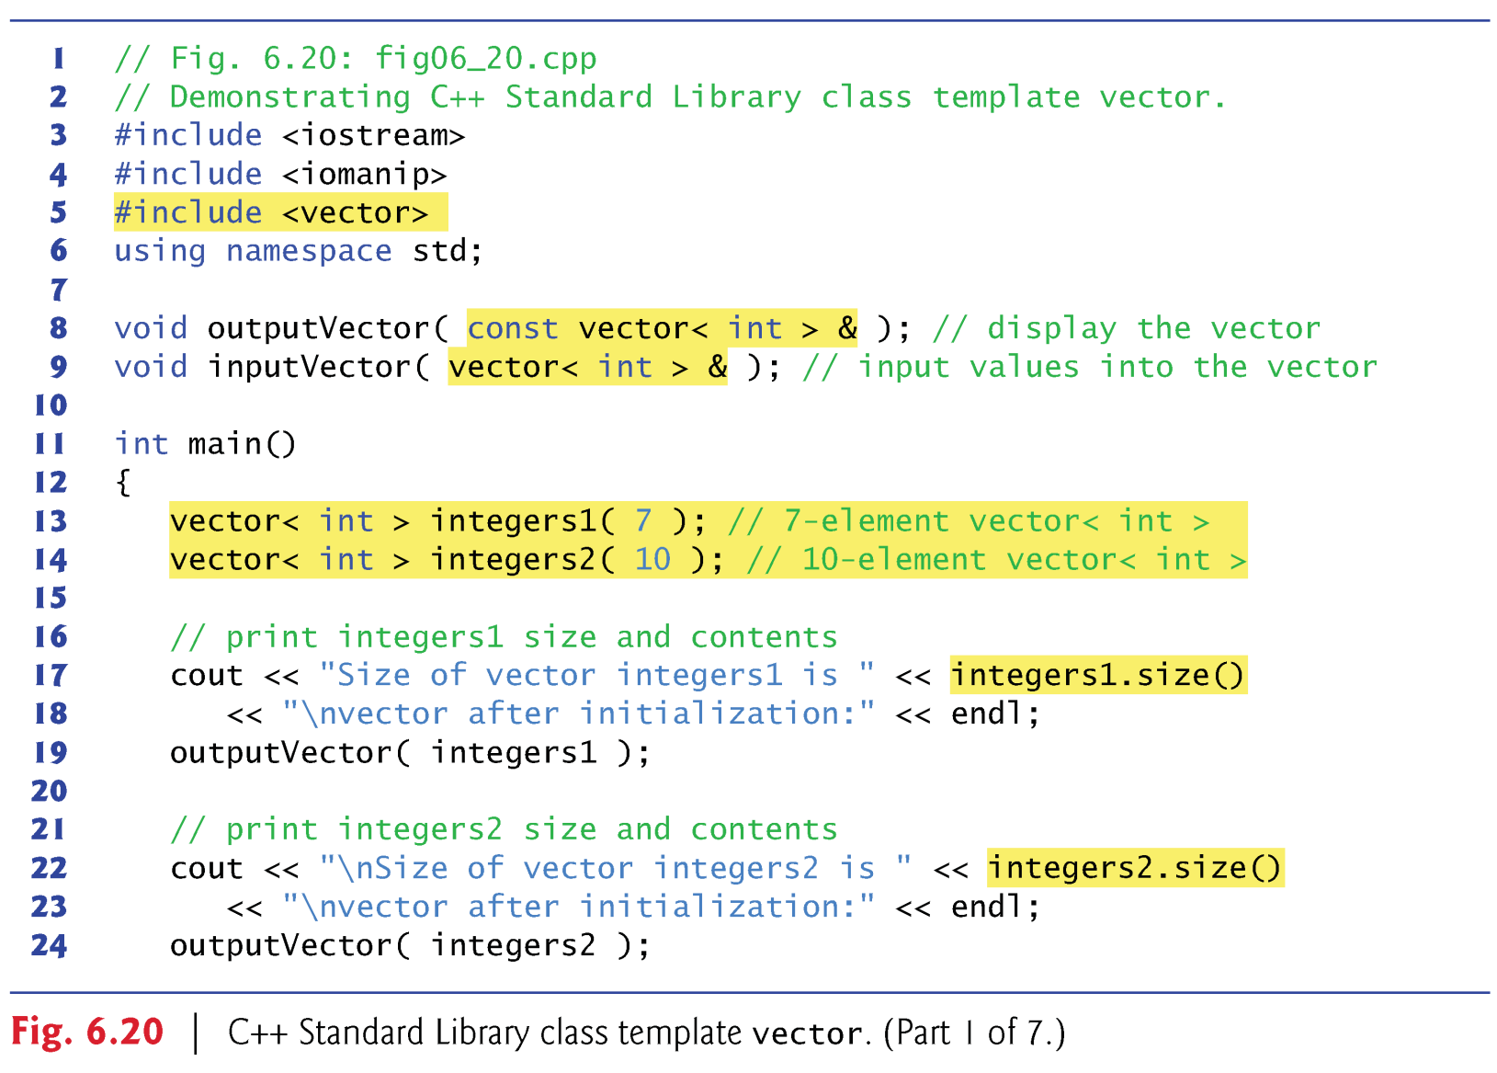

Slide 278
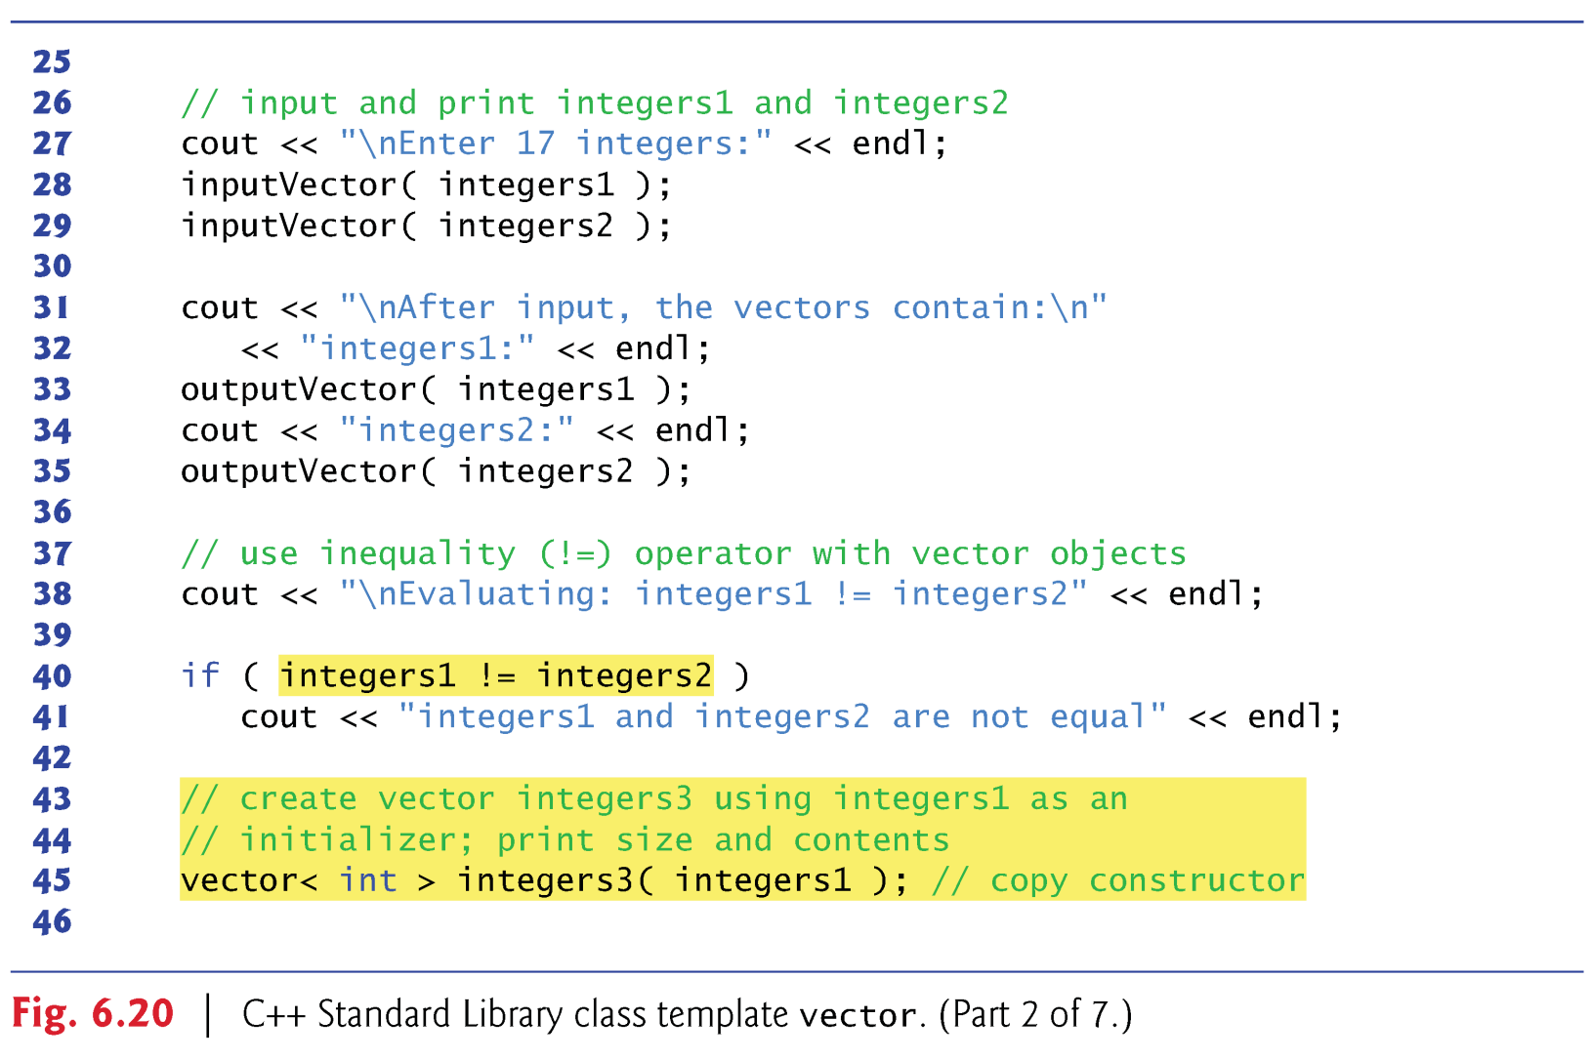

Slide 279
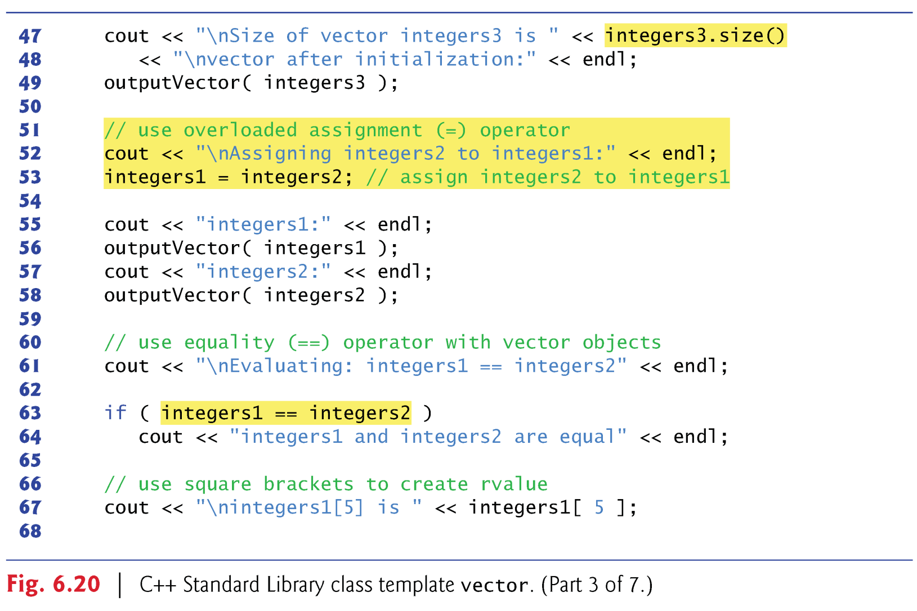

Slide 280
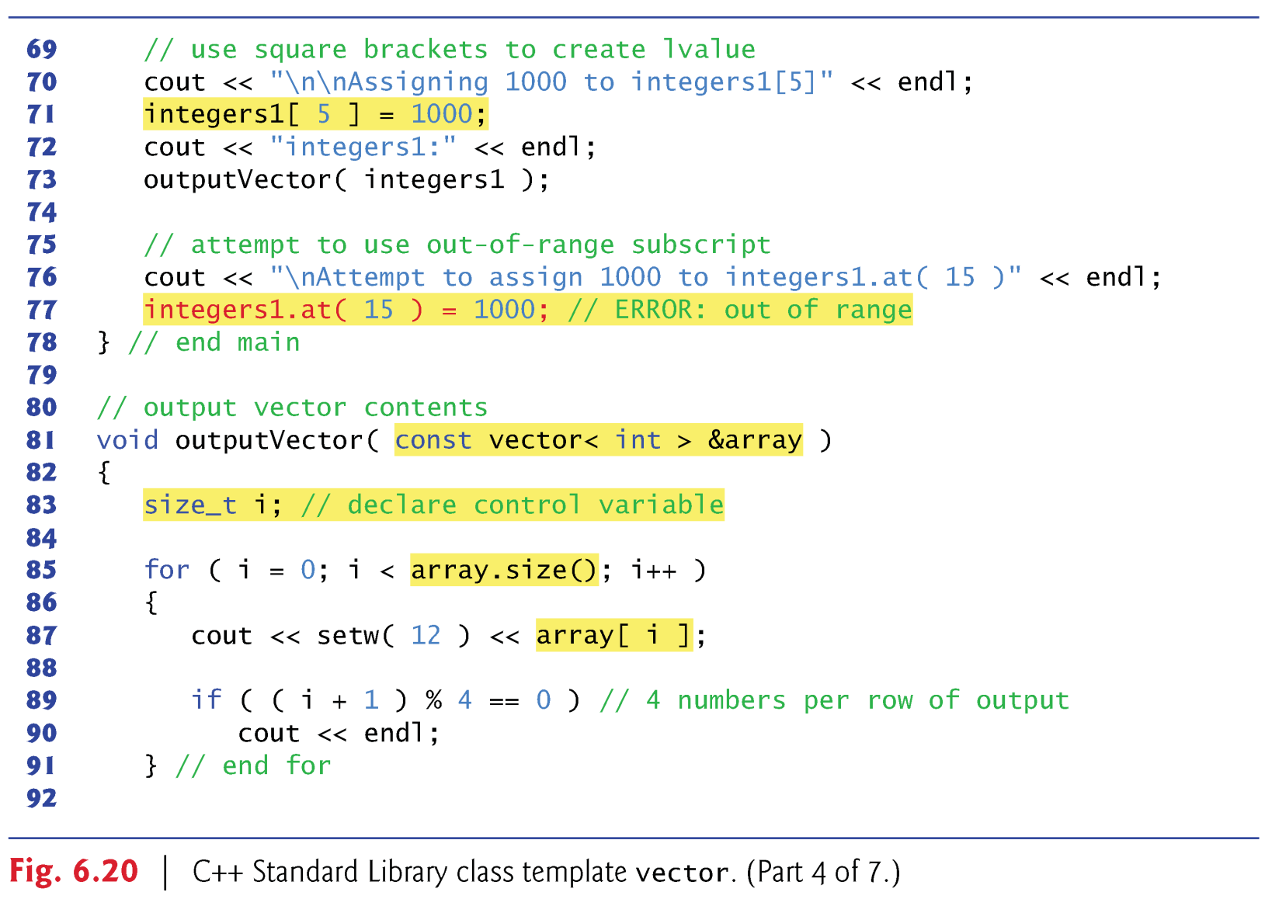

Slide 281
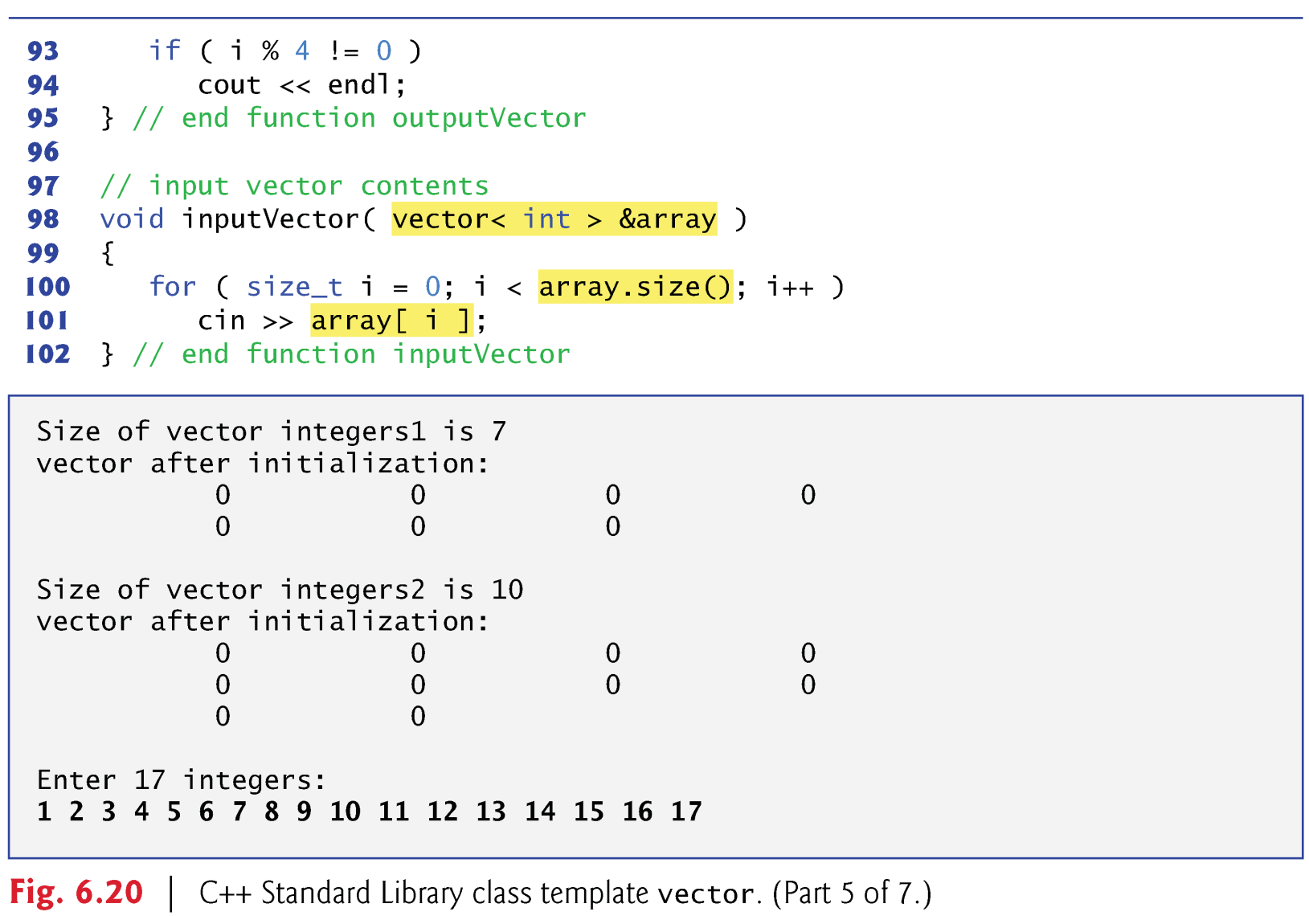

Slide 282
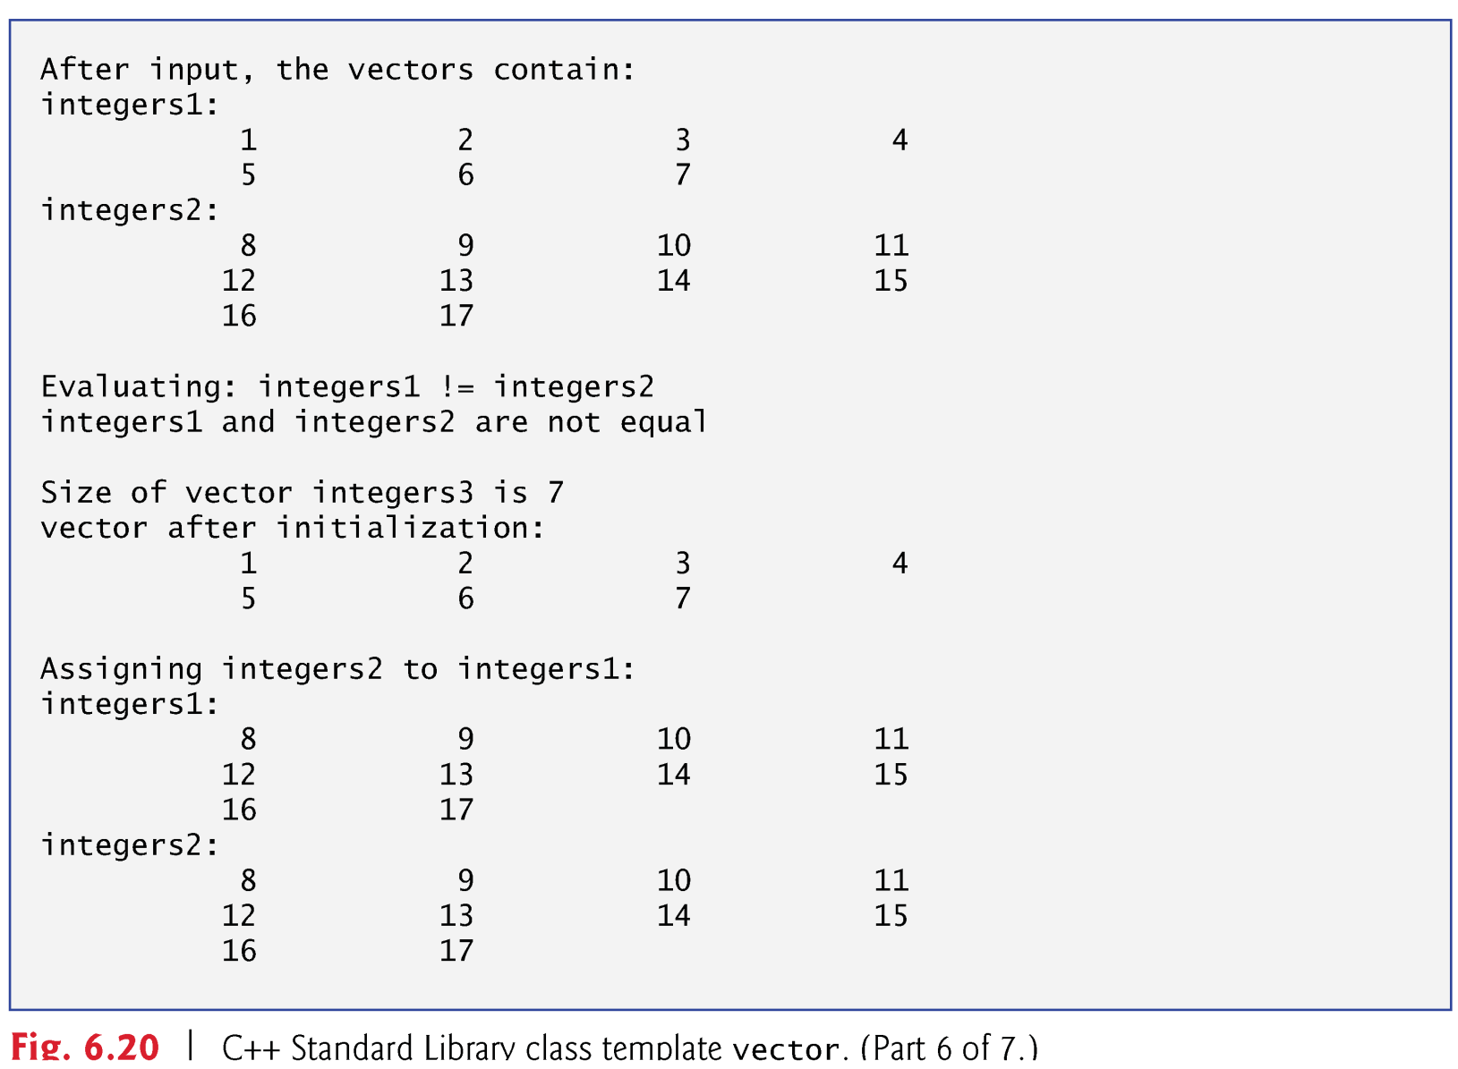

Slide 283
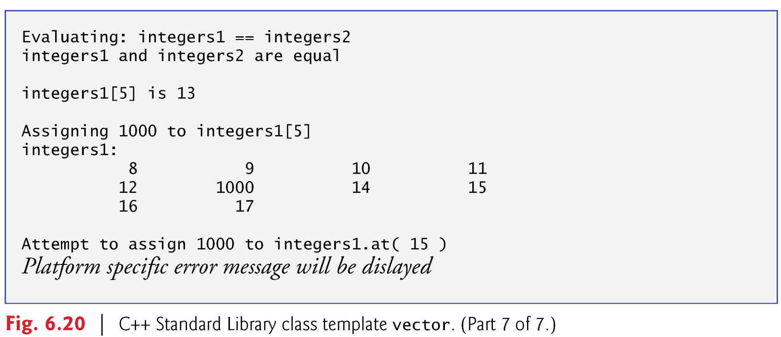

Slide 284
int main()
{
vector< int > integers1( 7 );
vector< int > integers2( 10 );
cout < integers1.size() << endl;
outputVector( integers1 );
cout << integers2.size() << endl;
outputVector( integers2 );
cout << "\nEnter 17 integers:\n";
inputVector( integers1, 1 );
inputVector( integers2, integers1.size() + 1 );
cout << "integers1:" << endl;
outputVector( integers1 );
cout << "integers2:" << endl;
outputVector( integers2 );
int main()
{
const int size1 = 7;
const int size2 = 10;
int integers1[ size1 ];
int integers2[ size2 ];
int i;
for ( i = 0; i < size1; i++ )
integers1[ i ] = 0;
for ( i = 0; i < size2; i++ )
integers2[ i ] = 0;
cout << size1 << endl;
outputVector( integers1, size1 );
cout << size2 << endl;
outputVector( integers2, size2 );
cout << "\nEnter 17 integers:\n";
inputVector( integers1, size1, 1 );
inputVector( integers2, size2, 7 + 1 );
cout << "integers1:" << endl;
outputVector( integers1, size1 );
cout << "integers2:" << endl;
outputVector( integers2, size2 );

Slide 285
if ( integers1 != integers2 )
cout << "integers1 != integers2\n";
vector< int > integers3( integers1 );
cout << integers3.size() << endl;
outputVector( integers3 );
cout << "\nintegers1 = integers2:\n";
integers1 = integers2;
cout << "integers1:" << endl;
outputVector( integers1 );
cout << "integers2:" << endl;
outputVector( integers2 );
if ( size1 != size2 )
cout << "integers1 != integers2\n";
else
{
for ( i = 0; i < size1; i++ )
if(integers1[i] != integers2[i])
break;
if ( i < size1 )
cout << "integers1 != integers2\n";
}
const int size3 = size1;
int integers3[ size3 ];
for ( i = 0; i < size3; i++ )
integers3[ i ] = integers1[ i ];
cout << size3 << endl;
outputVector( integers3, size3 );
cout << "\nintegers1 = integers2:\n";
for ( i = 0; i < size1; i++ )
integers1[ i ] = integers2[ i ];
cout << "integers1:" << endl;
outputVector( integers1, size1 );
cout << "integers2:" << endl;
outputVector( integers2, size2 );

Slide 286
if ( integers1 == integers2 )
cout << "integers1 == integers2\n";
cout << "\nintegers1[5] is " << integers1[ 5 ];
cout << "\n\nintegers1[ 5 ] = 1000\n";
integers1[ 5 ] = 1000;
cout << "integers1:" << endl;
outputVector( integers1 );
}
if ( size1 == size2 )
{
for ( i = 0; i < size1; i++ )
if(integers1[i] != integers2[i])
break;
if ( i == size1 )
cout << "integers1 == integers2\n";
}
cout << "\nintegers1[5] is " << integers1[ 5 ];
cout << "\n\nintegers1[ 5 ] = 1000\n";
integers1[ 5 ] = 1000;
cout << "integers1:" << endl;
outputVector( integers1, size1 );
}

Slide 287
void outputVector( vector< int > &array )
{
int i;
for ( i = 0; i < array.size(); i++ )
{
cout << setw( 12 ) << array[ i ];
if ( ( i + 1 ) % 4 == 0 )
cout << endl;
}
if ( i % 4 != 0 )
cout << endl;
}
void inputVector( vector< int > &array, int start )
{
for( size_t i = 0; i < array.size(); i++ )
array[ i ] = i + start;
}
void outputVector( int *array, int size )
{
int i;
for ( i = 0; i < size; i++ )
{
cout << setw( 12 ) << array[ i ];
if ( ( i + 1 ) % 4 == 0 )
cout << endl;
}
if ( i % 4 != 0 )
cout << endl;
}
void inputVector( int *array, int size, int start )
{
for( int i = 0; i < size; i++ )
array[ i ] = i + start;
}

Slide 288
6.10 Introduction to C++ Standard Library Class Template vector (cont.)
By default, all the elements of a vector object are set to 0.
vectors can be defined to store any data type.
vector member function size obtain the number of elements in the vector.
You can use square brackets, [], to access the elements in a vector.
vector objects can be compared with one another using the equality operators.
You can create a new vector object that is initialized with a copy of an existing vector.

Slide 289
6.10 Introduction to C++ Standard Library Class Template vector (cont.)
You can use the assignment (=) operator with vector objects.
As with C-style pointer-based arrays, C++ does not perform any bounds checking when vector elements are accessed with square brackets.
Standard class template vector provides bounds checking in its member function at, which “throws an exception” (see Chapter 16, Exception Handling) if its argument is an invalid subscript.

Slide 290
Two Recursive Insertion Sort Functions
void recursiveInsertionSort( int data[], const int last )
{
if( last > 0 )
{
recursiveInsertionSort( data, last - 1 );
insertion( data, last );
}
}
void recursiveInsertionSort( vector< int > &data, int last )
{
if( last > 0 )
{
recursiveInsertionSort( data, last - 1 );
insertion( data, last );
}
}

Slide 291
void insertion( int data[], const int last )
{
int insert = data[ last ];
int moveItem = last;
while ( ( moveItem > 0 ) && ( data[ moveItem - 1 ] > insert ) )
{
data[ moveItem ] = data[ moveItem - 1 ];
moveItem--;
}
data[ moveItem ] = insert;
}
void insertion( vector< int > &data, const int last )
{
int insert = data[ last ];
int moveItem = last;
while ( ( moveItem > 0 ) && ( data[ moveItem - 1 ] > insert ) )
{
data[ moveItem ] = data[ moveItem - 1 ];
moveItem--;
}
data[ moveItem ] = insert;
}

Slide 292
6.11 Introduction to C++ Standard Library Class string
Figure 6.21 demonstrates many of class string’s capabilities.
Lines 9–12 create four string objects
  s1 is initialized with the literal "happy"
  s2 is initialized with the literal " birthday"
  s3 and s4 create empty strings

Slide 293
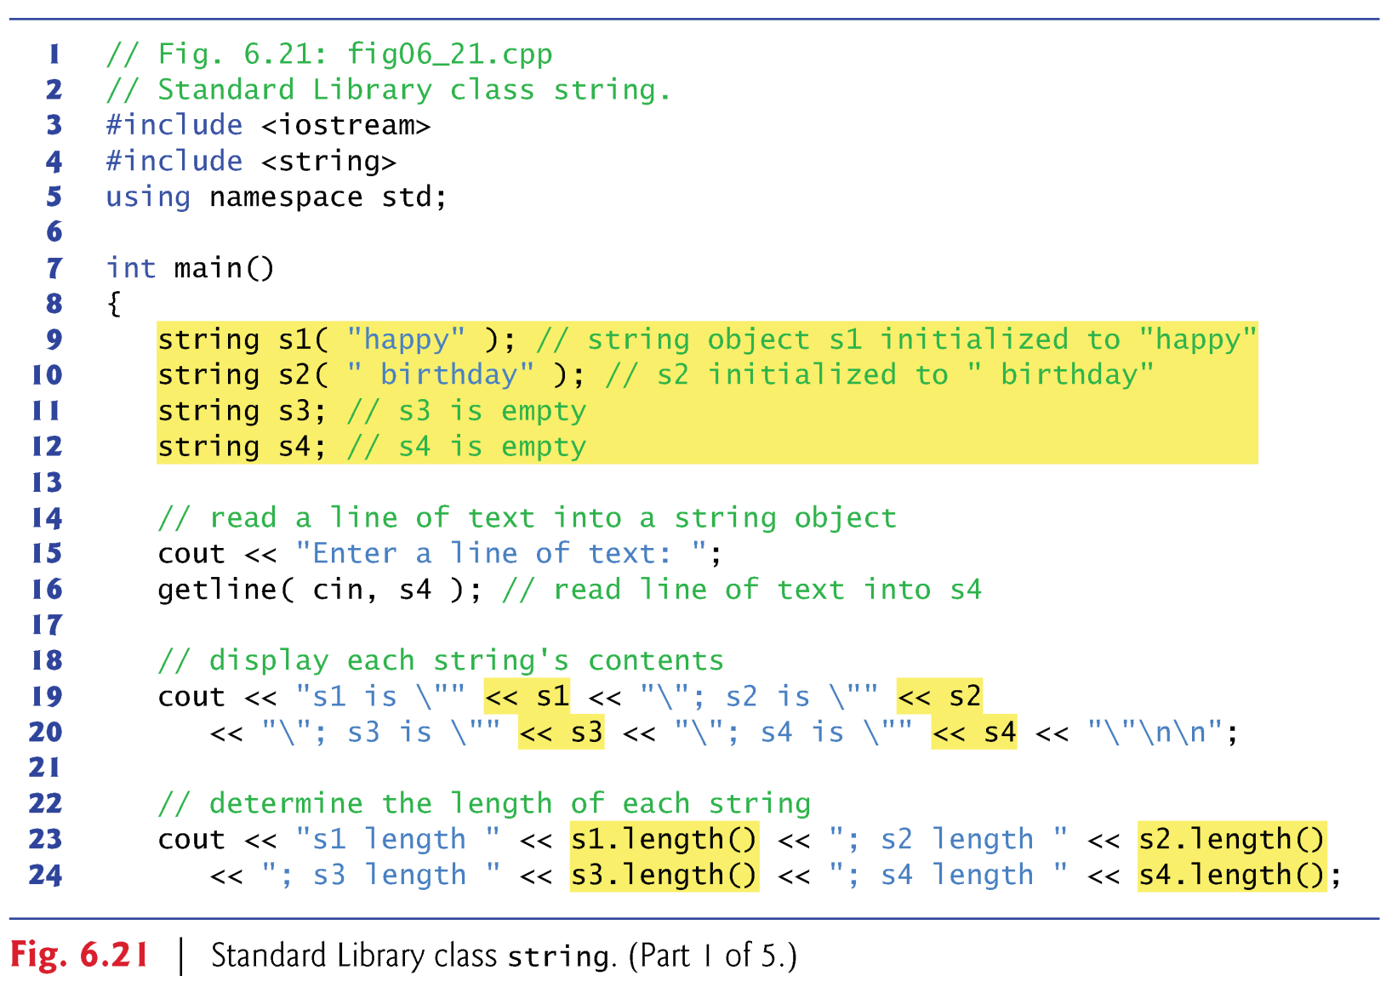

Slide 294
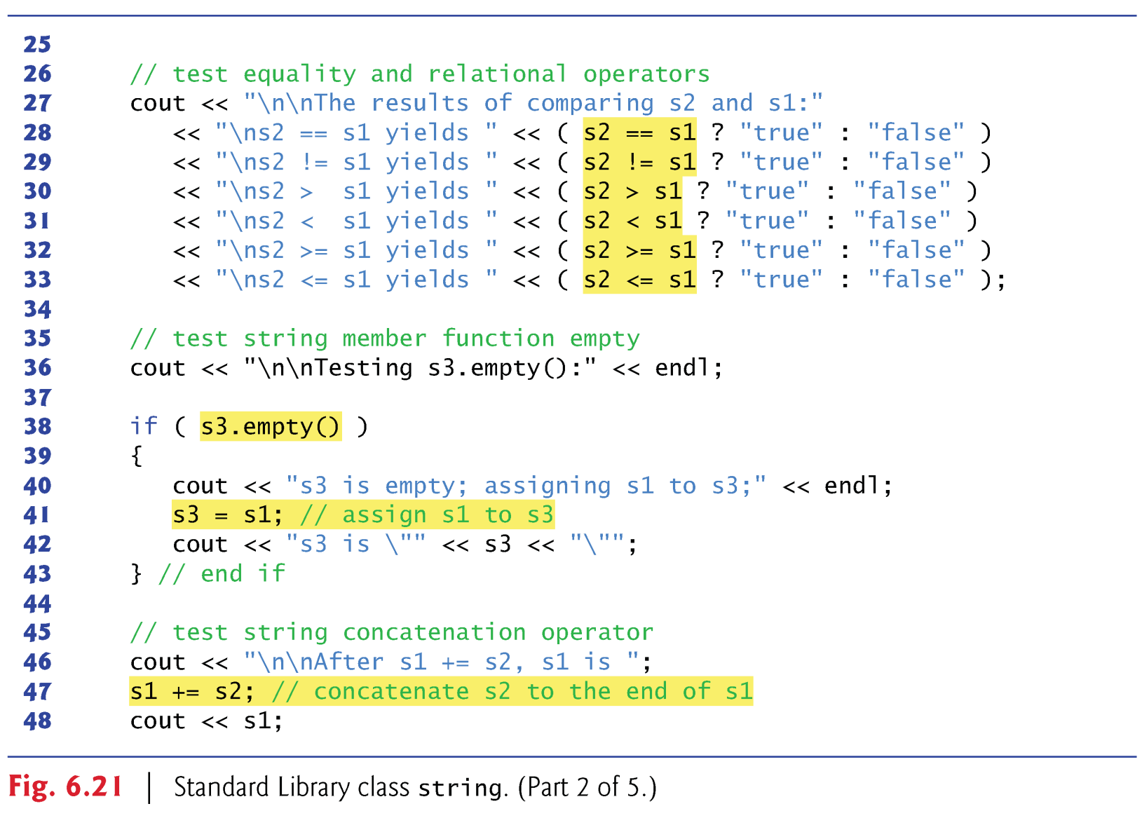

Slide 295
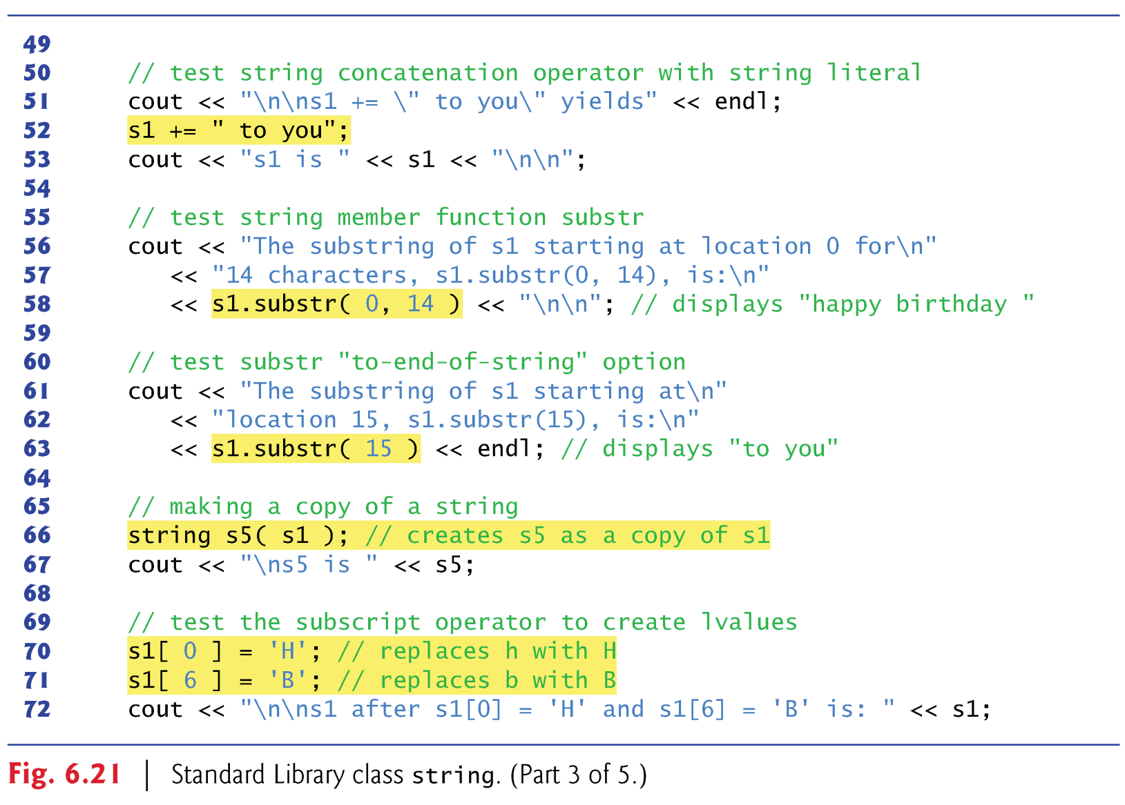

Slide 296
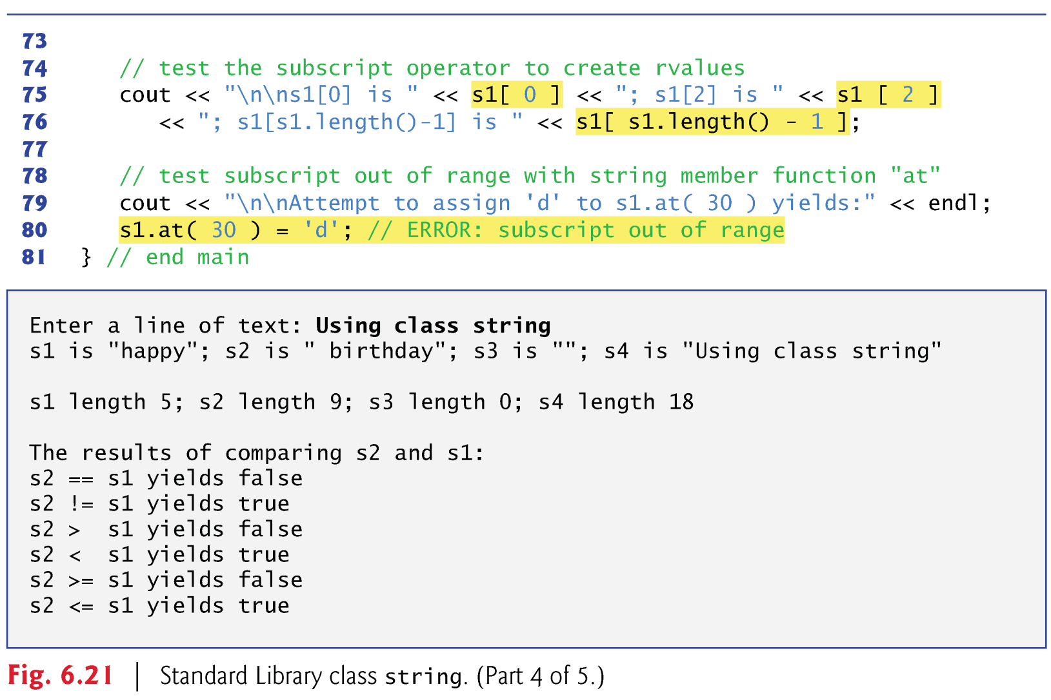

Slide 297
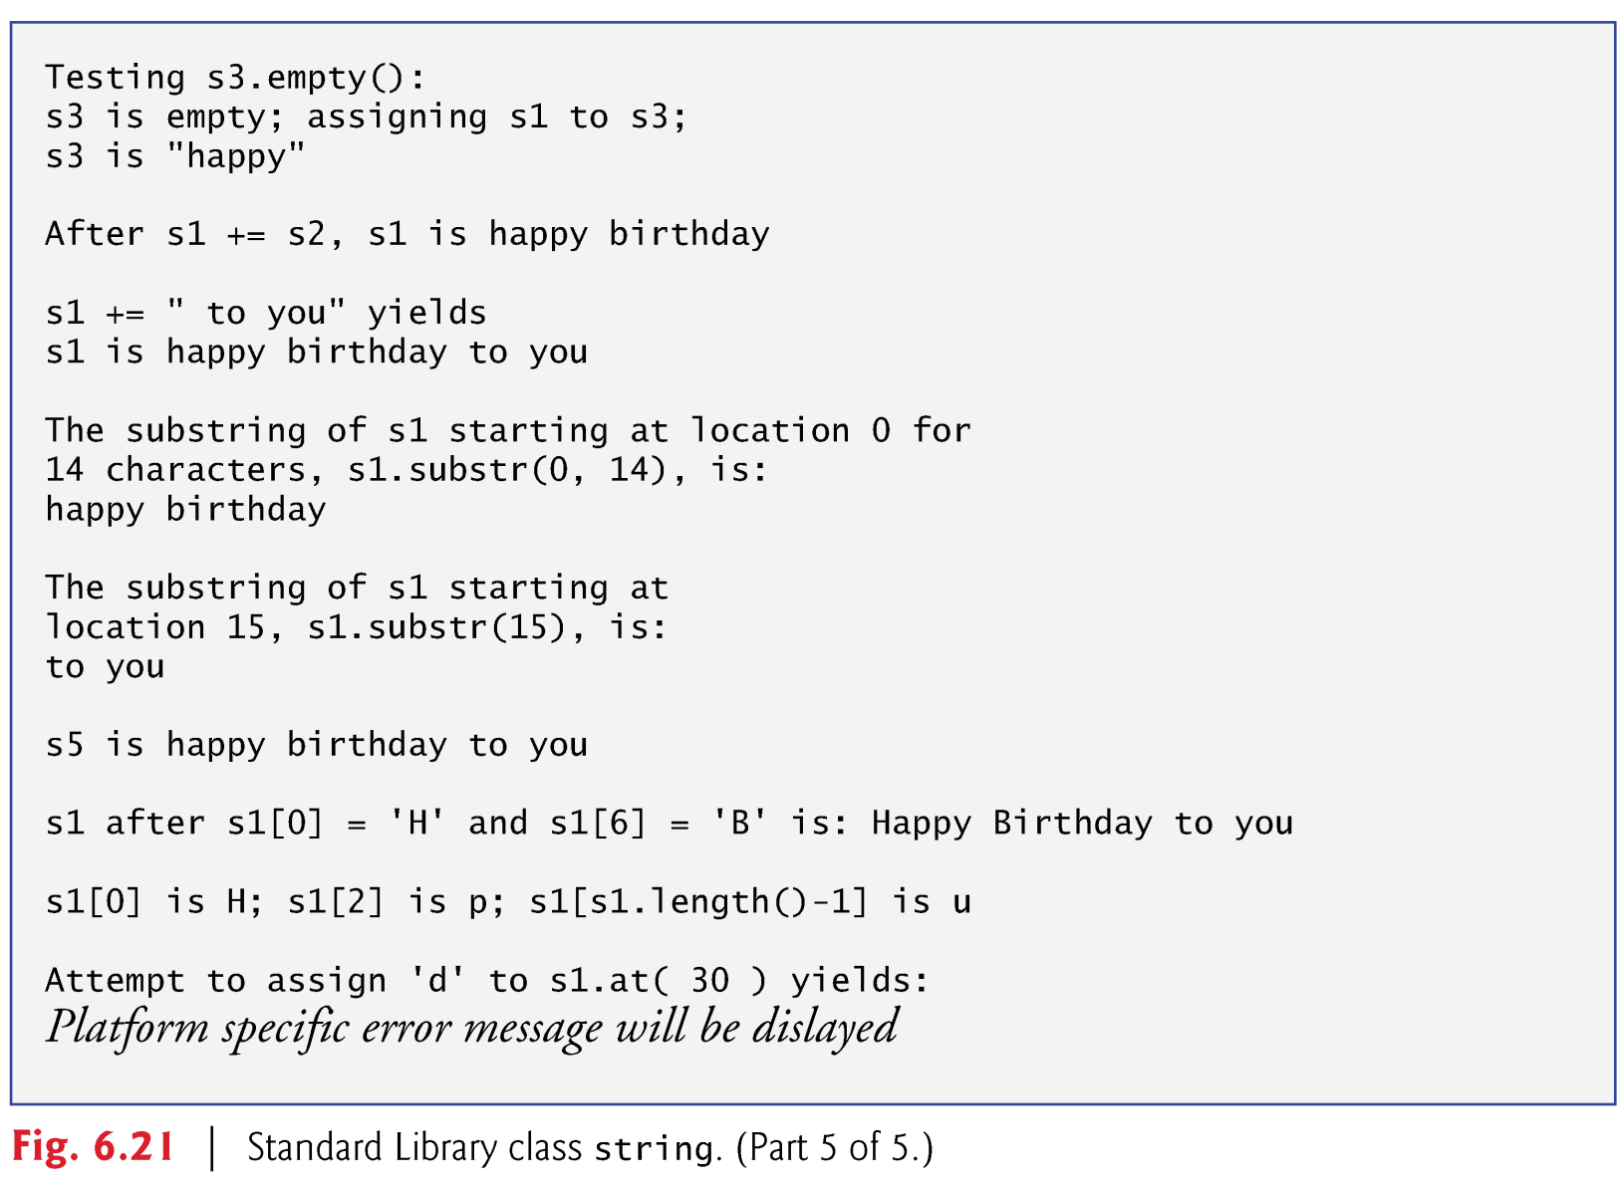

Slide 298
int main()
{
string s1( "happy" );
string s2( " birthday" );
string s3;
string s4;
cout << "Enter a string: ";
cin >> s4;
cout << "s1 is \"" << s1 << "\"; s2 is \"" << s2
<< "\"; s3 is \"" << s3 << "\"; s4 is \"" << s4 << "\"\n\n";
int main()
{
char s1[ 80 ] = "happy";
char *s2 = " birthday";
char s3[ 80 ] = "";
char s4[ 80 ];
cout << "Enter a string: ";
cin >> s4;
cout << "s1 is \"" << s1 << "\"; s2 is \"" << s2
<< "\"; s3 is \"" << s3 << "\"; s4 is \"" << s4 << "\"\n\n";

Slide 299
cout << "s1 length " << s1.length() << "; s2 length " << s2.length()
<< "; s3 length " << s3.length() << "; s4 length " << s4.length();
cout << "\n\nThe results of comparing s2 and s1:"
<< "\ns2 == s1 yields " << ( s2 == s1 ? "true" : "false" )
<< "\ns2 != s1 yields " << ( s2 != s1 ? "true" : "false" )
<< "\ns2 > s1 yields " << ( s2 > s1 ? "true" : "false" )
<< "\ns2 < s1 yields " << ( s2 < s1 ? "true" : "false" )
<< "\ns2 >= s1 yields " << ( s2 >= s1 ? "true" : "false" )
<< "\ns2 <= s1 yields " << ( s2 <= s1 ? "true" : "false" );
cout << "s1 length " << strlen( s1 ) << "; s2 length " << strlen( s2 )
<< "; s3 length " << strlen( s3 ) << "; s4 length " << strlen( s4 );
cout << "\n\nThe results of comparing s2 and s1:"
<< "\ns2 == s1 yields " << ( strcmp( s2, s1 ) == 0 ? "true" : "false" )
<< "\ns2 != s1 yields " << ( strcmp( s2, s1 ) != 0 ? "true" : "false" )
<< "\ns2 > s1 yields " << ( strcmp( s2, s1 ) == 1 ? "true" : "false" )
<< "\ns2 < s1 yields " << ( strcmp( s2, s1 ) == -1 ? "true" : "false" )
<< "\ns2 >= s1 yields " << ( strcmp( s2, s1 ) >= 0 ? "true" : "false" )
<< "\ns2 <= s1 yields " << ( strcmp( s2, s1 ) <= 0 ? "true" : "false" );

Slide 300
cout << "\n\nTesting s3.empty():" << endl;
if ( s3.empty() )
{
cout << "s3 is empty; assigning s1 to s3;" << endl;
s3 = s1;
cout << "s3 is \"" << s3 << "\"";
}
cout << "\n\nAfter s1 += s2, s1 is ";
s1 += s2;
cout << s1;
cout << "\n\nTesting s3.empty():" << endl;
if ( strcmp( s3, "" ) == 0 )
{
cout << "s3 is empty; assigning s1 to s3;" << endl;
strcpy( s3, s1 );
cout << "s3 is \"" << s3 << "\"";
}
cout << "\n\nAfter s1 += s2, s1 is ";
strcat( s1, s2 );
cout << s1;

Slide 301
cout << "\n\ns1 += \" to you\" yields" << endl;
s1 += " to you";
cout << "s1 is " << s1 << "\n\n";
cout << "The substring of s1 starting at location 0 for\n"
<< "14 characters, s1.substr(0, 14), is:\n"
<< s1.substr( 0, 14 ) << "\n\n";
cout << "\n\ns1 += \" to you\" yields" << endl;
strcat( s1, " to you" );
cout << "s1 is " << s1 << "\n\n";
char s6[ 16 ];
strncpy( s6, s1, 15 );
s6[ 15 ] = '\0';
cout << "The substring of s1 starting at location 0 for\n"
<< "14 characters, s1.substr(0, 14), is:\n"
<< s6 << "\n\n";

Slide 302
cout << "The substring of s1 starting at\n"
<< "location 15, s1.substr(15), is:\n"
<< s1.substr( 15 ) << endl;
char s7[ 10 ];
memcpy( s7, s1 + 15, strlen( s1 ) - 15 );
s7[ strlen( s1 ) - 15 ] = '\0';
cout << "The substring of s1 starting at\n"
<< "location 15, s1.substr(15), is:\n"
<< s7 << endl;

Slide 303
string s5( s1 );
cout << "\ns5 is " << s5;
s1[ 0 ] = 'H';
s1[ 6 ] = 'B';
cout << "\n\ns1 after s1[0] = 'H' and s1[6] = 'B' is: " << s1;
cout << "\n\ns1[0] is " << s1[ 0 ] << "; s1[2] is " << s1 [ 2 ]
<< "; s1[s1.length()-1] is " << s1[ s1.length() - 1 ];
cout << "\n\nAttempt to assign 'd' to s1.at( 30 ) yields:\n";
}
char s5[ 30 ];
strcpy( s5, s1 );
cout << "\ns5 is " << s5;
s1[ 0 ] = 'H';
s1[ 6 ] = 'B';
cout << "\n\ns1 after s1[0] = 'H' and s1[6] = 'B' is: " << s1;
cout << "\n\ns1[0] is " << s1[ 0 ] << "; s1[2] is " << s1 [ 2 ]
<< "; s1[s1.length()-1] is " << s1[ strlen( s1 ) - 1 ];
cout << "\n\nAttempt to assign 'd' to s1.at( 30 ) yields:\n";
}

Slide 304
6.11 Introduction to C++ Standard Library Class string
Line 16 reads the line of text from the user by using the library function getline (from the header file <string>).
We can’t simply write
  cin >> s4;
to obtain a line of text.
When cin is used with the stream extraction operator, it reads characters until the first white-space character is reached.

Slide 305
6.11 Introduction to C++ Standard Library Class string
Lines 19–20 output string objects, using cout and operator <<.
  The << operator is overloaded to handle string objects.
Lines 23–24 use string member function length to obtain the number of characters in each string object.

Slide 306
6.11 Introduction to C++ Standard Library Class string
Lines 27–33 show the results of comparing strings by using class string’s overloaded equality and relational operators.
  These operators perform lexicographical comparisons on string objects—they compare the numerical values of the characters (see Appendix B, ASCII Character Set) in each string.
Class string provides member function empty, which returns true if the string is empty; otherwise, it returns false.

Slide 307
6.11 Introduction to C++ Standard Library Class string
Line 41 demonstrates class x’s overloaded assignment operator.
Line 47 demonstrates class string’s overloaded += operator for string concatenation.
  Line 52 demonstrates that a string literal can also be appended to a string object by using operator +=.

Slide 308
6.11 Introduction to C++ Standard Library Class string
Class string provides member function substr (lines 58 and 63) to return a portion of a string as a string object.
  The version with two arguments obtains the number of characters specified by the second argument starting at the position specified by the first argument.
  The single argument version obtains a substring starting from the specified index.

Slide 309
6.11 Introduction to C++ Standard Library Class string
Class string’s overloaded [] operator can be used to create lvalues that enable new characters to replace existing characters in a string.
  No bounds checking is performed.
Class string’s overloaded [] operator can be used to obtain the character at a specified index.

Slide 310
6.11 Introduction to C++ Standard Library Class string
Class string provides bounds checking in its member function at, which throws an exception if its argument is an invalid subscript.

